Slide 1


Heating of ALFA detectors
03-11-2011
Sune Jakobsen

Slide 2

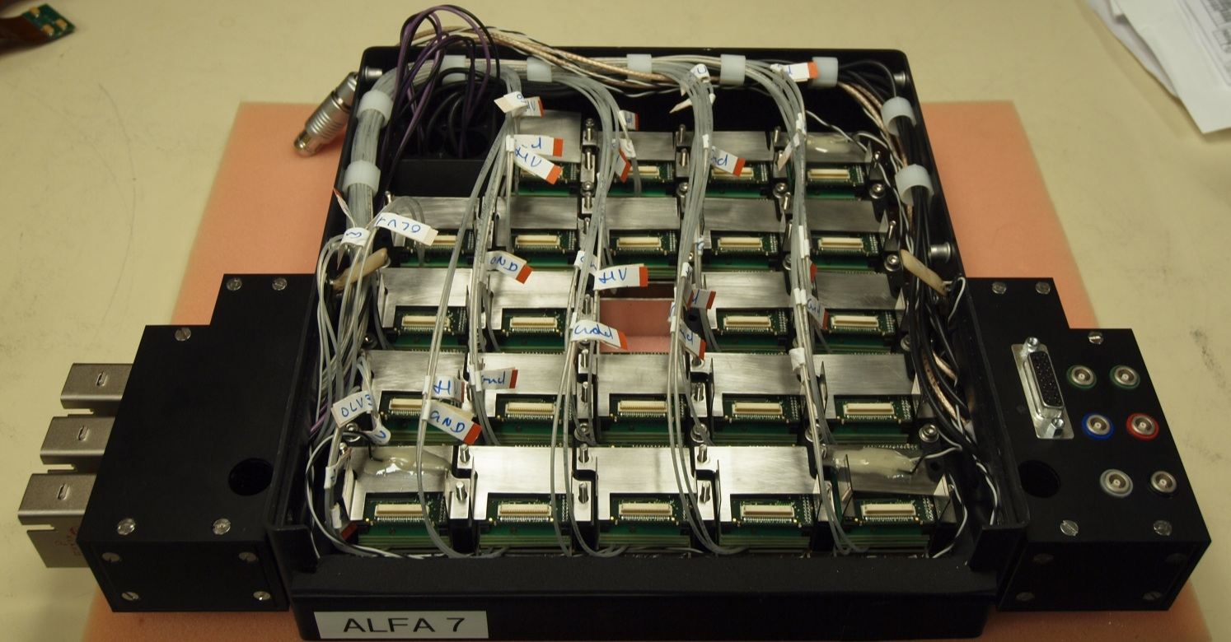
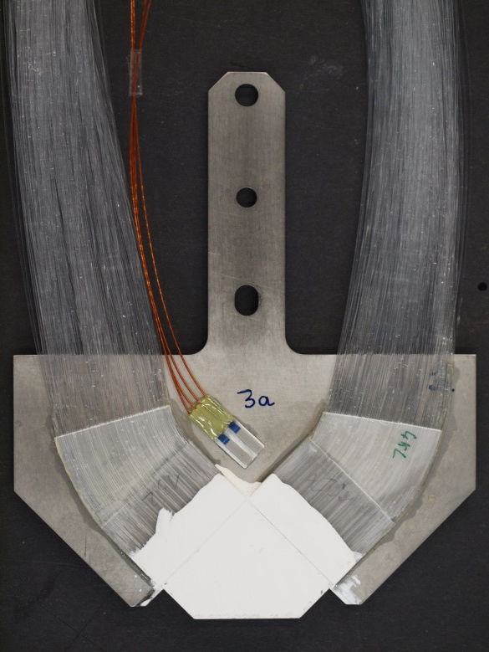

Temperature sensors installed Temperature vs time Temperature vs number of particles Suggested counter measures Planned activities
Temperature sensors installed
Detector 1 + 2
PMF23
Air in
Air out
PMF1
PMF19
5 temperature sensors inside the black box
2 temperature sensors on the titanium substrate for the main trigger
The temperature sensors (PT100) are not calibrated and has an offset of 5-15 °C
NIELS BOHR INSTITUTE
UNIVERSITY OF COPENHAGEN
2/6
Heating of ALFA detectors
Sune Jakobsen

Slide 3
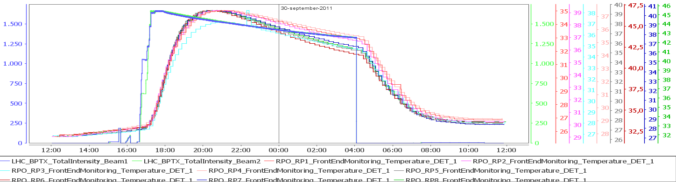
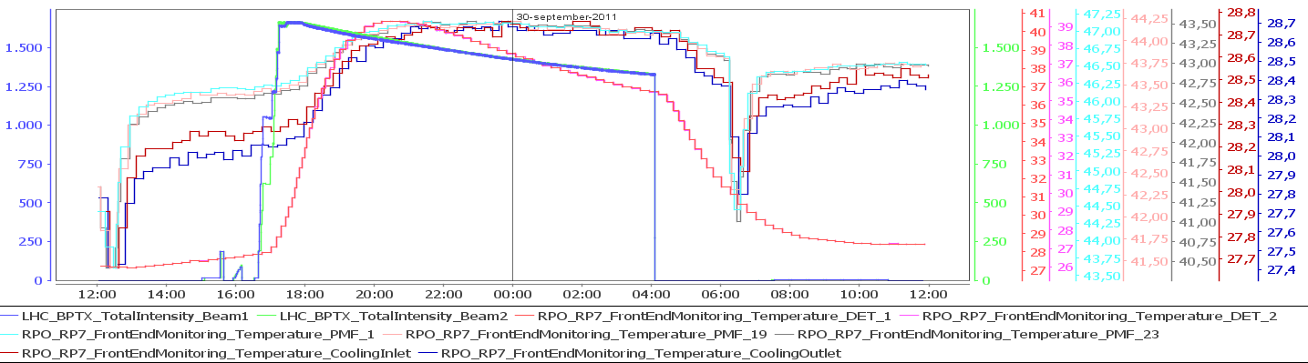
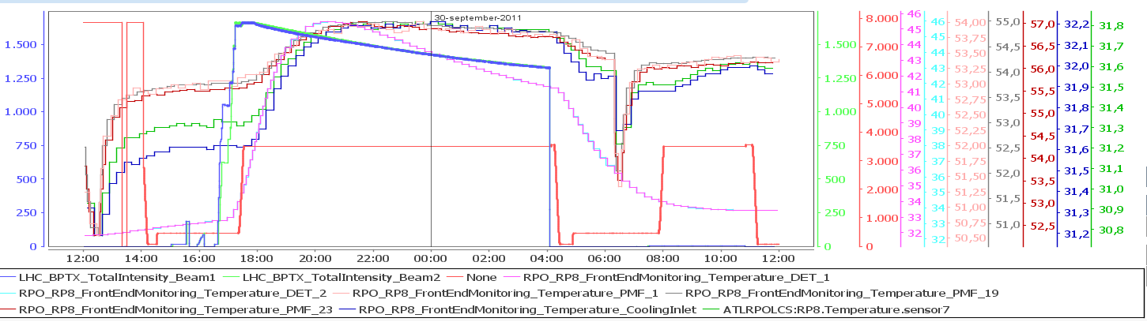
Temperature sensors installed Temperature vs time Temperature vs number of particles Suggested counter measures Planned activities
Temperature vs time
Temperature on each of the 8 ALFA detectors
All temperature sensors of Position7 (a upper detector)
All temperature sensors of Position8 (a lower detector)
Beam energy
NIELS BOHR INSTITUTE
UNIVERSITY OF COPENHAGEN
3/6
Heating of ALFA detectors
Sune Jakobsen

Slide 4
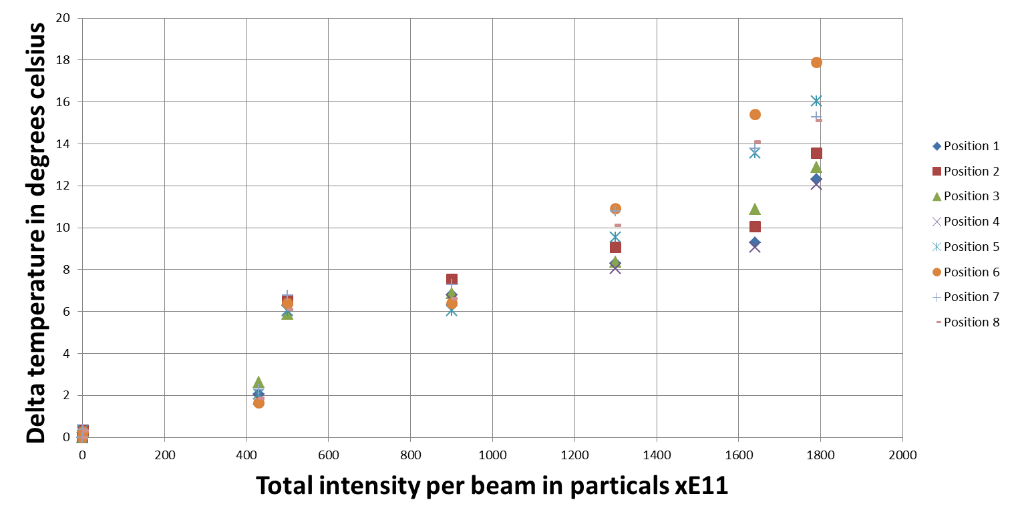
Temperature sensors installed Temperature vs time Temperature vs number of particles Suggested counter measures Planned activities
Temperature vs number of particles in LHC
This year the temperature increase from beam presence has been up to 18 °C (expected to be a max temperature of ~ 40 °C)
If LHC doubles the number of particles next year the extrapolation would give a temperature increase from beam presence has been up to 30-40 °C (expected to be a max of ~ 60 °C)
NIELS BOHR INSTITUTE
UNIVERSITY OF COPENHAGEN
4/6
Heating of ALFA detectors
Sune Jakobsen

Slide 5
Temperature sensors installed Temperature vs time Temperature vs number of particles Suggested counter measures Planned activities
Suggested counter measures
Box with evaporating nitrogen around the ALFA station
Liquid cooling of the detector/ Roman Pot
Peltier element cooling for the detector/ Roman Pot (combined with air cooling for hot side)
Large fan in front of each station
Removed detectors from LHC
NIELS BOHR INSTITUTE
UNIVERSITY OF COPENHAGEN
5/6
Heating of ALFA detectors
Sune Jakobsen

Slide 6
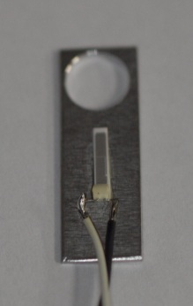
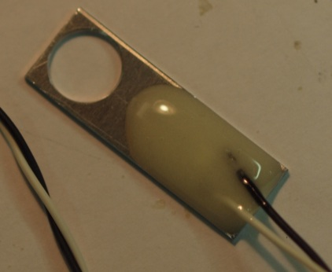
Temperature sensors installed Temperature vs time Temperature vs number of particles Suggested counter measures Planned activities
Planned activities
Installing PT100 temperature sensors on the detector baseplate, Roman Pot “baseplate” and beam pipe. (Next week in the technical stop).
Hope to clarify the heat propagating
Fill up empty space inside the black boxes with foam to improve cooling of electronics
Effect on detector temperature expected to be small
Temperature cycle one layer of an ALFA detector and observed effects
Details to be discussed now
Also temperature cycle layer trigger?
NIELS BOHR INSTITUTE
UNIVERSITY OF COPENHAGEN
6/6
Heating of ALFA detectors
Sune Jakobsen

