Slide 1


TDI.8R after TS4-2011
V. Baglin(13/09/11)
CERN TE-VSC, Geneva
1.
2.

Slide 2
TS4-2011
During the TS 4, wh 35, the TDI.8R and TCTVB.8R were equipped with thermocouples
TC1 And TC2 are located on TCTVB.8R
TC 4 and TC11 are located are located on TDI.8R transitions
TC5,6,8 and 10 are located on TDI.8R extremity
TC 7,8 are located at the centre of TDI.8R
TC3 and TC12 are located at reference vacuum chambers NEG coated.
Pressure is measured at TDI by VGPB.231.4R8.X

Slide 3
Drawing

Slide 4
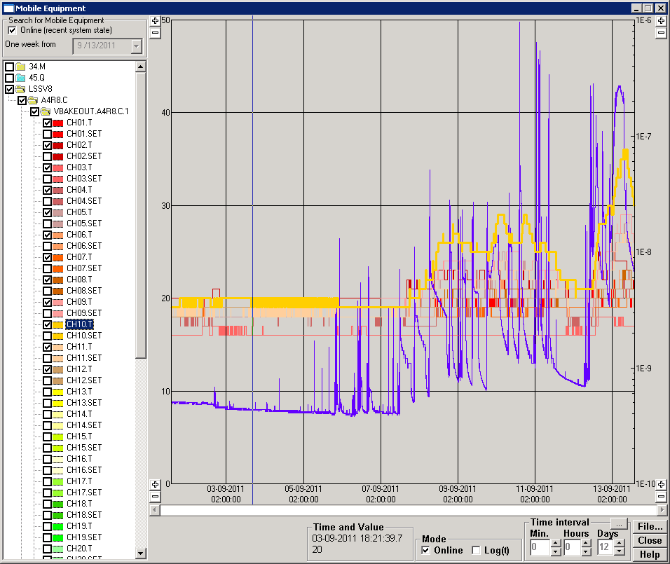
Pressure and temperature history
During TS, the temperature were 16 to 20 deg
After TS, TC10 increases during operation

Slide 5
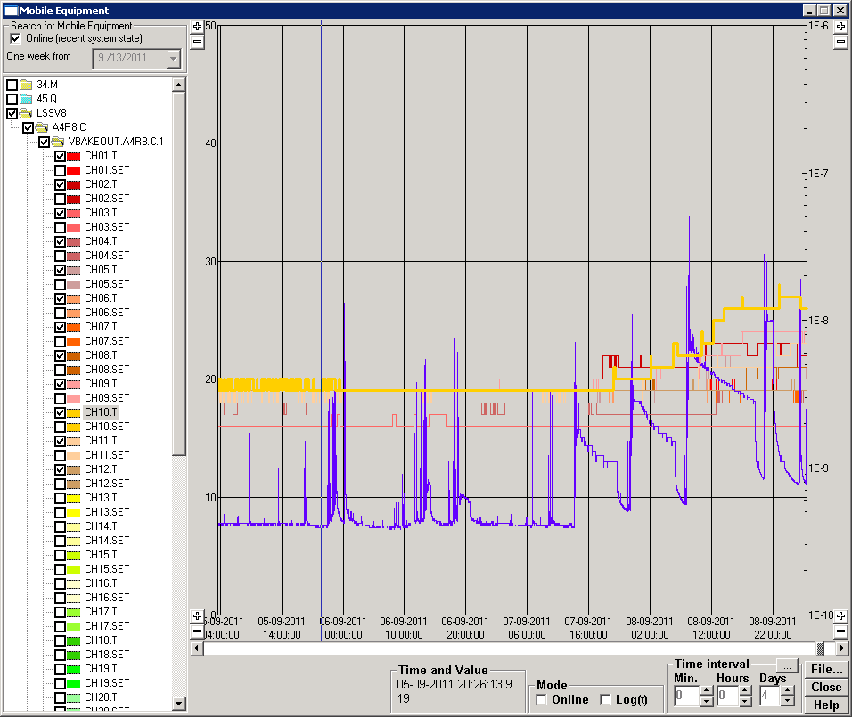
5-sept till 9-sept-2011
TC10 started to increase from 7th Sept 20h, fill 2083 @ 59.6 mA/beam, 264b, 1.25e11 ppb

Slide 6
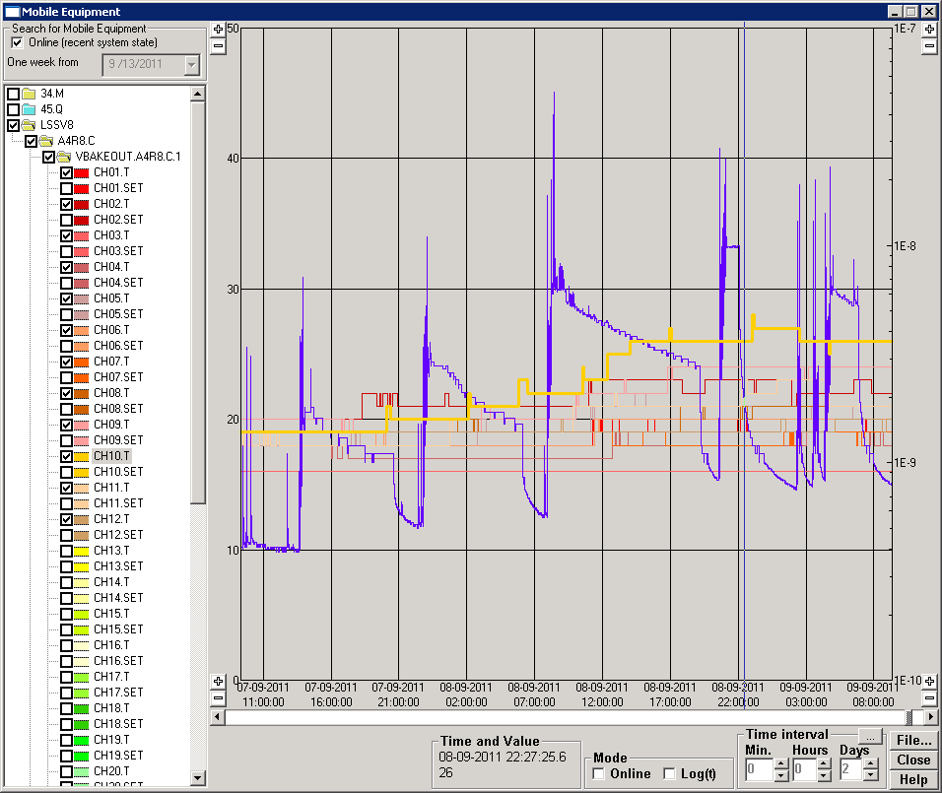
Intensity ramp-up
From fill 2083,2085,2086,2087,2090 with 264,480,912 then 1380 b
TC10 increased by 7-8 deg
Fill 2086 lasted 10 h, but there were no pressure increase despite temperature reached 26 deg
Proton burn rate = 4.0 10⁸ p/s
Fill | 2083 | 2085 | 2086 | 2087 | 2090
Nb | 264 | 480 | 912 | 1380 | 1380
I (mA) | 59.7 | 111 | 208 | 316 | 293
Ppb (x1E11) | 1.25 | 1.29 | 1.26 | 1.27 | 1.17
2086

Slide 7
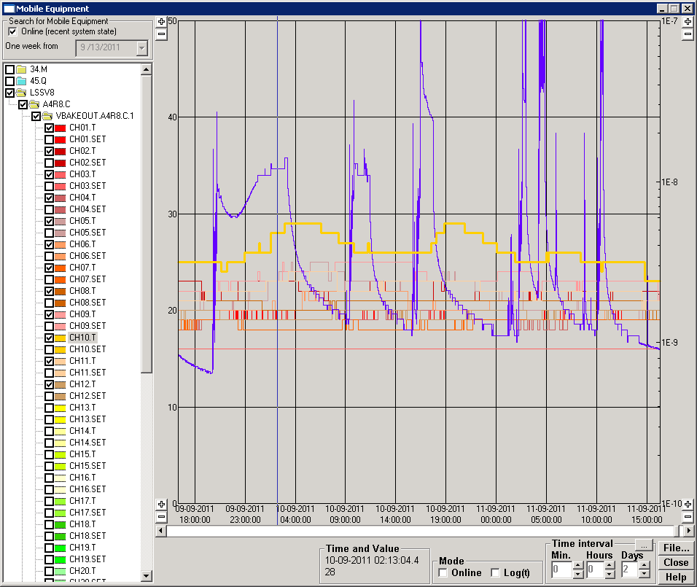
“Nominal” fills
Fill | 2092 | 2093 | 2094
Nb | 1380 | 1380 | 1380
I (mA) | 321 | 323 | 327
Ppb (x1E11) | 1.29 | 1.30 | 1.30
fill 2092 lasted 7 h, but pressure started to increase after 1h30 min when temperature was 25 deg.
TC10 reached 29 deg
Burn rate at fill 2092 is 7.6 10⁸ p/s
Temperature is still increasing after fill 2094
2094
2092
TDI parking at +/- 40 mm

Slide 8
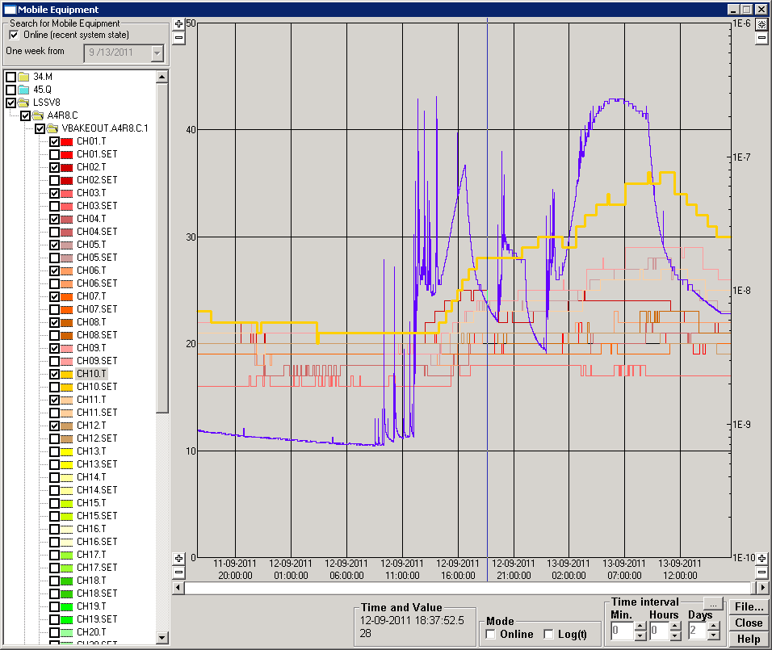
“Nominal” fills
Fill | 2101 | 2102 | 2103
Nb | 1380 | 1380 | 1380
I (mA) | 330 | 334 | 332
Ppb (x1E11) | 1.33 | 1.34 | 1.33
Temperature increased 1h30 and 45 min after machine full for fills 20101 and 20103 respectively.
For fill 2103, pressure started to decrease again after having increased.
TC10 reached 36 deg
TC9 reached 29 deg
TC5 reached 27 deg
2103
TC | deg | Delta | What ?
1 | 21 | 3 | TCTVB
2 | 24 | 4 | TCTVB
4 | 21 | 3 | VCT @TDI
11 | 26 | 8 | VCT@ TDI
5 | 28 | 10 | TDI extremity
10 | 36 | 17 | TDI extremity
6 | 22 | 3 | TDI extremity
9 | 29 | 10 | TDI extremity
7 | 19 | 0 | TDI centre
8 | 22 | 3 | TDI centre
3 | 17 | 1 | Reference
12 | 21 | 2 | Reference
2101
2102
450 GeV

Slide 9
Summary
12 thermocouples have been installed at TDI.8R during last TS
Starting from fill 2092, pressure increases are seen at TDI about 1h-2h after machine full
Temperature increases from 8 to 17 deg are observed at TDI extremities

