Slide 1
BLMs at the LHC
C.Octavio Domínguez, Humberto Maury Cuna
Thanks to
Eduardo Nebot (BI)
2nd March 2011 - ICE meeting

Slide 2
Contents
What are BLMs? What are they used for?
Types of BLMs
During the MD
Data saving and other useful tips for analysis
2
2nd March 2011 - ICE meeting

Slide 3
Contents
What are BLMs? What are they used for?
Types of BLMs
During the MD
Data saving and other useful tips for analysis
3
2nd March 2011 - ICE meeting

Slide 4
BLMs - Intro
Lost particles cause activation of accelerator components (nuclear reactions)
Surrounding material can be destroyed by the radiation and/or heating (quenches!)
Beam Loss Monitors (BLMs) are devices (mainly particle counters, detecting secondary reaction products) used for beam losses detection.
The measurement principle is based on the energy deposition detection of secondary shower particles, which energy flux is linear with the initiating protons.
They are mounted outside the vacuum pipe all along the machine, with special importance at crucial locations (QFs at 450 GeV and final tripplets at 7 TeV).
They create an interlock system
They have to achieve high sensitivity (usable signal from small losses) and large dynamic range (detection of irregular losses; several orders of magnitude in the same place!!).
4
2nd March 2011 - ICE meeting

Slide 5
Contents
What are BLMs? What are they used for?
Types of BLMs
During the MD
Data saving and other useful tips for analysis
5
2nd March 2011 - ICE meeting

Slide 6
BLMs - Types
There are many kinds of BLMs:
Plastic scintillantors
Liquid scintillantor
Aluminium coated Electron multiplier
PIN diode
BF3 proportional tube
Ionization chamber
Optical fiber
Secondary Electron (Emission) Monitor (SEM)
6
2nd March 2011 - ICE meeting

Slide 7
BLMs - Types
There are many kinds of BLMs:
Plastic scintillantors
Liquid scintillantor
Aluminium coated Electron multiplier
PIN diode
BF3 proportional tube
Ionization chamber
Optical fiber
Secondary Electron (Emission) Monitor (SEM)
7
2nd March 2011 - ICE meeting

Slide 8
BLMs - Types
Plastic scintillators:
They detect charged particles due to their electronic stopping as well as γ-rays.
Neutron scattering → A fast proton travels through the scintillator material, leading to light emission by its electronic stopping.
The light is guided to a photomultiplier, converted to electrons and amplified.
Digitizing the analog voltage using a relatively small gain
2 modes
Particle counting mode (higher sensitivity and larger dynamic range)
They use to be placed close to collimators and other crucial areas (injection, extraction) thanks to their large dynamic range and high sensitivity.
They can be modulated in nearly any kind of shape and size
Disadvantage: low radiation hardness
8
2nd March 2011 - ICE meeting

Slide 9
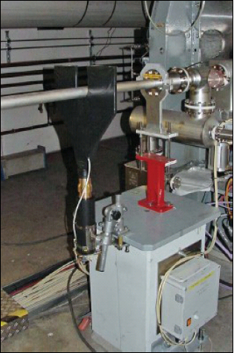
BLMs - Types
Plastic scintillators
Plastic scintillator at DESY
Photomultiplier
9
2nd March 2011 - ICE meeting

Slide 10
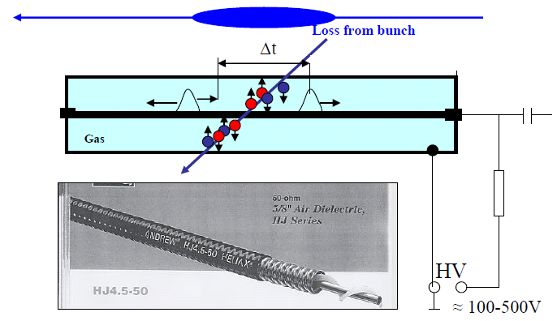
BLMs - Types
(Short) Ionization Chambers:
- That’s the most used BLM device in the LHC (>4000) → They have to be cheap.
They measure the amount of secondary charges created in a gas volume (ionization).
- The measurement principle is based on the energy deposition detection of secondary shower particles using ionisation chambers located outside of the magnet cryostats.
10
2nd March 2011 - ICE meeting

Slide 11
BLMs - Types
(Short) Ionization Chambers:
They are placed more or less equally spaced along the machine with additional units in critical parts (collimators, high aperture, high β, …)
Calibration is relatively independent of the applied voltage
Calibration is determined by geometry
Little maintenance required. Leakage in N₂ filled chambers not critical
Don’t use electronegative gases (O₂, CO₂, H₂O, …). Use better Ar, N₂ or Air.
Ion-chambers can be build from radiation hard materials (ceramic, glass metal), with no aging
They do not response as fast as scintillators (ions need time to reach the cathode!)
11
2nd March 2011 - ICE meeting

Slide 12
Contents
What are BLMs? What are they used for?
Types of BLMs
During the MD
Data saving and other useful tips for analysis
12
2nd March 2011 - ICE meeting

Slide 13
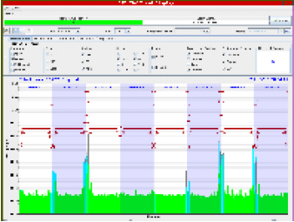
BLMs – During the MD
The data are saved automatically in Timber → No need of special interactive software
Acquisition: 1.3 s might be the most appropriate for e- cloud, but ask collimation people
Typical screen:
If this screen becomes orange
WARNING!!!
Security
thresholds
Logbook
You can click on a concrete monitor to see its signal
13
2nd March 2011 - ICE meeting

Slide 14
Contents
What are BLMs? What are they used for?
Types of BLMs
During the MD
Data saving and other useful tips for analysis
14
2nd March 2011 - ICE meeting

Slide 15
BLMs – Data analysis
The data are saved automatically in Timber
Looking for our monitors:
If you search for BLM% → 100887 variables!!!!!
But we are only interested in the BLM%LOSS_RS% → 47988 !!!! (still too much)
I was recommended to use only one Running Sum (RS)*, e.g. RS09 → 3999
Wild character in Timber
* A “RS” is the integration time interval, since the quench levels depend not only on the radiation but also on the time in which the radiation is deposited. There are 12 RS:
RS | Time (s) | RS | Time (s) | RS | Time (s)
1 | 4.e-5 | 5 | 256.e-5 | 9 | 1.31072
2 | 8.e-5 | 6 | 1.024e-2 | 10 | 5.24288
3 | 32.e-5 | 7 | 8.192e-2 | 11 | 20.97152
4 | 6.4e-4 | 8 | 0.65536 | 12 | 83.88608
15
2nd March 2011 - ICE meeting

Slide 16
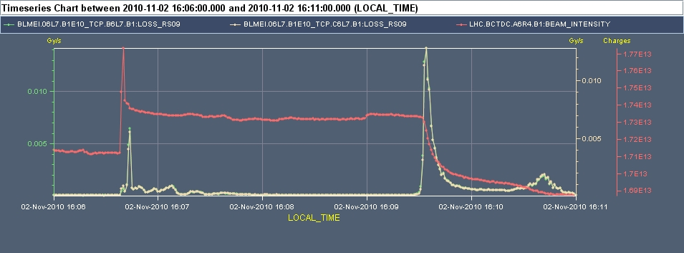
BLMs – Data analysis
Looking for our monitors (cont.):
We can also discard all BLMES, which are SEM and are not so important for us
For a first analysis we mainly have to focus on the BLM%TCP%LOSS_RS09, which are the BLMs situated at the primary collimators → only 20 variables!
If we see losses at the TCPs that can indicate losses in other places of the machine
After that we can check the secondary collimators: BLM%TCS%LOSS_RS09 (169)
It’s useful to represent the BLM data together with the BCT (or FBCT) data:
16
2nd March 2011 - ICE meeting

