Slide 1
Head-Tail monitor
Benoit, with the help of Christian Boccard and Ralph Steinhagen (BE/BI-QP)

Slide 2
Agenda
What is the Head-Tail monitor?
Objectives
How does it work?
Information specific to LHC HT monitor
Example

Slide 3
What is the Head-tail monitor?
It is a long stripline coupler
Striplines are more sensitive than button BPMs, but their response is not flat in frequency

Slide 4
Agenda
What is the Head-Tail monitor?
Objectives
How does it work?
Information specific to LHC HT monitor
Example

Slide 5
Objectives
the Head-Tail monitor is designed to measure chromaticity
(see for instance R. Jones, H. Schmickler “The measurement of Q’ and Q’’ in the CERN-SPS by head-tail phase shift analysis”, 2001 and S. Fartoukh, R. Jones, “Determination of Chromaticity by the Measurement of Head-Tail Phase Shifts: simulations, results from the SPS and a robustness study for the LHC”, 2002)
- Issues for practical implementation in LHC:
→ Need for large kicks
→ head-tail phase shift is also strongly affected by collective effects and octupole settings
it is also a very nice tool to observe transverse instabilities

Slide 6
Agenda
What is the Head-Tail monitor?
Objectives
How does it work?
Information specific to LHC HT monitor
Example

Slide 7
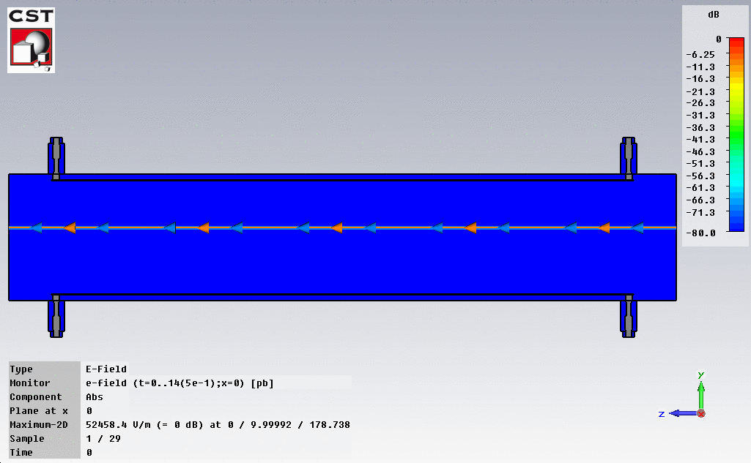
How does a stripline work?
Port 1
Port 2
Port 1
Port 2
The Head-Tail monitor is long enough: signal and reflection do not mix
→ Very clean time domain signal of the transverse position along the bunch

Slide 8
Agenda
What is the Head-Tail monitor?
Objectives
How does it work?
Information specific to the LHC HT monitors
Example

Slide 9
Specifics of the LHC headtail monitor
Component names:
BPLH.6R4.B2, BPLV.A6R4.B1, BPLH.7R4.B1, BPLV.7R4.B2
1 stripline per beam and per plane
The same type of striplines are used for the tune measurement
Inner diameter: 80 mm
Length of striplines: 400 mm
Positioned with most of the specialised instrumentation in straight sections on each side of IP4 (LSS4)
More details, drawings, layouts at http://layout.web.cern.ch/layout/ and https://edms.cern.ch/file/599636/1.0/LHC-LJ-EC-0009-10-00.pdf

Slide 10
How to use the Head-Tail viewer application?

Slide 11
How to use the Head-Tail viewer application?
Many issues have been fixed by Ralph during the 2010 run:
automatic save
increase of turn*bunches
Some comments:
very small amplitudes are difficult to resolve if no instability.
acquisition is not synchronized with machine events
the viewer sometimes gets offline
do not use fine delays
raw data are affected by the cable and hybrid frequency response.

Slide 12
Agenda
What is the Head-Tail monitor?
Objectives
How does it work?
Information specific to LHC HT monitor
Example

Slide 13
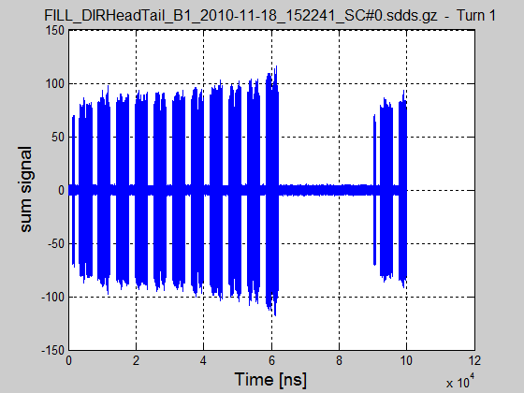
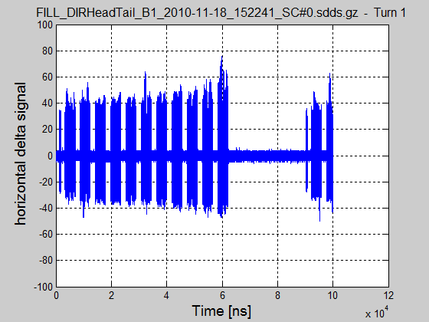
Example of LHC acquisition (2010) Observation of instability on B1 before chromaticity increase

Slide 14
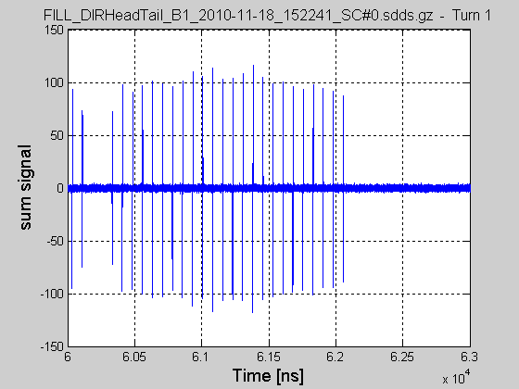
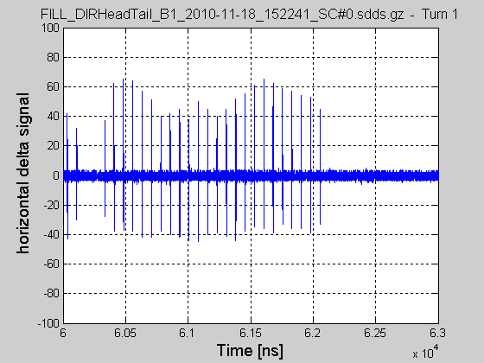
Example of LHC acquisition (2010) Observation of instability on B1 before chromaticity increase Zoom on last batch

Slide 15
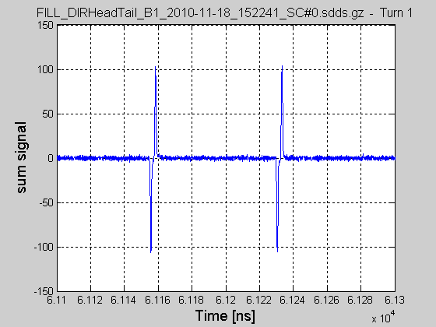
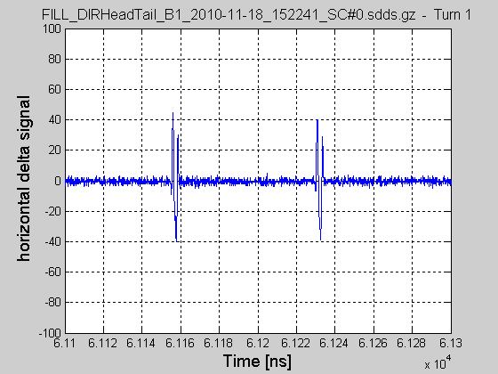
Example of LHC acquisition (2010) Observation of instability on B1 before chromaticity increase Zoom on last batch and two bunches

Slide 16
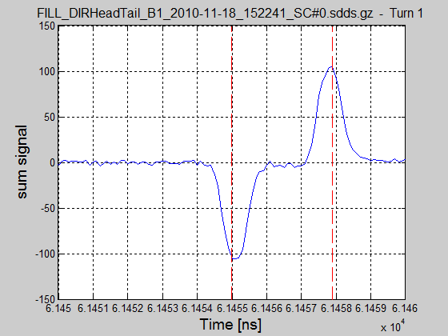
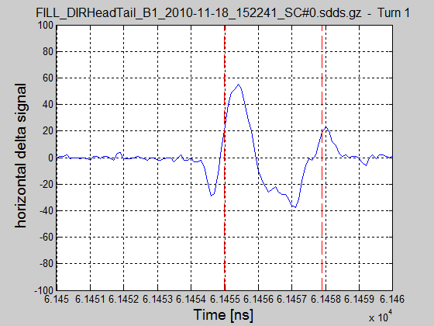
Example of LHC acquisition (2010) Observation of instability on B1 before chromaticity increase Zoom on last batch and one bunch

Slide 17
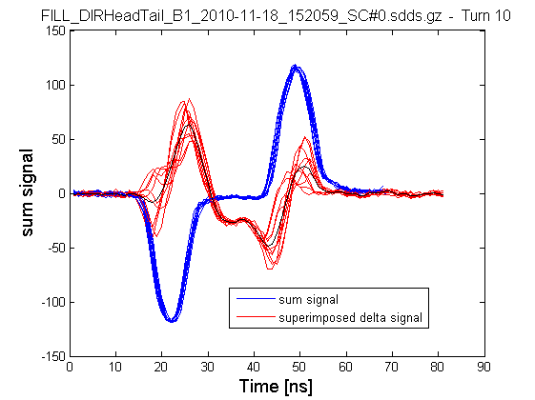
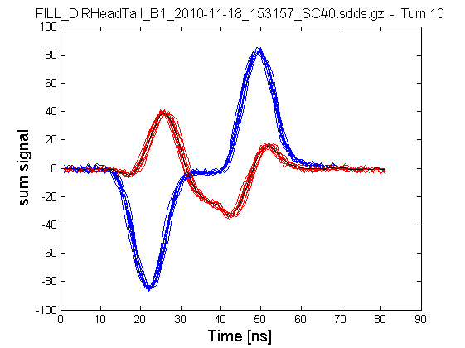
Example of LHC acquisition (2010) Comparison between before and after chromaticity increase
Superimposed HT signal before chromaticity increase
Superimposed
HT signal after chromaticity increase
Clear transverse motion inside the bunch
No transverse motion inside the bunch

Slide 18
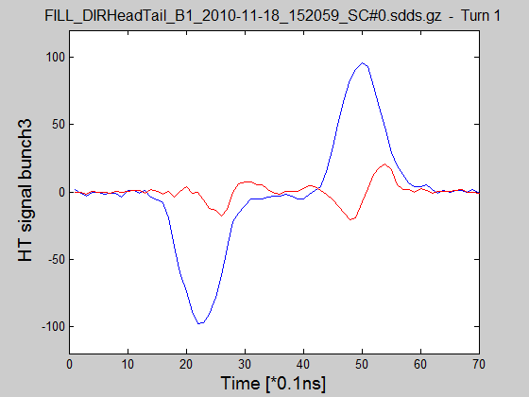
Example of LHC acquisition (2010) Suppressing the average motion to try to see the intrabunch mode

