Slide 1
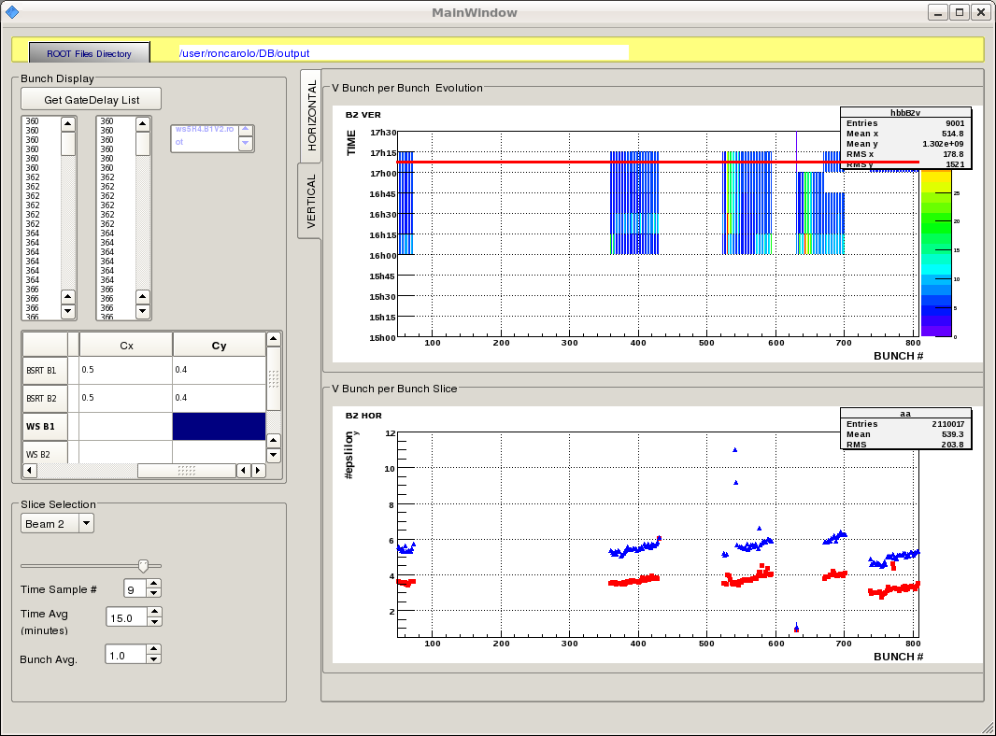
Fill1674 at 14-17 5th April
Beam 2

Slide 2
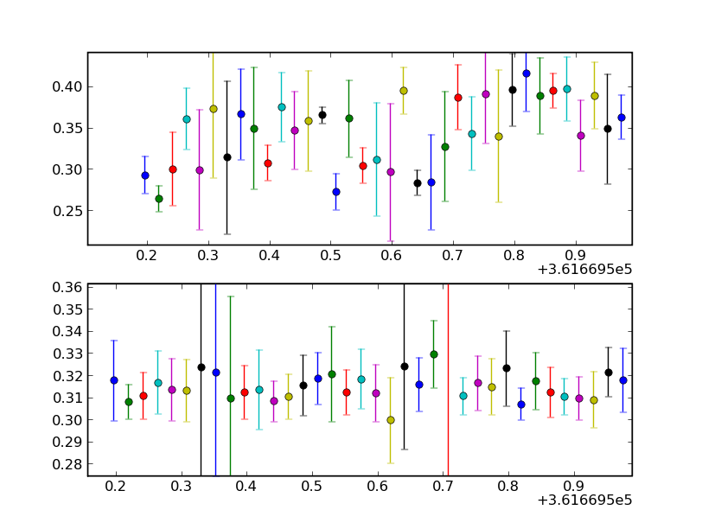
Fill1674 at 14-17 5th April
Beam 2
-very noisy no visible schottky bands

Slide 3
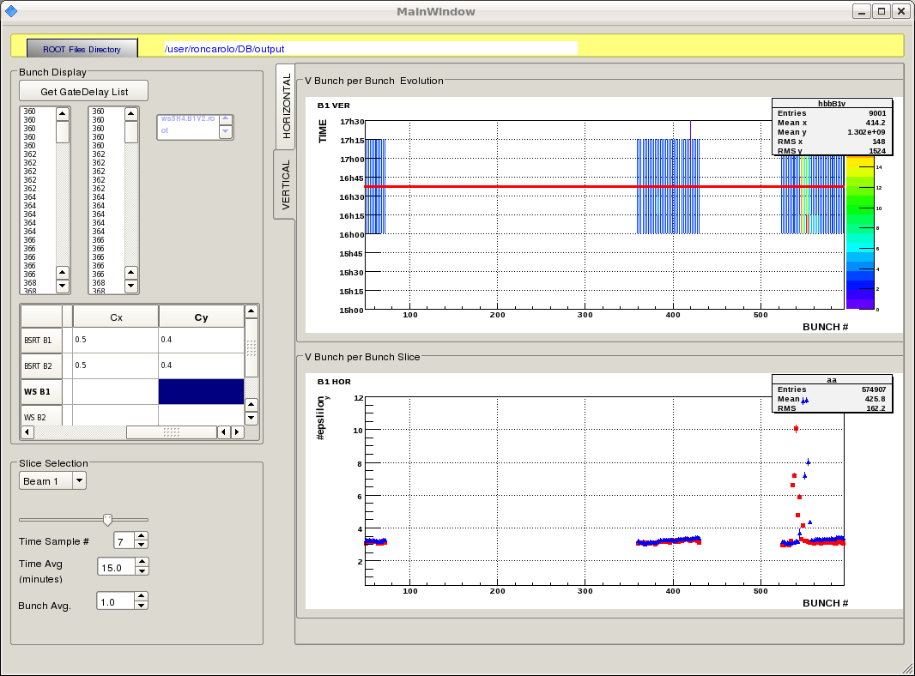
Fill1674 at 14-17 5th April
Beam 1

Slide 4
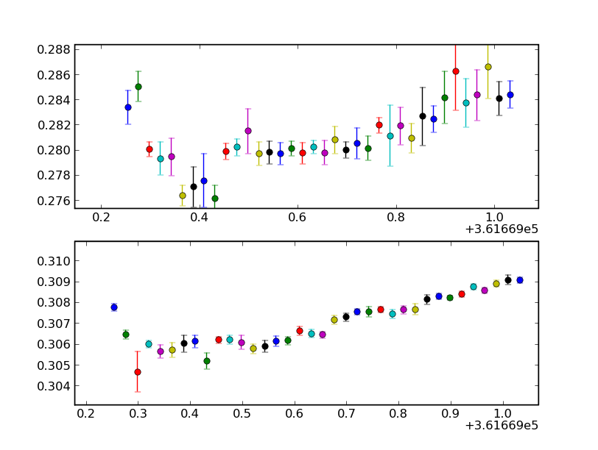
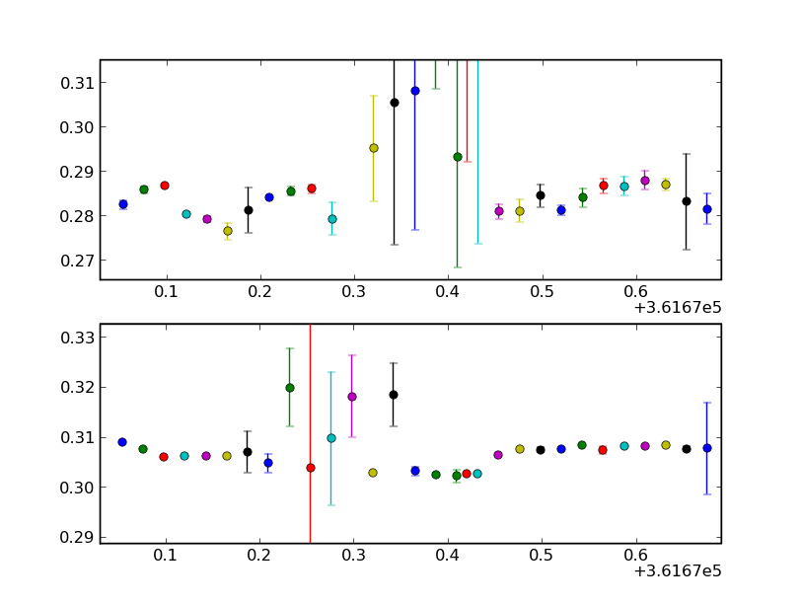
Fill1674 at 14-17 5th April
Beam 1
-first train shows

Slide 5
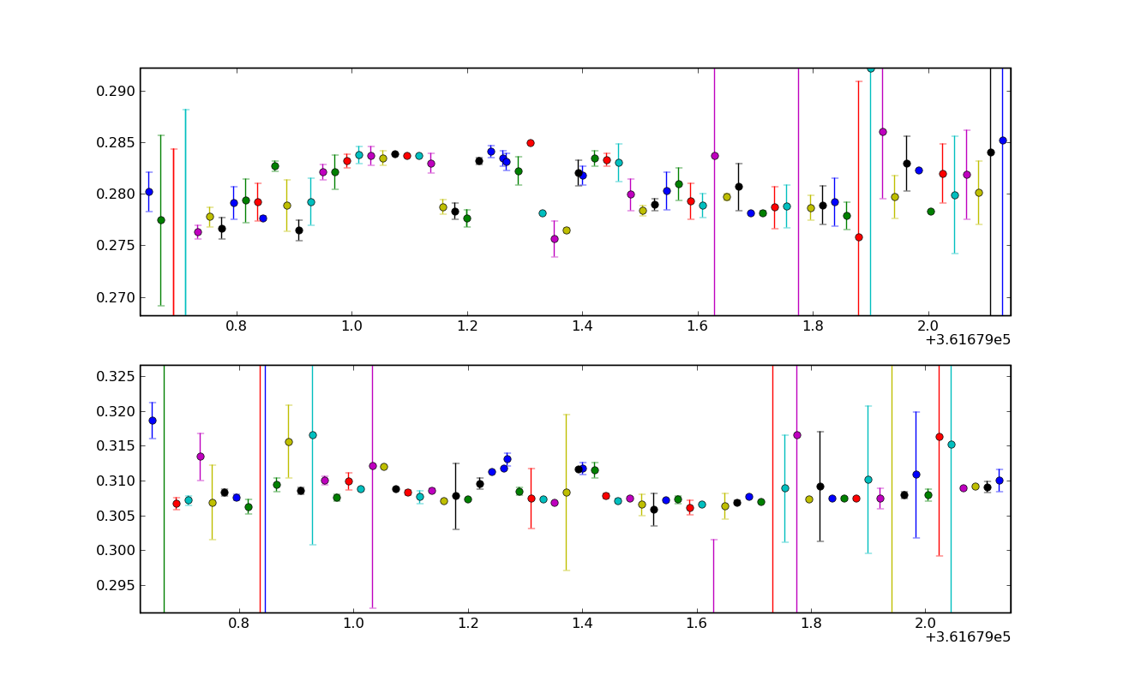
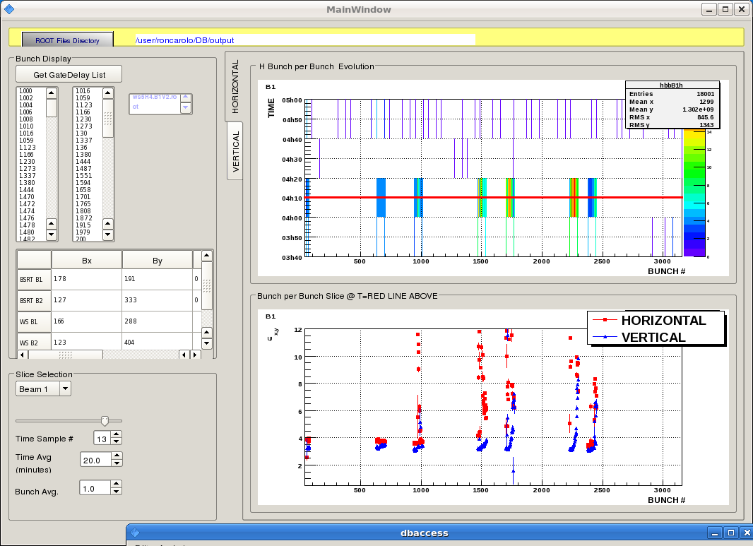
Fill1674 around 12pm
Beam 1
-first train 36 bunches

Slide 6
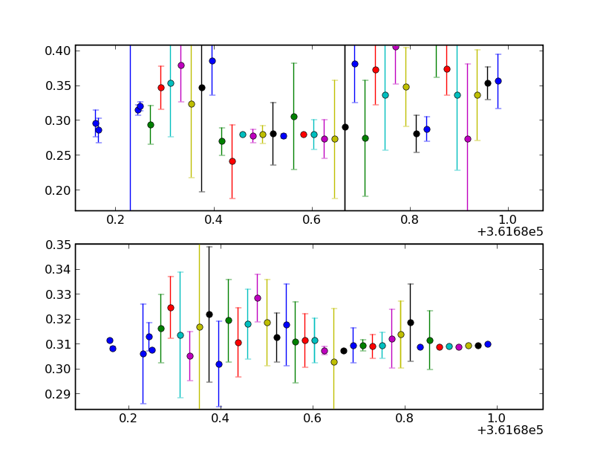
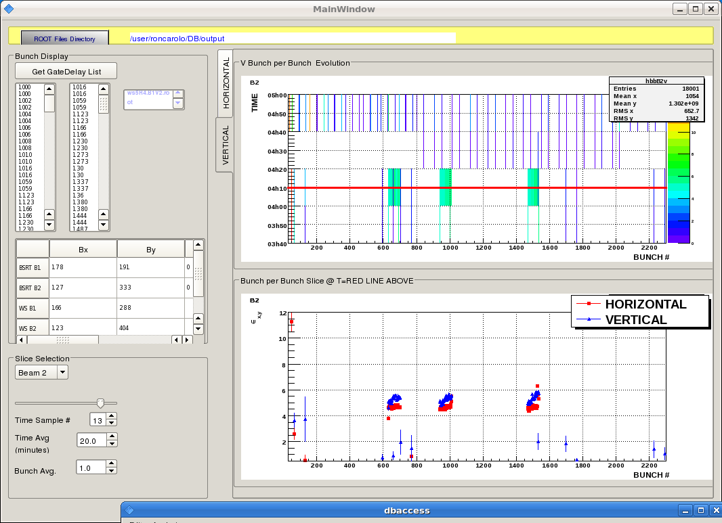
Fill1674 around 12pm
Beam 2
-first train 36 bunches

Slide 7
Fill1674 around 12pm
Beam 1
-second train 36 bunches

Slide 8
Fill1674 around 12pm
Beam 2
-second train 36 bunches

Slide 9
Fill1674 around 12pm
Beam 1
-3rd train 36 bunches

Slide 10
Fill1674 around 12pm
Beam 2
-3rd train 36 bunches

