Slide 1
Status of the EM simulations and modeling of ferrite loaded kickers
C. Zannini, G. Rumolo
Thanks to: H. Day, G. De Michele, E. Métral, T. Pieloni, B. Salvant

Slide 2
Overview
Introduction and motivations
Simulation models
Comparing C-magnet and Tsutsui model
Conclusions, future steps and open issues

Slide 3
Definition of wake potential
y
x
s
z
z
Define the transverse position of the source particle
Define the transverse position of the test particle

Slide 4
Separating dipolar and quadrupolar wake using CST Particle studio

Slide 5
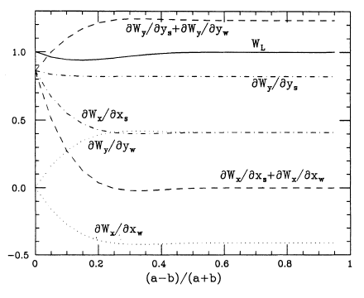
Example of application:
the resistive beam pipe
Aspect ratio q:
2 b
L
b= 1mm
a=3mm
L=10mm
Vacuum
Conductive material
2 a
Analytical form factors of the wake functions for rectangular pipes
K. Yokoya. Resistive Wall Impedance of Beam Pipes of General Cross Section. Number 41. Part. Acc., 1993.
The values are normalized by those of the round pipe with radius b.

Slide 6
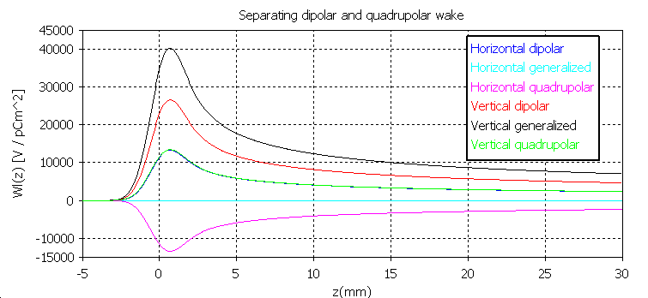
First example of application:
the resistive beam pipe
σ
q=0.5
2 b
Gaussian bunch adopted as excitation signal
2 a
→ In the horizontal plane, W_{general}=0, and W_{driving}=- W_{detuning}
→ In the vertical plane, W_{general}=3*W_{detuning}, and W_{driving}= 2* W_{detuning}
6

Slide 7
First example of application:
the resistive beam pipe
Comparing theoretical and simulation results

Slide 8
Introduction and motivations
Up to now for the impedance model of the kickers we used the Tsutsui model. For this simplified model we compared with good results simulation and theoretical results.
In the frame of an improvement of the kicker impedance model we are making a simulation study step by step to allow a good understanding of the different contributions to the kicker impedance.

Slide 9
New simulation: MKE. 61651

Slide 10
New simulation results: MKE. 61651
Dipolar Vertical imaginary impedance: Comparing theoretical and simulation results
- - Old simulation
- - New simulation
Theory

Slide 11
Overview
Introduction and motivations
Simulation models
Comparing C-magnet and Tsutsui model
Conclusions, future steps and open issues

Slide 12
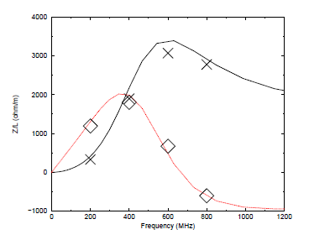
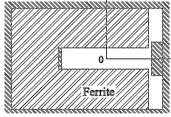
Simulation models
C-magnet model
y
x
Tsutsui studied the C-magnet model in ‘’CERN-SL-2000-004 AP’’, but only for the longitudinal impedance.

Slide 13
Ferrite Model

Slide 14
Ferrite Model
Using the Tsutsui theory
Using the C-Magnet model to investigate the low frequency behavior quantitatively we have to use the 8C11 model

Slide 15
Ferrite model
At the moment we have data from 1 MHz to 1.8 GHz for the ferrite 8C11
It could be interesting to measure again the electromagnetic properties of the ferrite

Slide 16
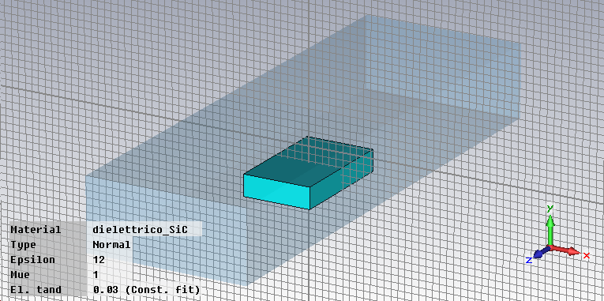
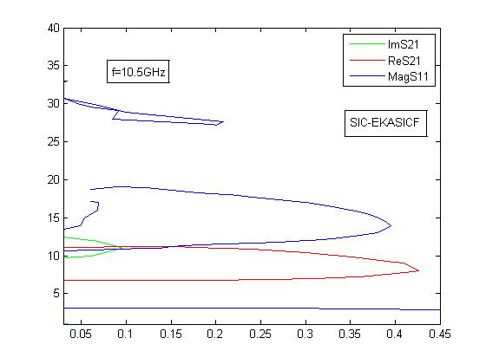
Electromagnetic characterization of materials
We characterize the material at high frequency using the waveguide method
The intersection of the surfaces with the measured S21 yields the possible solutions. Often we obtain the uniqueness of the solution with only the two constrains furnished from the complex S21.
Imaginary S21 at 10.5 GHz
To use a transmission line method: Coaxial line, strip line etc.

Slide 17
Characterization of materials using an open ended coaxial line
Z0, k0
Z_DUT, k_DUT
Zload
l
EM material characterization at microwave frequencies has a long history, dating from early 1940s. Over the past few decades, significant advances have been made in this field and a variety of new measurement techniques have been developed. Broadband EM material characterization is a major requirement in many applications. In this scenario, coaxial line methods have gained much importance as compared to other methods.

Slide 18
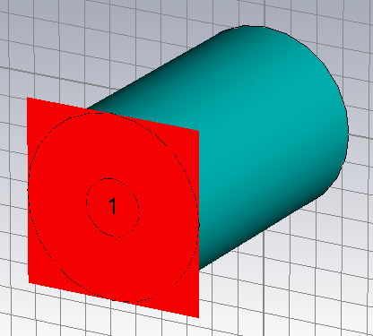
Validation of the method via 3D EM simulations
We simulate the for a given material
Simulations
Model

Slide 19
Validation of the method via 3D EM simulations
The output data of the simulation is the complex S11. Using the simulated S11 we obtained from the trasmission line model the characteristic of the material.
In principle the method should work very well also if we use the measured S11.

Slide 20
Improving measurements: using a sample well known
We can be confident about the simulated S11
Simulations
Model
Measurements
The measurements are correct

Slide 21
Overview
Introduction and motivations
Simulation models
Comparing C-magnet and Tsutsui model
Conclusions, future steps and open issues

Slide 22
Comparing the two models
Real horizontal detuning impedance calculated at x=1 cm
Using the C-magnet model in the transverse horizontal impedance a high peak at 40MHz appears. At low frequency the Tsutsui model is not able to estimate correctly the kicker impedance. The two models are in good agreement at high frequency (>400MHz).

Slide 23
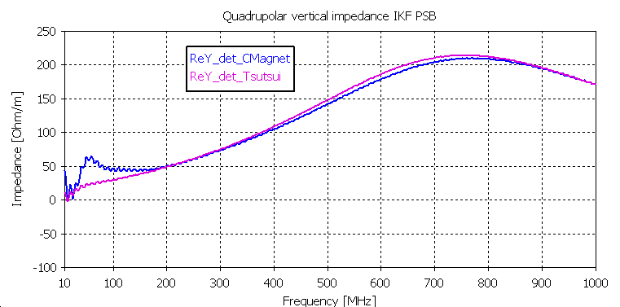
Comparing the two models
Real longitudinal impedance
Real vertical detuning impedance calculated at y=0.5cm
Impedance [Ohm]
We can see the peak also in the longitudinal and vertical impedance

Slide 24
Comparing the two models
Real horizontal detuning impedance calculated at x=1cm: MKE 61651
The frequency of the peak at low frequency is related to the length of the kicker.

Slide 25
Comparing the two models
Frequency of the peak vs length in the MKE 61651
We have to use the real length of the kicker

Slide 26
Calculation of the impedance for the C-Magnet model in case of PML boundary in the longitudinal plane
Where is the low frequency impedance in a C-Magnet kicker model calculated using the Sacherer Nassibian formalism and is the impedance calculated using the Tsutsui formalism.
The Tsutsui impedance is calculated in H. Tsutsui. Transverse Coupling Impedance of a Simplified Ferrite Kicker Magnet Model. LHC Project Note 234, 2000. Instead we have to spend some word about the Sacherer Nassibian impedance.
This impedance is defined as:
Where l is the length of the magnet, x0 the beam position, L the inductance of the magnet and Zg is the characteristic impedance of the kicker

Slide 27
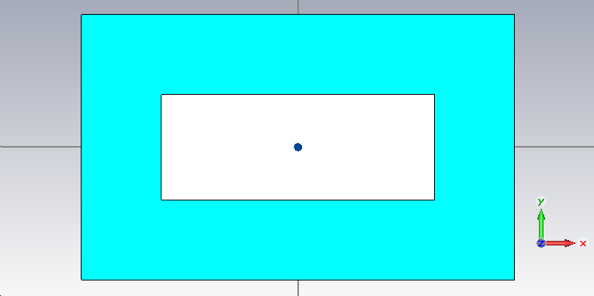
Comparing with analytical results
Horizontal driving impedance calculated at x=1cm: MKP
The simulations of the C-magnet model are in agreement with a theoretical prediction based on Sacherer-Nassibian and Tsutsui formalism
Horizontal dipolar impedance
Frame Magnet model

Slide 28
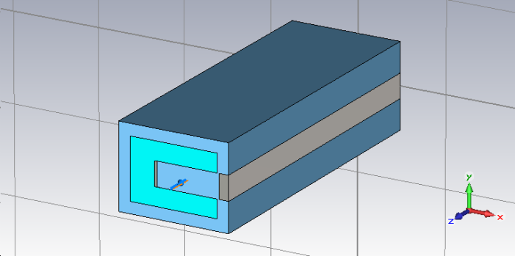
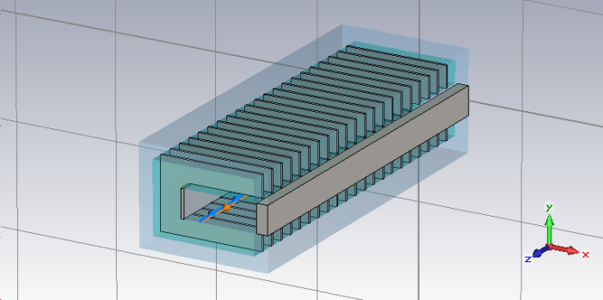
MKP: horizontal transverse impedance
The segmentation seems to affect strongly the low frequency peak

Slide 29
MKP: Comparing measured and simulated longitudinal impedance
seg

Slide 30
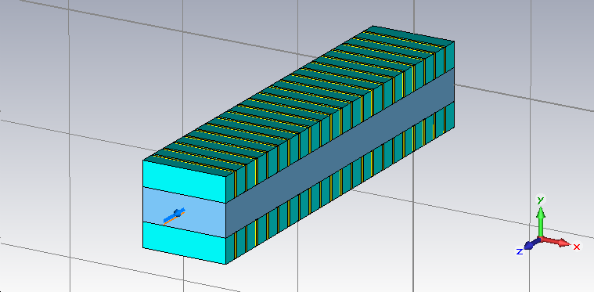
MKP measurements in the vertical plane

Slide 31
Overview
Introduction and motivations
Simulation models
Comparing C-magnet and Tsutsui model
Conclusions, future steps and open issues

Slide 32
Conclusions, future steps and open issues
A very high kicker impedance is observed at low frequency
The Tsutsui formalism falls down at low frequency.
External circuit: no matching termination
The impact of transition pieces, segmentation (from the first studies seems to affect the impedance specially al low frequency in the transverse plane), etc.
Low frequency impedance simulations
Reliability of the coaxial wire method

