Slide 1
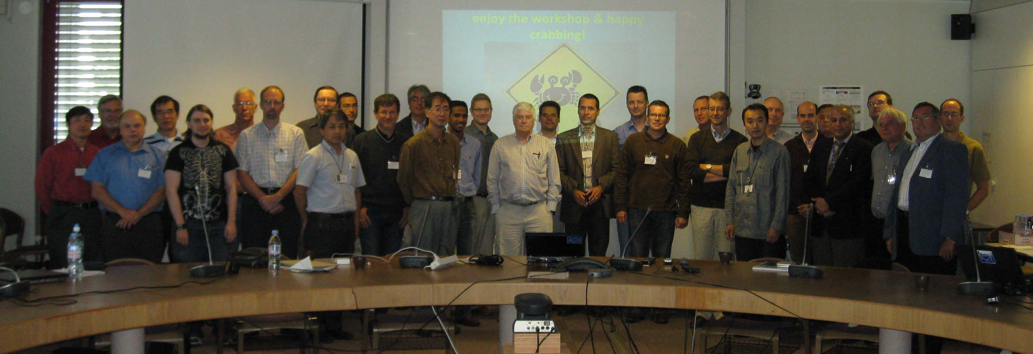
LHC-CC09 workshop
LHC Crab Cavity Workshop, jointly organized by CERN, EuCARD-ACCNET, US-LARP, KEK, & Daresbury Lab/Cockcroft Institute
CERN, 16-18 September 2009
~50 participants, LHC Crab Cavity Advisory Board established

Slide 2
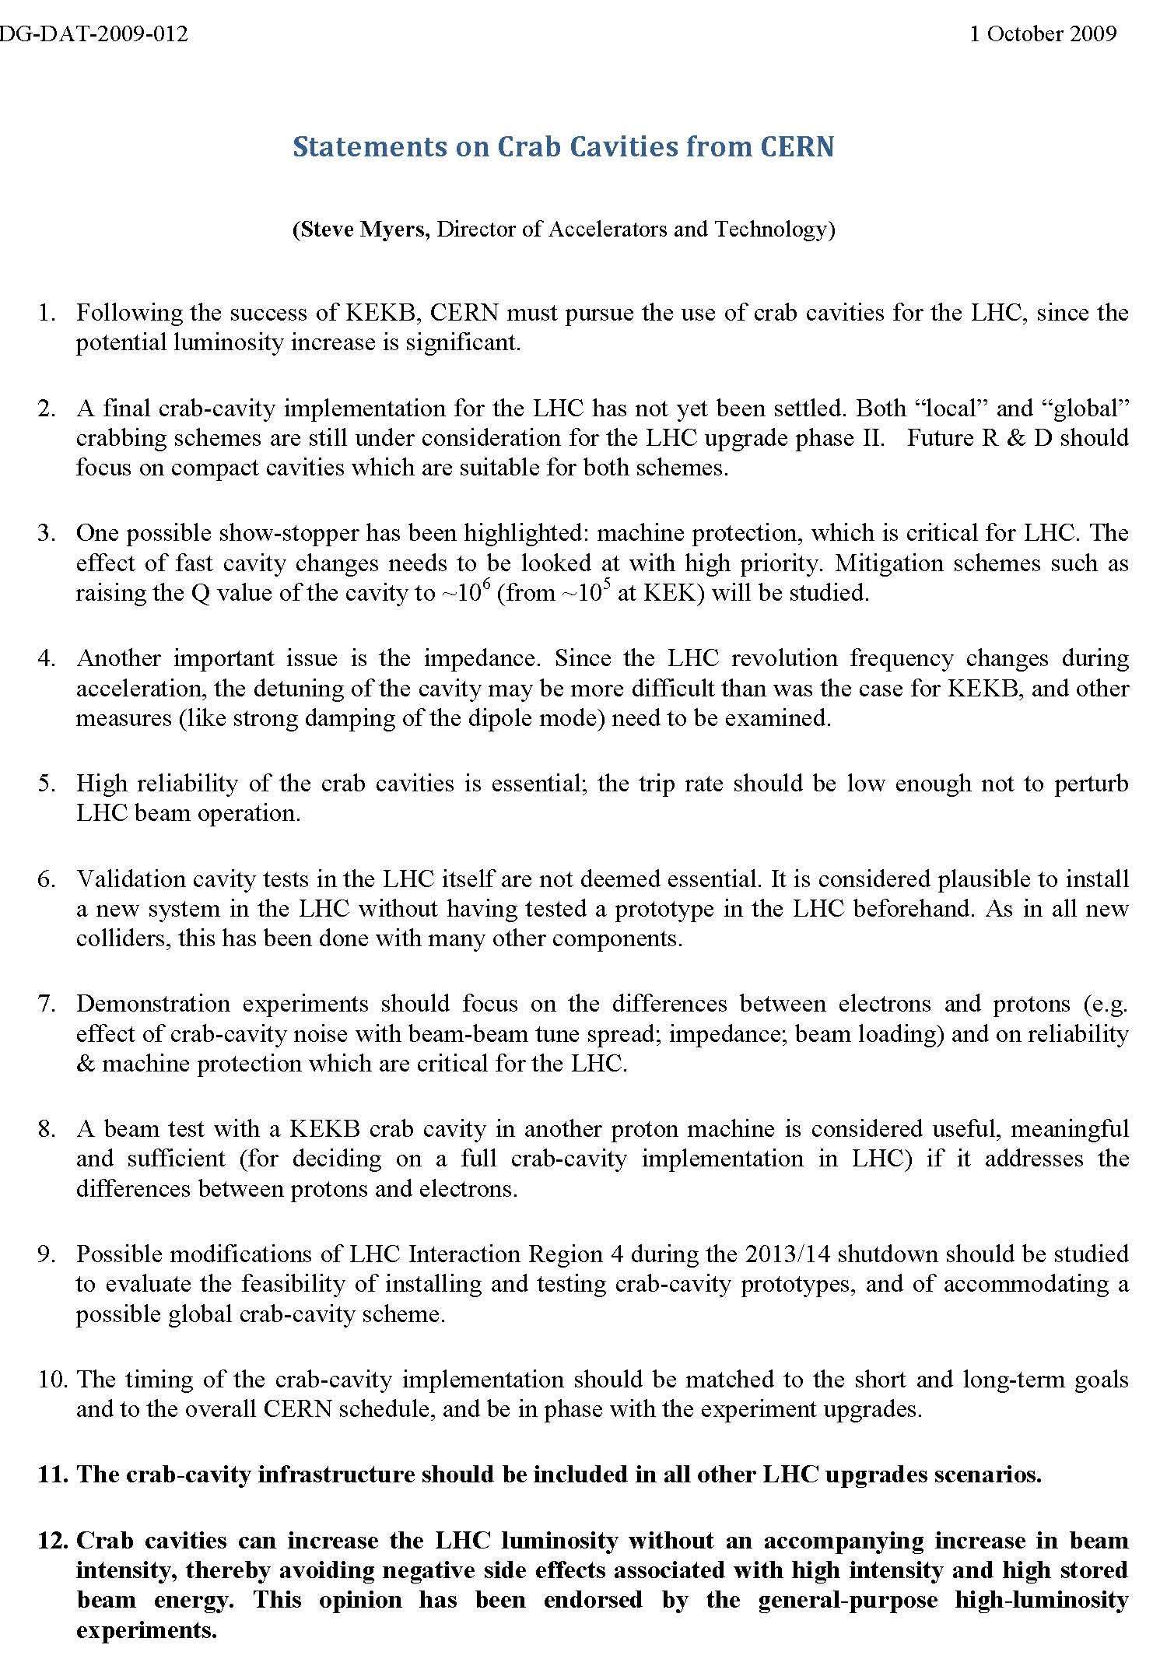
CERN statement (Steve Myers) on LHC crab cavities issued after AccNet LHC-CC09 workshop

Slide 3
CERN statements (excerpts)
KEKB success … CERN must pursue crab cavities for LHC
2. … Future R&D should focus on compact cavities … suitable for both [local and global] schemes
Demonstration experiments should focus on differences between electrons and protons (e.g. effect of crab-cavity noise with beam-beam, impedance, beam loading) and on reliability & machine protection which are critical for LHC
A beam test with KEKB crab cavity in another proton machine … is … useful, meaningful and sufficient …
9. Possible modifications of Interaction Region 4 during the 2013/14 shutdown
11. Crab cavity infrastructure … be included in all … LHC upgrades
12. Crab cavities can increase luminosity w/o accompanying increase in beam intensity, thereby avoiding negative side effects

Slide 4
frequencies and bunch patterns
KEKB crab freq: 508.9 MHz
operational tuner stroker 100 kHz (max. 200 kHz)
proposed SPS frequency: 510.6-511.0 MHz
needs mechanical detuning by ~2MHz
with 511 MHz crab bunches with 100 ns spacing,
anticrab intermediate bunches at 50 ns, and
kick in opposite direction every second 25 ns bunch; different experiments would be possible

Slide 5
test objectives in view of LHC
feasibility of crab cavities in a hadron machine
emittance growth from crab RF noise & tune spread
(due to octupoles and/or BBLR)
intensity dependence
static & dynamic frequency tuning
adjust to the correct bunch frequency
make the cavity “invisible” if not needed (incuding during ramp!)
ramping
increase crab voltage from “zero” to target
impedance
orbit control, beam loading, active feedback!
intensity & bunch-pattern dependence

Slide 6
test objectives in view of LHC cont’d
reliability
cavity trips
machine protection, interlocks and worst case scenarios
“one turn failure” cavity trips (voltage and/or phase)
using crab cavity for off-momentum cleaning
measurement of optics, emittances, beam losses, etc.

Slide 7
some boundary conditions
minimize potential impact on LHC
schedule test during LHC shutdown
duration of tests ~ a few weeks?
cryo system
demand depends on test duration & crab voltage required
minimize impact on SPS programme e.g. CNGS
make crab cavity transparent for FT beam?
effect of cavity trip, impedance?
(in-)visibility of a warm crab cavity?

Slide 8
Information from Kota Nakanishi
22 September 2009
KEKB crab cavity has two tuners.
One is driven by piezo stack.
It is called fine tuner.
It can be moved much faster than rough tuner. That range is about ~5kHz
Another tuner which called rough tuner is driven by stepping motor.
Range of the tuner is ~100kHz.
That speed is about ~10kHz/sec now.

Slide 9
More information K.N., 6 October 2009
1. The heat loading to liquid helium is about 100W.
But to cool down coaxial part, liquid helium must be flowed.
We omitted to circulate liquid helium, a part of liquid helium go back to room temperature port.
It makes big ice ball. Please look at a picture.
Please ask cryogenic group whether it is acceptable.
2.The cavity frequency can be adjusted to 511MHz.
It have to be disassembled and expanded and reassembled.
It takes at least 3 month.(Hosoyama-san's estimation)
3.Range of mechanical tuner is 200kHz.
The speed is only 1kHz/sec.
It can't keep valid frequency offset during acceleration, because of its small adjustable range.
And probably it's too slow.
4.I have a shorter input coupler (larger Q-ext).
It is available, if you need.
How big wideband amplifier do you have?
Akai-san said that 20kW solid-state amplifiers are commercially available.
Can you decide Q-ext based on capacity of amplifier?

