Slide 1
(SOME) EFFECTS NEAR TRANSITION
E. Métral (CERN)
Transition energy
Longitudinal beam dynamics “far” below or above transition
Transition crossing (with the example of the CERN PS machine)
Transverse (slow) head-tail instability
Fast (vertical) single-bunch instability
  Crossing transition in the CERN PS
  Injecting just above transition in the CERN SPS
Conclusion

Slide 2
TRANSITION ENERGY (1/3)
Momentum compaction factor
Machine circumference
Horizontal dispersion
Beam momentum
Bending radius
=> Parameter coming from the accelerator lattice
Gamma transition
  In most circular machines, α_{p} > 0
  However, α_{p} < 0 is also possible (e.g. CERN LEAR machine) => Called “Negative Momentum Compaction” (NMC) or “Imaginary γ_{t}” lattice

Slide 3
TRANSITION ENERGY (2/3)
  Assume α_{p} > 0
    dp > 0 => dC > 0
    dp > 0 => dv > 0
    At (very) high energy, v ≈ clight and remains constant => f_{rev} 
    At low energy, v increases faster than C => f_{rev} 
  => What happens to the revolution frequency f_{rev} = v / C?
There is an energy for which the velocity variation is compensated by the trajectory variation (i.e. df_{rev} = 0):
=> TRANSITION ENERGY

Slide 4
TRANSITION ENERGY (3/3)
Slip factor
Relativistic mass factor of the beam
    η < 0 below transition
    η = 0 at transition => Isochronous condition
    η > 0 above transition

Slide 5
LONGITUDINAL BEAM DYNAMICS
“FAR” BELOW OR ABOVE TRANSITION (1/2)
(Bucket) separatrices: Below transition
Above transition

Slide 6
LONGITUDINAL BEAM DYNAMICS
“FAR” BELOW OR ABOVE TRANSITION (2/2)
Particle trajectories: Below transition

Slide 7
TRANSITION CROSSING (1/9)
“Far” below or above transition ⬄ Adiabaticity condition
“Close” to transition, the adiabaticity condition is not satisfied => Non-adiabatic synchrotron motion
  When the time is close enough to transition, the particle will not be able to catch up with the rapid modification of the bucket shape
  Nonadiabatic time
~ 2 ms for the
nTOF bunch in the CERN PS

Slide 8
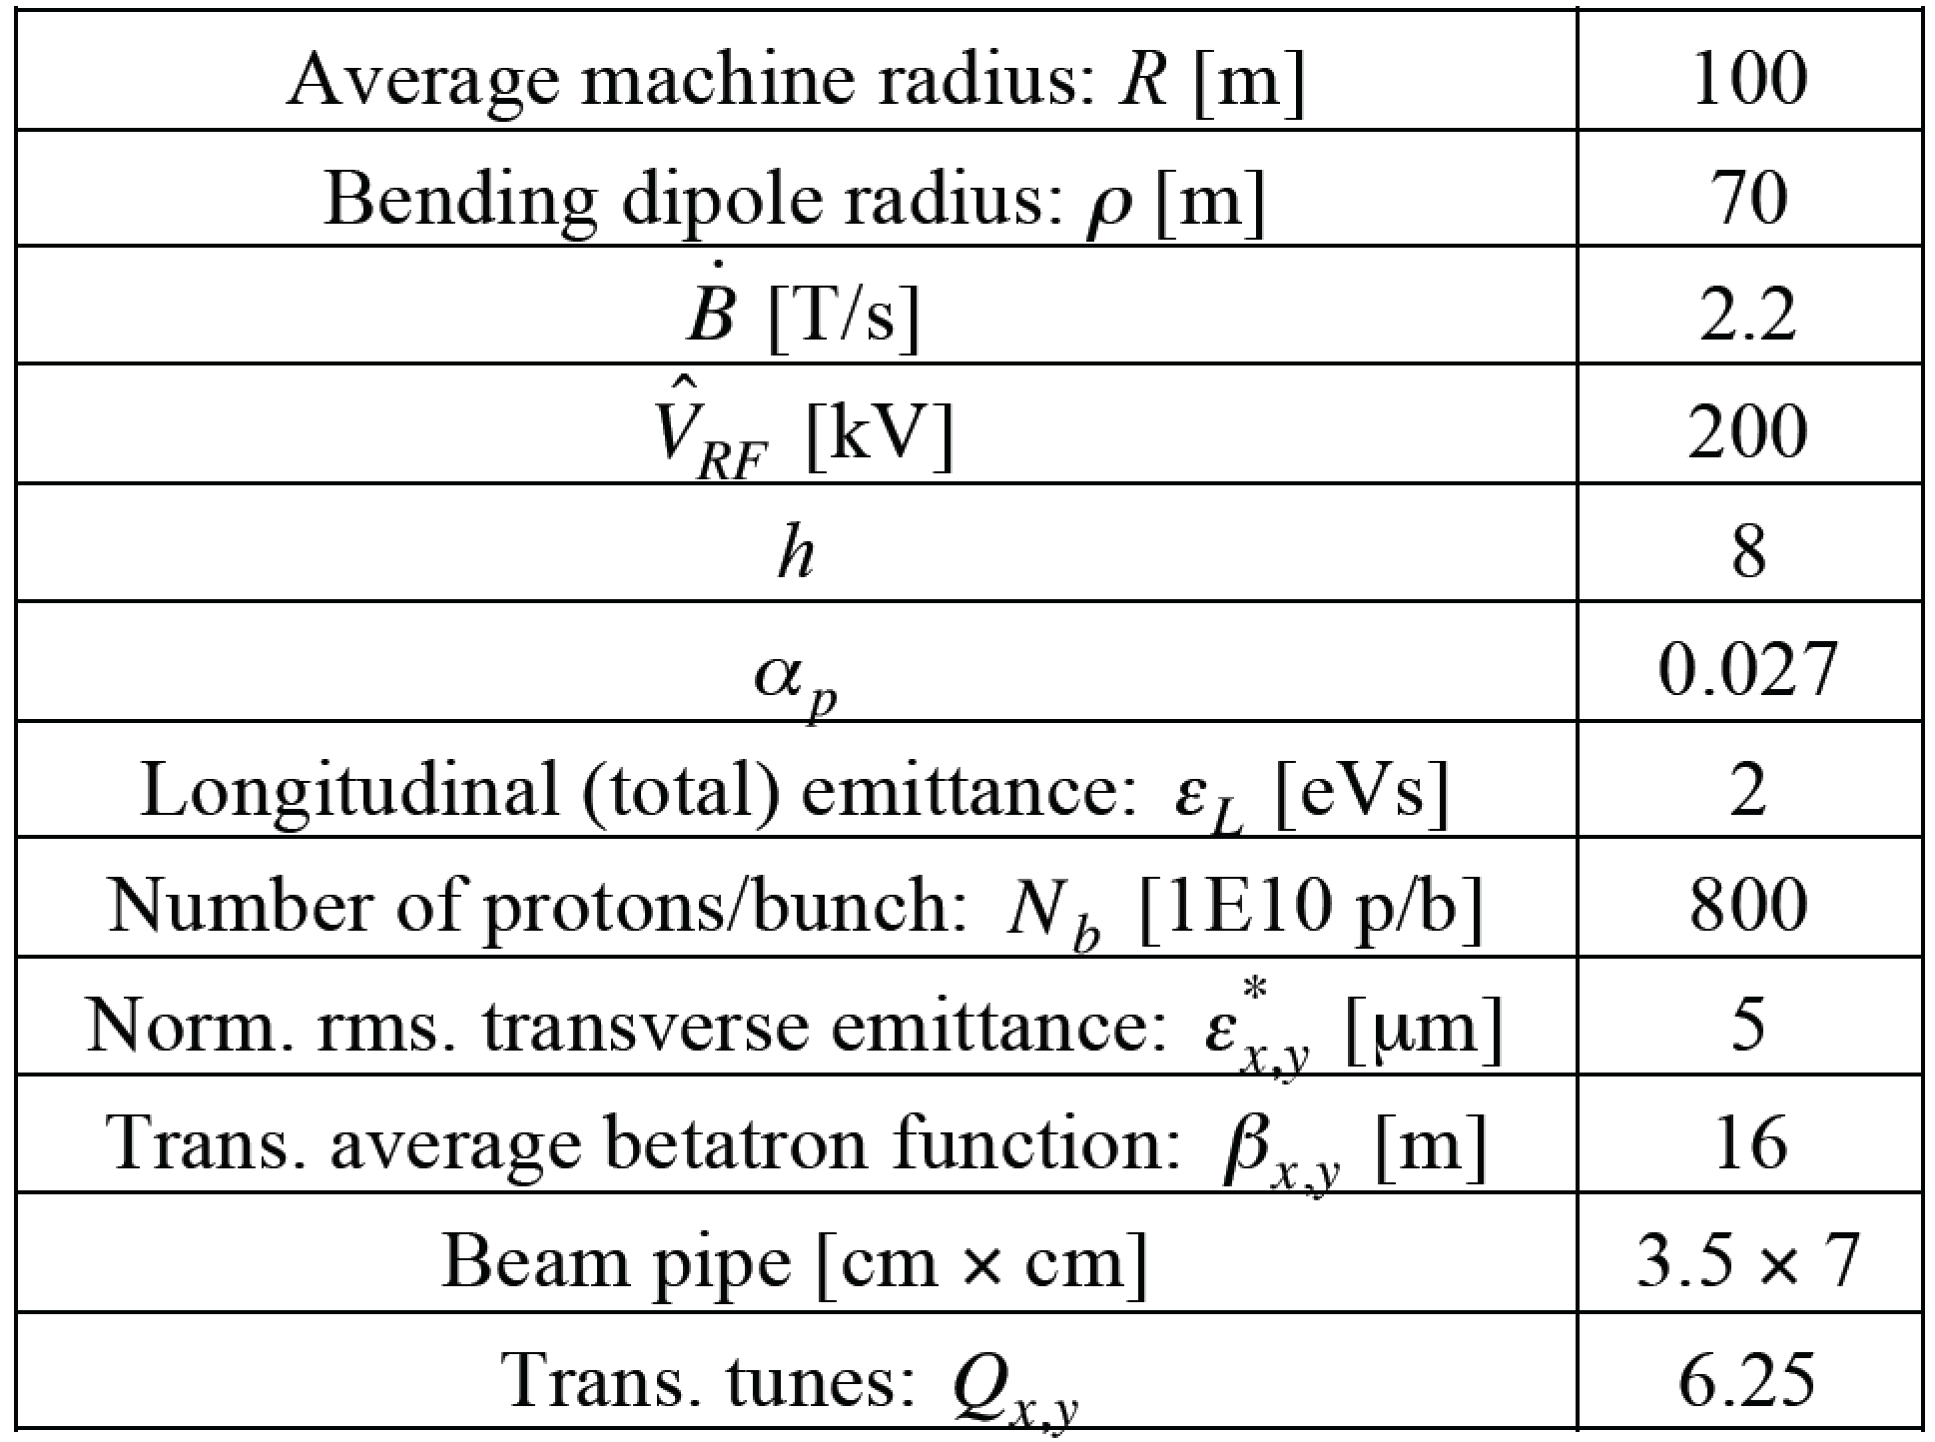
TRANSITION CROSSING (2/9)
nTOF bunch in the CERN PS
=> γ_{t} ≈ 6.1

Slide 9
TRANSITION CROSSING (3/9)

Slide 10
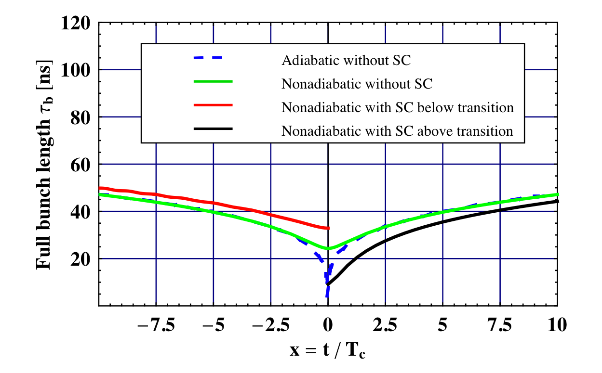
TRANSITION CROSSING (4/9)
Longitudinal mismatch (due to the longitudinal Space Charge): IN STATIC

Slide 11
TRANSITION CROSSING (5/9)
Longitudinal mismatch (due to the longitudinal Space Charge): IN DYNAMIC (i.e. crossing transition)

Slide 12
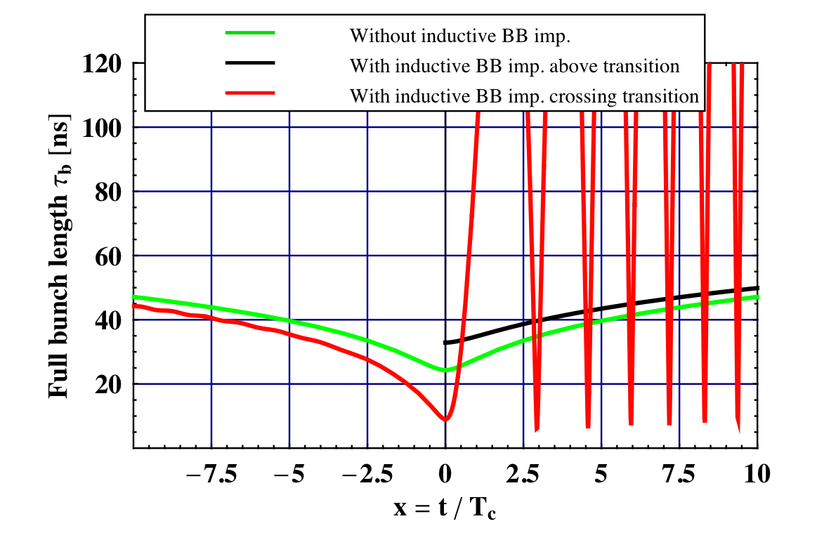
TRANSITION CROSSING (6/9)
Longitudinal mismatch (due to the inductive part of the longitudinal Broad-Band impedance): IN DYNAMIC (i.e. crossing transition)

Slide 13
TRANSITION CROSSING (7/9)
Remedies
  Avoid crossing transition in the design phase => α_{p} < 0
  If transition crossing cannot be avoided, the “γ_{t} jump” is the only (known) method to overcome all the intensity limitations => Artificial increase of the transition crossing speed by means of fast pulsed quadrupoles (at non zero dispersion locations)
Effective crossing speed ~ 50 times faster with the γ_{t} jump

Slide 14
TRANSITION CROSSING (8/9)
  Asymmetric or symmetric γ_{t} jump?

Slide 15
TRANSITION CROSSING (9/9)

Slide 16
TRANSVERSE (SLOW) HEAD-TAIL INSTABILITY (1/2)
If the sign of the chromaticity (which is equal to ~ -1 for an uncorrected machine like the PS) is not changed (in both transverse planes) above transition, a (single-bunch) head-tail instability may develop
  This instability can be damped through Landau damping using octupoles, which introduce some amplitude detunings. This method was first used in the past to stabilize the PS beams
  However, the better method of changing the sign of the chromaticities (and keeping them to small positive values) by acting on the optics with sextupoles was then adopted, and it has become a routine operation at the CERN PS for many years
      => The chromatic frequency should be (slightly) positive to avoid the head-tail mode 0 (most critical) from developing

Slide 17
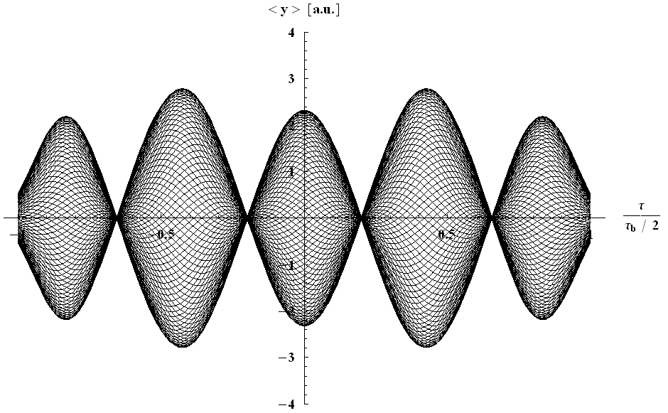

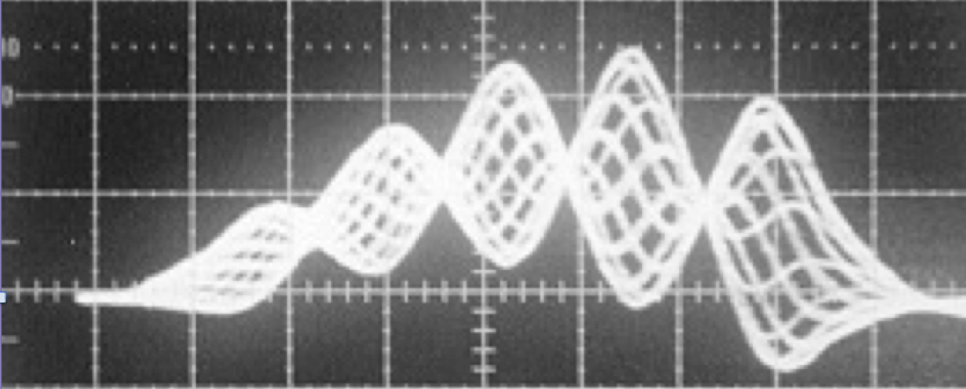
TRANSVERSE (SLOW) HEAD-TAIL INSTABILITY (2/2)
Example of transverse (slow) head-tail instability observed in the CERN PS at injection (below transition)
  Consecutive traces at a pick-up superimposed
  Standing-wave patterns with 4 nodes (called “mode 4”)
Measurements
Analytical prediction
(for a bunch going through the centre of the pick-up)

Slide 18
FAST (VERTICAL) SINGLE-BUNCH INSTABILITY (1/14)
A simple formula is obtained from 5 seemingly diverse formalisms (in the absence of space charge and transverse feedback), assuming i) a Broad-Band impedance and ii) the long-bunch regime:
  Coasting-Beam approach with peak values
  Fast Blow-Up
  Beam Break-Up
  Post Head-Tail
  Transverse Mode-Coupling Instability (TMCI)

Slide 19
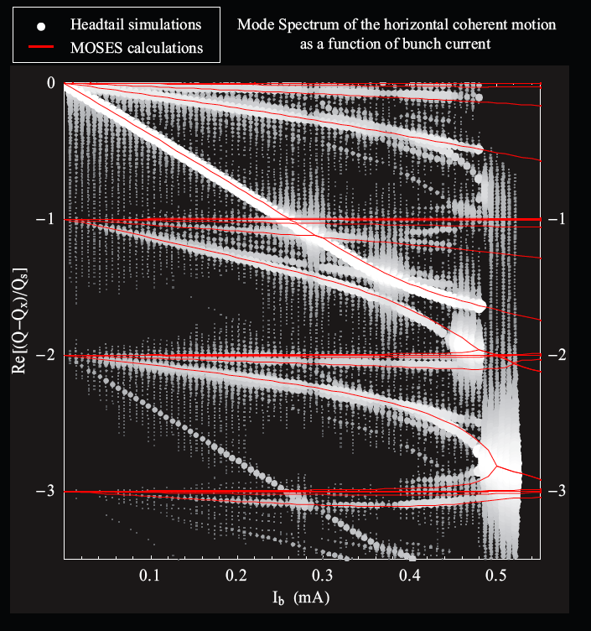
FAST (VERTICAL) SINGLE-BUNCH INSTABILITY (2/14)
Example of TMCI
Synchrotron period
Instability
rise-time
Q_{s}
(Synchrotron tune)
Q_{s}➔0 approaching transition
Courtesy of Benoit Salvant

Slide 20
FAST (VERTICAL) SINGLE-BUNCH INSTABILITY (3/14)
i) 1st assumption: Broad-Band impedance
Real part
Imaginary part

Slide 21
FAST (VERTICAL) SINGLE-BUNCH INSTABILITY (4/14)
ii) 2nd assumption: long-bunch regime

Slide 22
FAST (VERTICAL) SINGLE-BUNCH INSTABILITY (5/14)
Simple formula (with the 2 assumptions):
- Increase the
chromatic frequency
- Chromaticity jump in case transition has
to be crossed
Increase the beam longitudinal emittance (when possible)
Try to decrease the impedance and/or increase the resonance frequency => Impedance reduction campaign
Change the optics to increase
the betatron tune (decrease the beta function at critical impedances) and/or go further away from transition => New optics needed
* No dependence on Q_{s}!

Slide 23
FAST (VERTICAL) SINGLE-BUNCH INSTABILITY (6/14)
In the PS: even in the presence of the γ_{t} jump, together with the change of the sign of both chromaticities when transition is crossed, a fast vertical single-bunch instability is observed (with the nTOF bunch) when no longitudinal emittance blow-up is applied before transition
Σ, ΔR, ΔV signals
Tail unstable
Head stable
~ 700 MHz
Time (10 ns/div)
=> Instability suppressed by increasing the longitudinal emittance

Slide 24
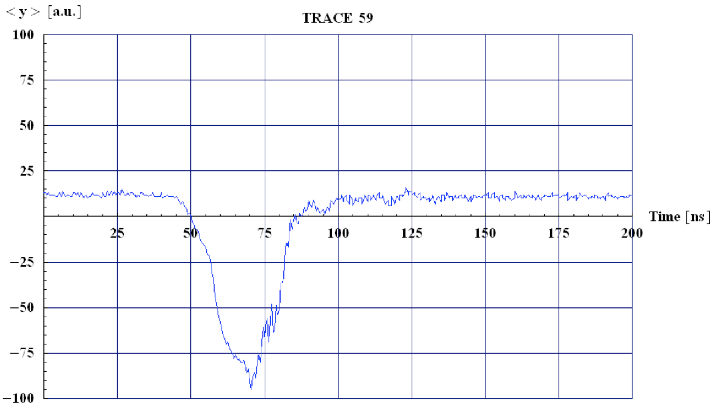
FAST (VERTICAL) SINGLE-BUNCH INSTABILITY (7/14)
=> Similar observation on other beams (e.g. below with the beam for the Antiproton Decelerator) when the longitudinal emittance is too small
Courtesy of Rende Steerenberg

Slide 25
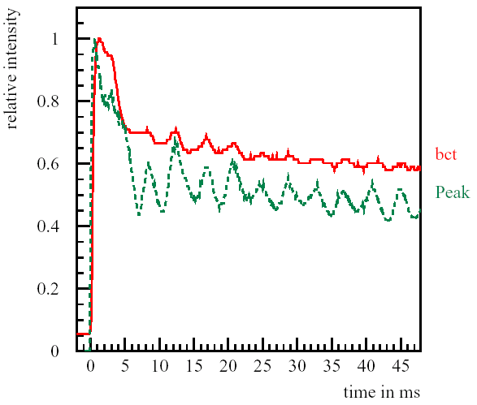
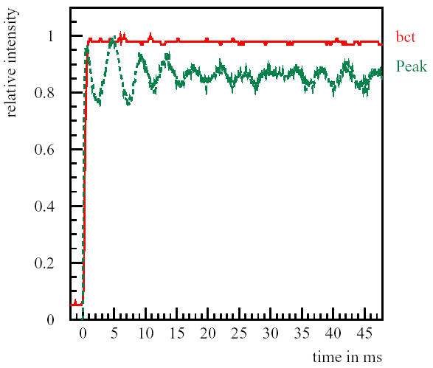
FAST (VERTICAL) SINGLE-BUNCH INSTABILITY (8/14)
In the SPS
Instability (initially)
suppressed by increasing
the chromaticity

Slide 26
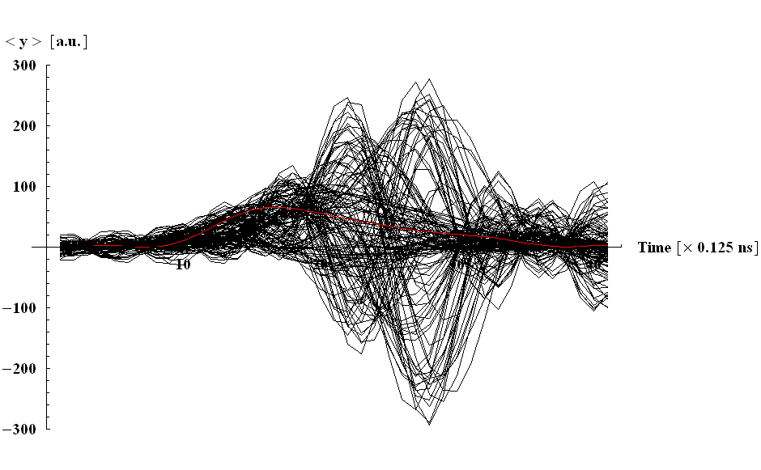

FAST (VERTICAL) SINGLE-BUNCH INSTABILITY (9/14)
⇒ Travelling-wave pattern along the bunch
Head
Tail
1st trace (in red) = turn 2
Last trace = turn 150
Every turn shown

Slide 27
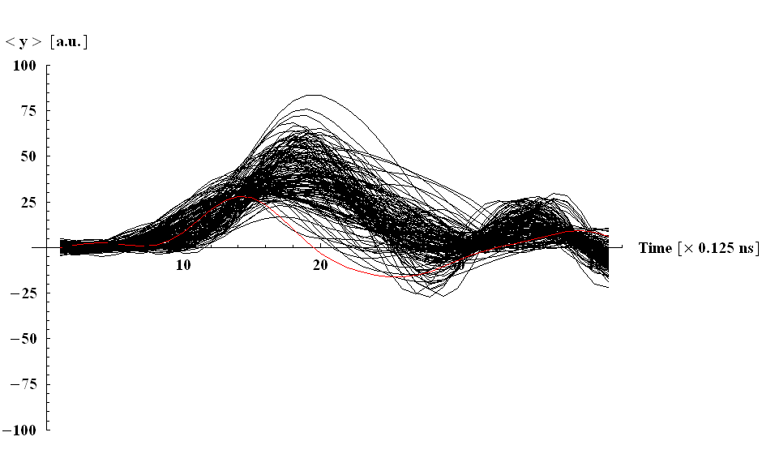

FAST (VERTICAL) SINGLE-BUNCH INSTABILITY (10/14)
1st trace (in red) = turn 2
Last trace = turn 150
Every turn shown

Slide 28
FAST (VERTICAL) SINGLE-BUNCH INSTABILITY (11/14)
γ_{t} was recently modified in the SPS to increase the TMCI intensity threshold above the foreseen intensities for the future upgrade
Simple rough estimate of γ_{t} for machines made of simple FODO cells:
  Approximating the machine radius by the bending radius, yields
  Inserting this in the definition of α_{p} (and then expressing γ_{t}) yields
    => If one wants to modify γ_{t}, (increase or decrease its value) one should modify the horizontal tune

Slide 29
FAST (VERTICAL) SINGLE-BUNCH INSTABILITY (12/14)
TMCI intensity threshold with the old (Q26) optics at injection: ~ 1.7 10¹¹ p/b
Predictions going from Q26 to the new (Q20) optics:
  Q26:
  Q20:
  => A gain of a factor 0.0362 / 0.0162 ≈ 2.2 in the intensity threshold was expected

Slide 30
FAST (VERTICAL) SINGLE-BUNCH INSTABILITY (13/14)
Gain of a factor
4.5 / 1.7 ≈ 2.6
Measurements
=> Good agreement with simple formula
Courtesy of Benoit Salvant et al.
Courtesy of Hannes Bartosik et al.

Slide 31
FAST (VERTICAL) SINGLE-BUNCH INSTABILITY (14/14)
Very good agreement between measurements and simulations
Courtesy of Hannes Bartosik et al.
=> Intensity threshold with the new (Q20) optics: ~ 4.5 10¹¹ p/b

Slide 32
CONCLUSION (1/2)
Stability of synchrotron motion (when crossing transition):
Head-Tail instability (when crossing transition): change the sign of the chromaticity (both planes) => Positive chromatic frequency
  Transverse Mode-Coupling Instability => With the 2 assumptions: i) Broad-Band impedance and ii) long-bunch regime (effects of space charge and transverse feedback still under discussion…)
  Impedance reduction
  Increase longitudinal emittance (as in the PS)
  Increase the |slip factor| (as in the SPS) and/or the tune
  Increase the chromatic frequency (below or above transition)
  “Chromaticity jump” when transition needs to be crossed => Not only the sign needs to be changed (for Head-Tail reason) but the shape could be optimised (for TMCI reason)

Slide 33
CONCLUSION (2/2)
Increasing the |slip factor| also helps for i) the Longitudinal Mode-Coupling Instability and ii) the fast single-bunch electron cloud instability
Attractive operation of synchrotrons under an isochronous or quasi-isochronous condition to (naturally) achieve very short bunches
=> Requires
    An accurate control of the first high-order component of the momentum compaction factor to provide the necessary momentum acceptance
    Effective ways to damp all the collective instabilities

Slide 34
REFERENCES
E. Métral and D. Möhl, Transition Crossing, Volume I of "Fifty years of the CERN Proton Synchrotron”, CERN–2011–004, June 2011, p. 59
(http://project-ps50.web.cern.ch/project-PS50/Document_proof/for-printer/cern2011-004.pdf)
and all the references therein
Detailed studies for the CERN PS => Sandra Aumon, High Intensity Beam Issues in the CERN PS, CERN-THESIS-2012-261
(http://cds.cern.ch/record/1517412/files/CERN-THESIS-2012-261_2.pdf).
Supervisor: Simone Gilardoni
Detailed studies for the CERN SPS => Hannes Bartosik, Beam Dynamics and Optics Studies for the LHC Injectors Upgrade, CERN-THESIS-2013-25
(http://cds.cern.ch/record/1644761/files/CERN-THESIS-2013-257.pdf).
Supervisor: Yannis Papaphilippou

