Slide 1
VMTSA measurements
February 1st 2012

Slide 2
Conditions
New shorter RF fingers.
Poor contact with the fingers.
Wedges at both ends to avoid bending due to the module’s own weight.
2 pieces of ferrite at each end of the module (4 in total)

Slide 3
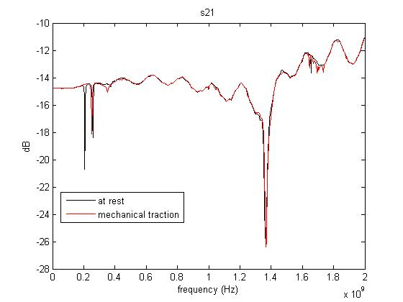
Resonances observed due to poor finger contact

Slide 4
First resonance (we see two)
Impedance
Dissipated power

Slide 5
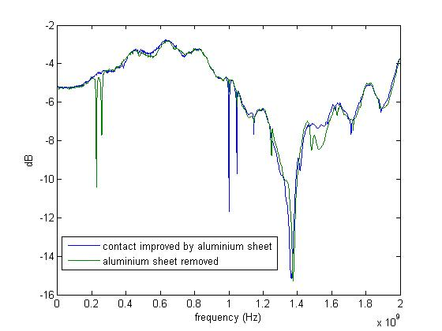
Finger contact improved by inserting an aluminum sheet

