Slide 1
VMTSA measurements
December 2011-January 2012

Slide 2
Warning
From the beginning we worked on the front side of the DUT, ignoring what was on the back side. Only last week, I realized that the back side was actually empty and that it should not have been the case. However it is not clear whether the back side was empty from the start. I hope that we can find out from the measurements…

Slide 3
Antenna measurements
VMTSA measurements

Slide 4
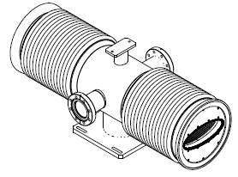
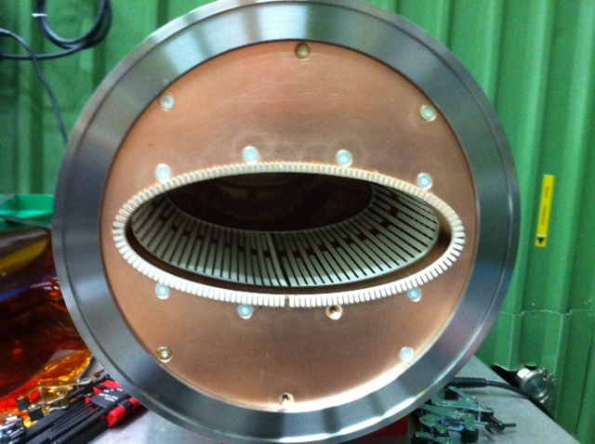
Antenna measurement setup
center
Back face
Front face
center
close-to-the-center
far-from-the-center
close-to-the-center
far-from-the-center

Slide 5
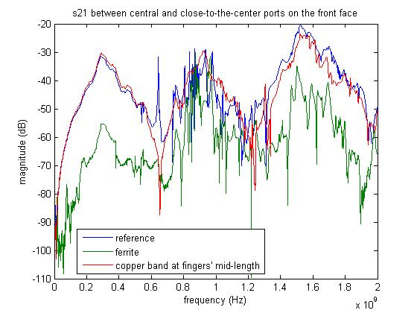
Antenna measurements 7.12.2011

Slide 6
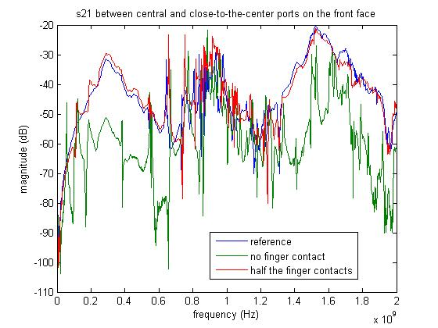
Antenna measurements 7.12.2011

Slide 7
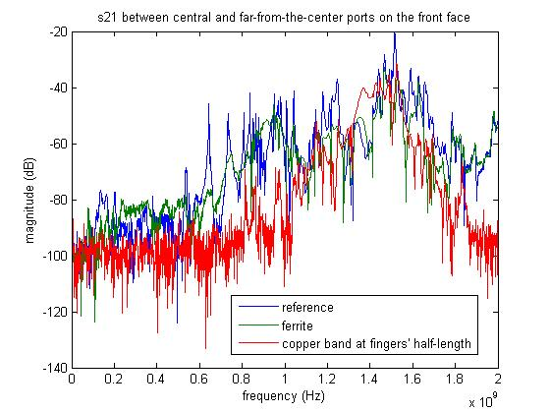
Antenna measurements 7.12.2011

Slide 8
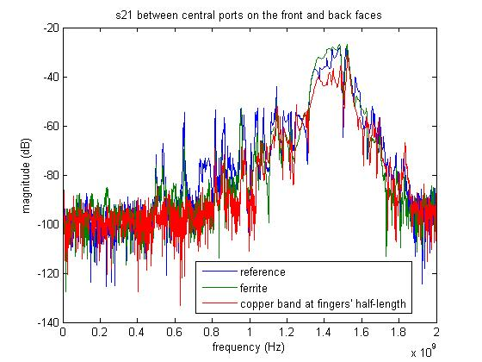
Antenna measurements 7.12.2011

Slide 9
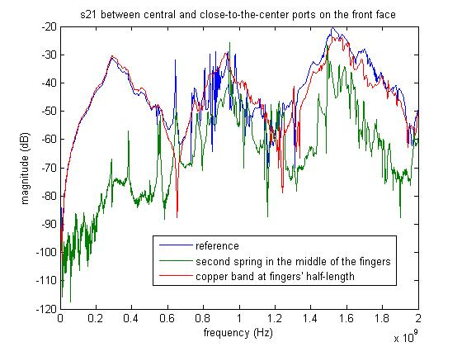
Antenna measurements 7.12.2011

Slide 10
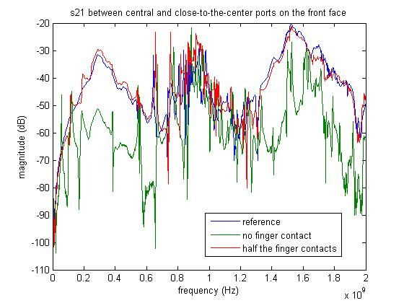
Antenna measurements 9.12.2011

Slide 11
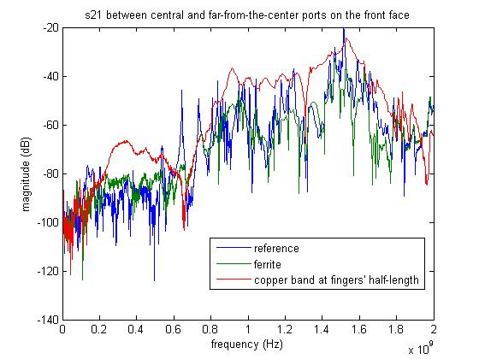
Antenna measurements 9.12.2011

Slide 12
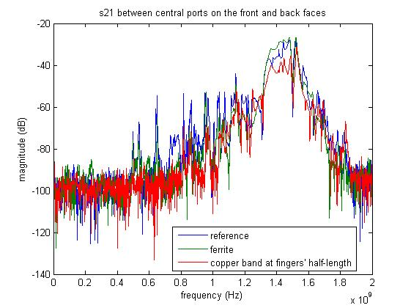
Antenna measurements 9.12.2011

Slide 13
Antenna measurements 9.12.2011

Slide 14
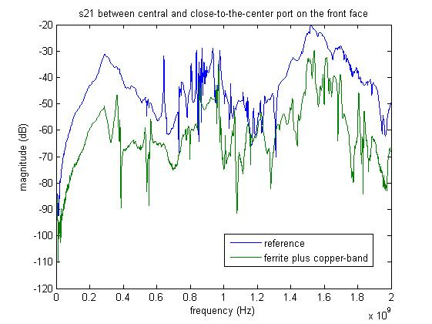
Antenna measurements 9.12.2011

Slide 15
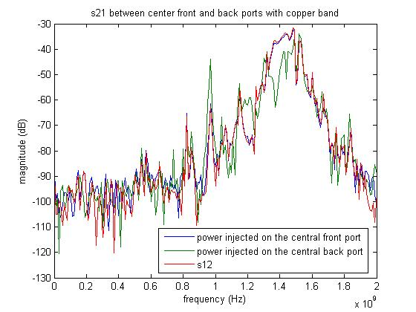
Antenna measurements 9.12.2011

Slide 16
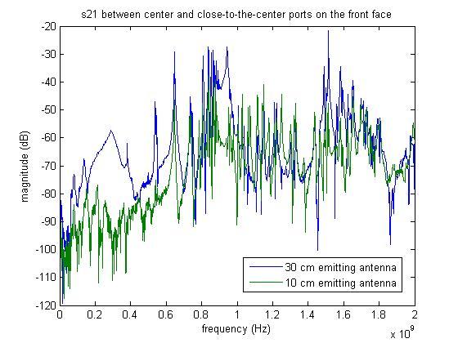
Antenna measurements 9.12.2011

Slide 17
wire measurements
VMTSA measurements

Slide 18
Conditions 12.12.2011
220 ohms matching resistors at both ends.
Copper band at 1/3-2/3 of the finger length.
After the measurements, last week, I realized that the back side of the DUT had been empty and that it should not have been the case.

Slide 19
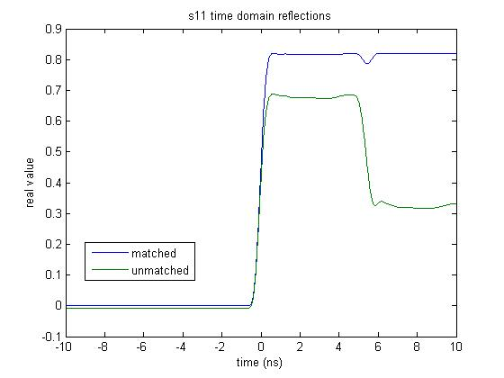
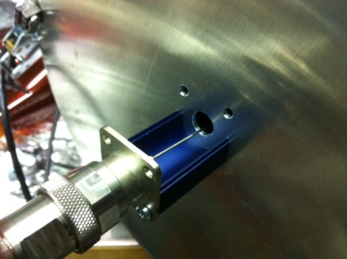
Wire measurements 12.12.2011

Slide 20
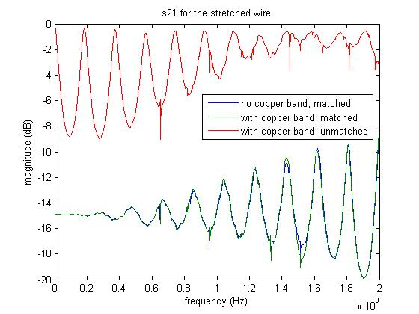
Wire measurements 12.12.2011

Slide 21
Conditions 13.01.2012
220 ohms matching resistor at only one end.
RF fingers on the back side of the DUT.

Slide 22
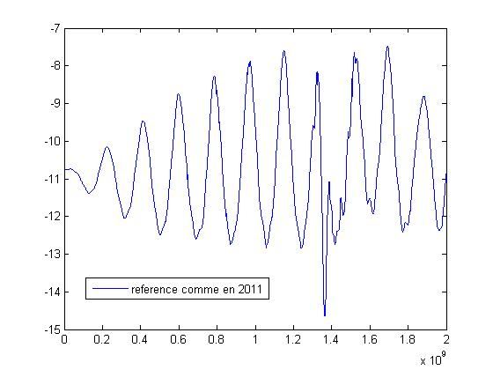
Wire measurements 13.01.2012

Slide 23
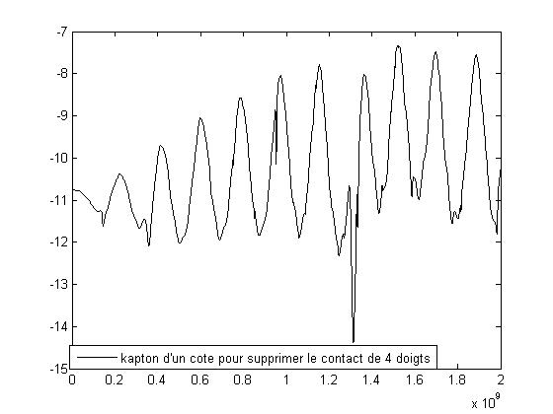
Wire measurements 13.01.2012

Slide 24
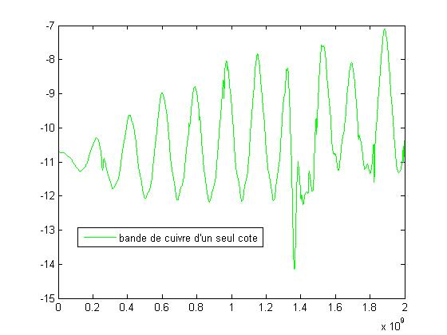
Wire measurements 13.01.2012

Slide 25
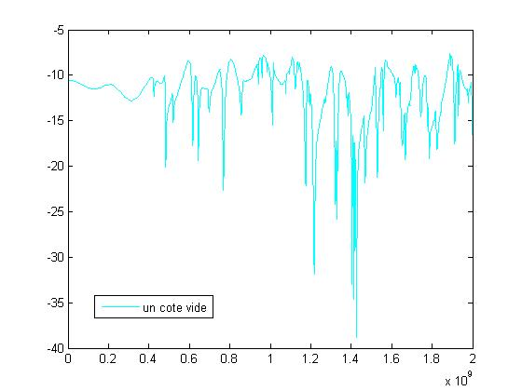
Wire measurements 13.01.2012

