Slide 1
VMTSA bench measurements
February 9th 2012

Slide 2
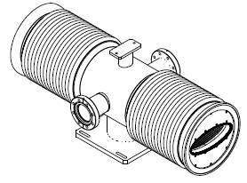
Measurement conditions
Use two moveable supports to exert a vertical upward force to straighten the bellows or let them bend due to their own weight.

Slide 3
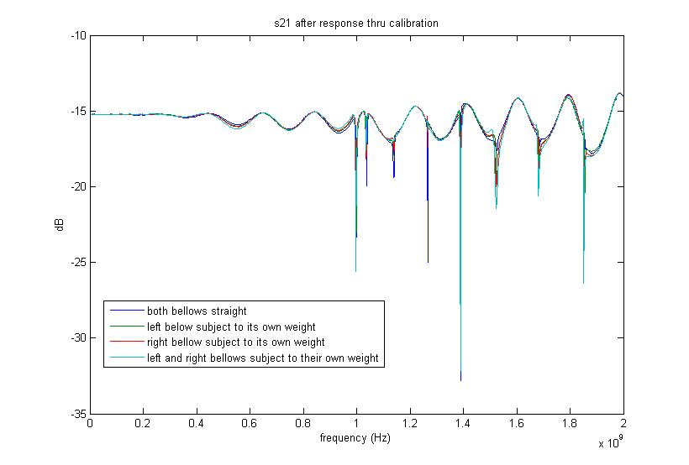
09.02.2012 resonance peaks evolution as we straighten the bellows (1/3)
Peaks’ amplitudes vary by random increments as we straighten the bellows

Slide 4
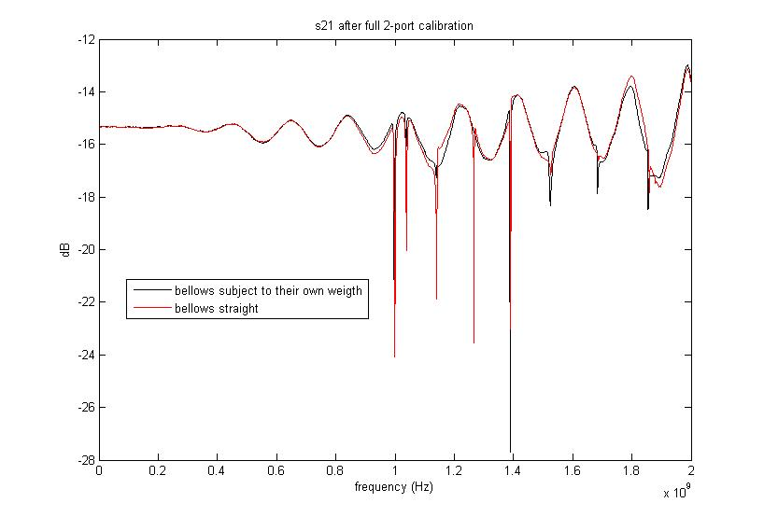
09.02.2012 resonance peaks evolution as we straighten the bellows (2/3)

Slide 5
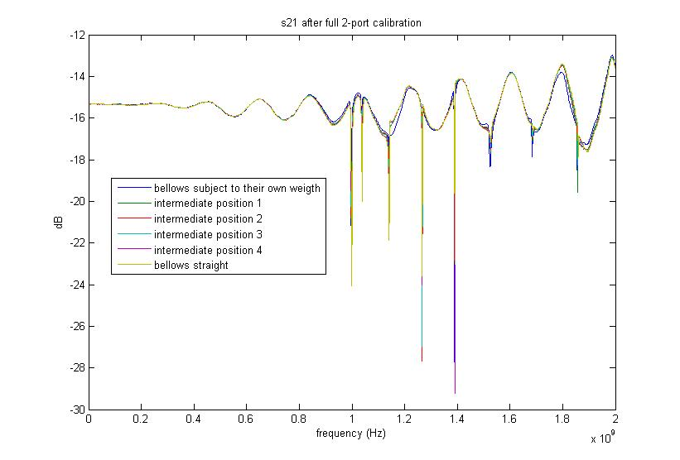
09.02.2012 resonance peaks evolution as we straighten the bellows (3/3)

Slide 6
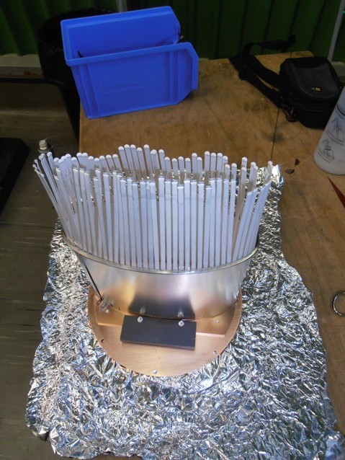

Slide 7
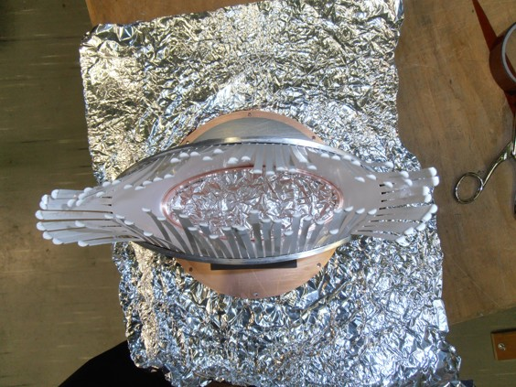

Slide 8
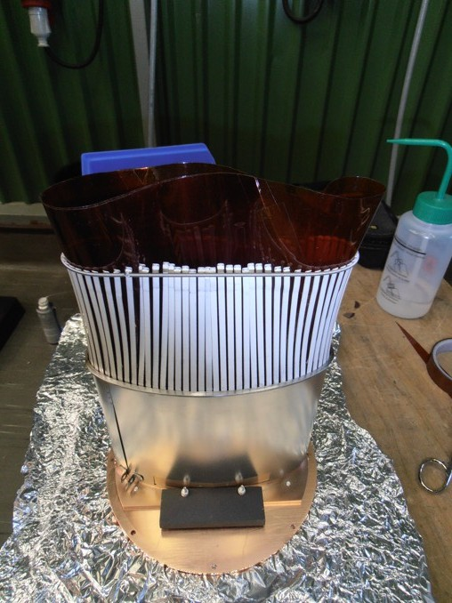

Slide 9
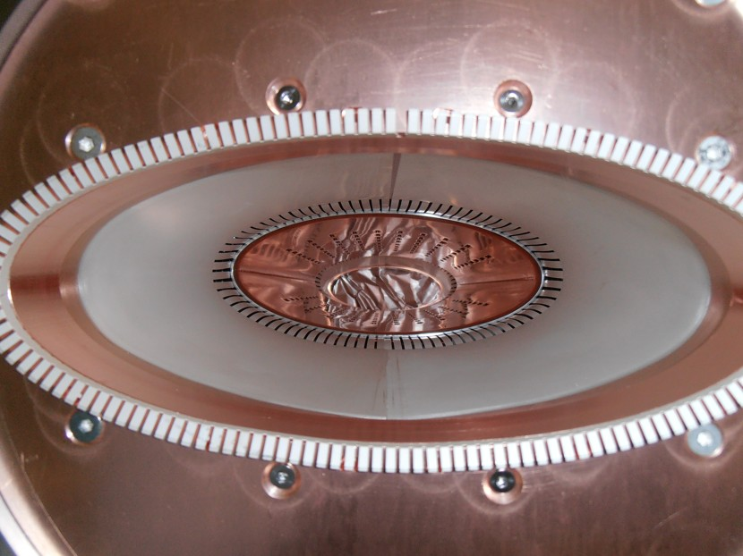

Slide 10
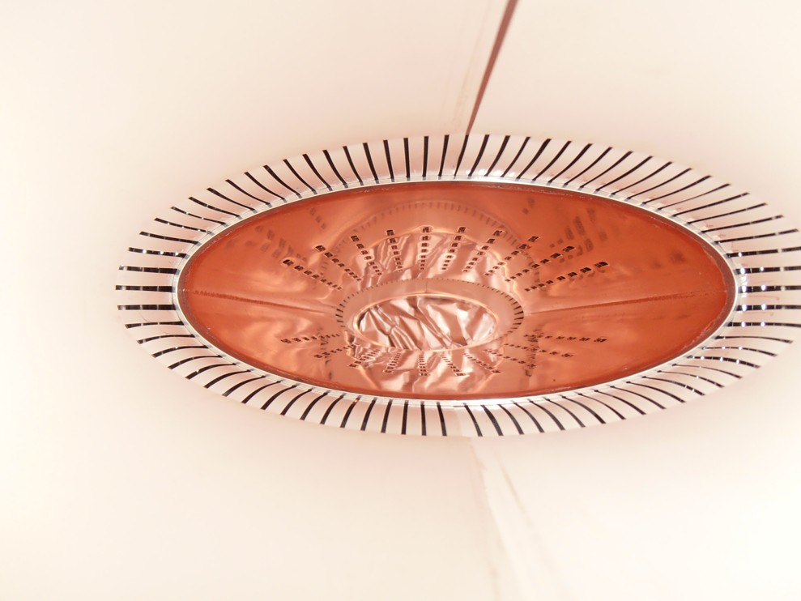

Slide 11
