Slide 1
VMTSA bench measurements
February 13th 2012

Slide 2
Conditions
New short RF fingers
2 modules of ferrite fixed to each end plate
Additional ferrite blocks
Present: Elias, Jean-Luc, Bernard Henrist, Fritz, Vincent Baglin.

Slide 3
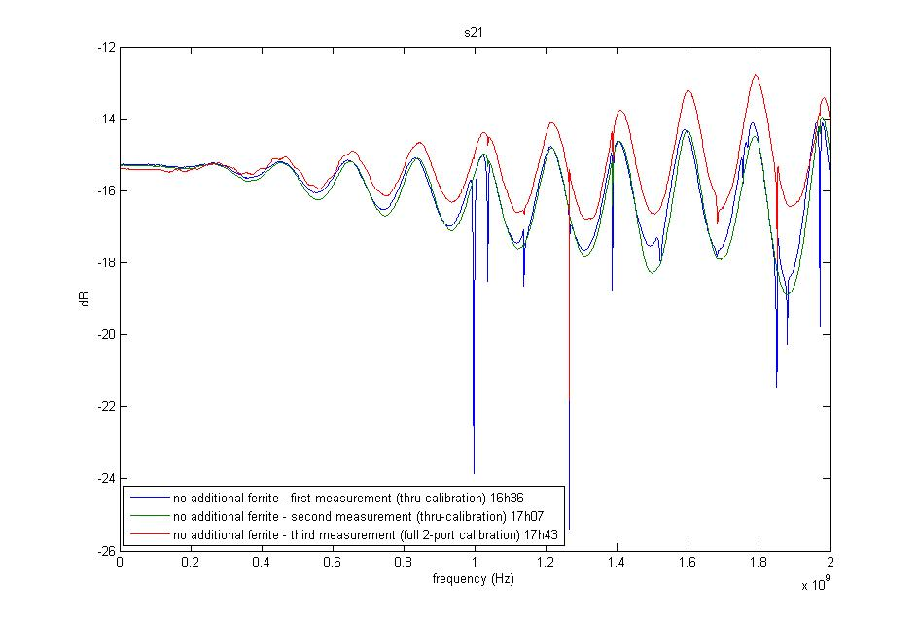
13.02.2012 no ferrites

Slide 4
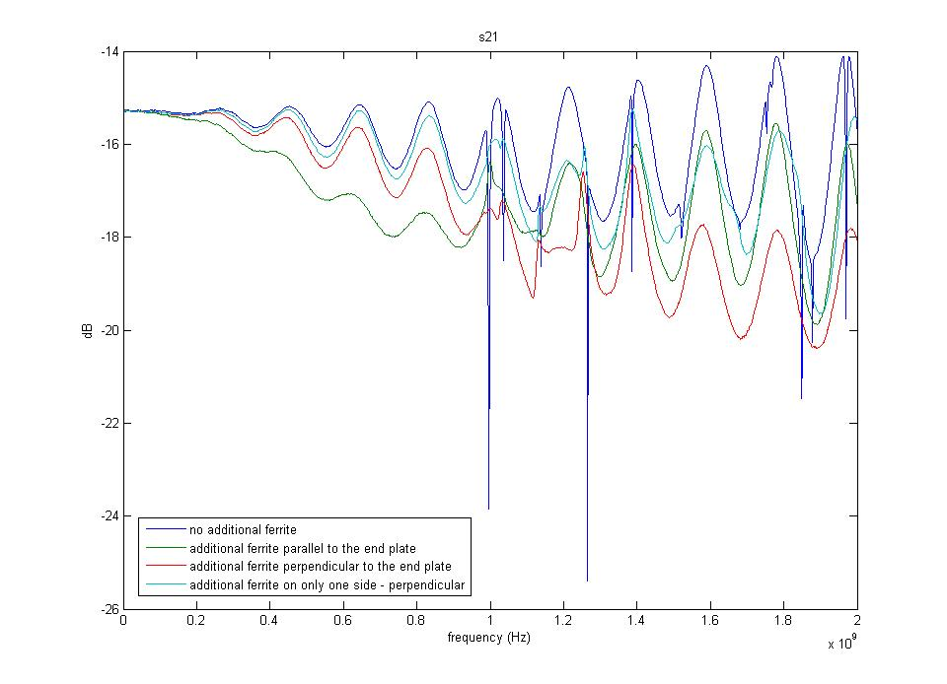
13.02.2012 effect of adding ferrites

Slide 5
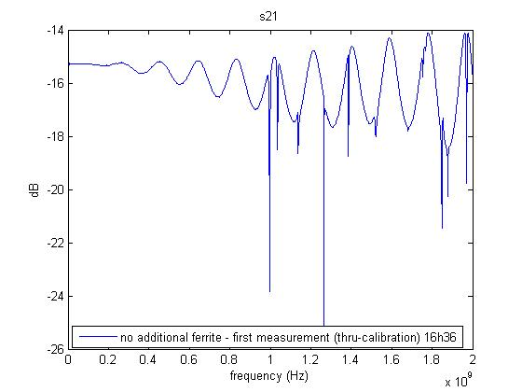
13.02.2012

Slide 6
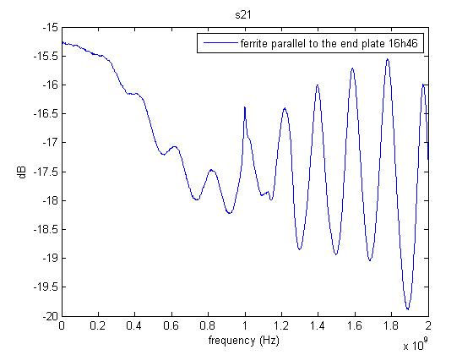
13.02.2012

Slide 7
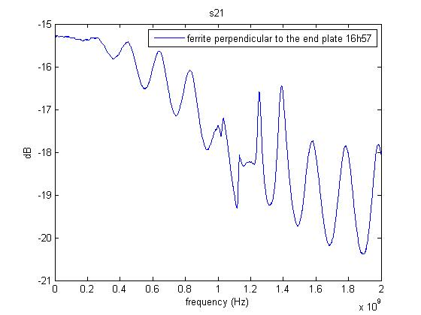
13.02.2012

Slide 8
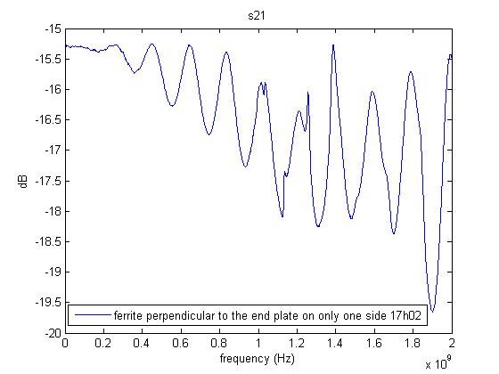
13.02.2012

Slide 9
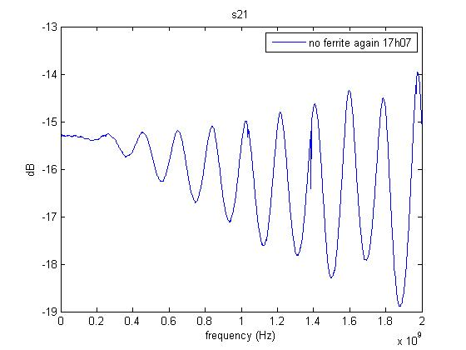
13.02.2012

Slide 10
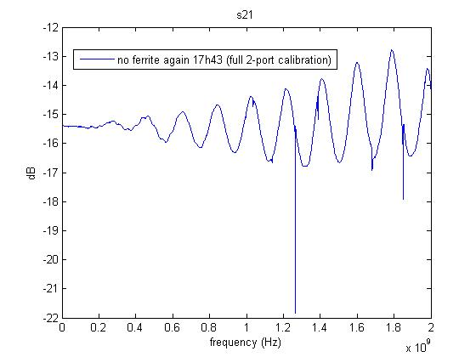
13.02.2012

Slide 11
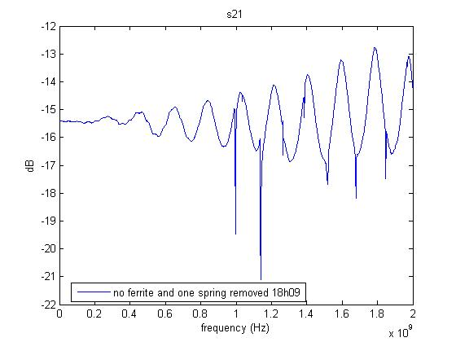
13.02.2012

