Slide 1
Ferrite outgassing results G. Cattenoz CWG 01-10-2012 Vincent Baglin, Giulia Lanza, Giuseppe Bregliozzi.

Slide 2
OUTLINE
Vacuum baseline for LHC
Overview of vacuum validation test
TCTP new features
Thermal outgassing results of ferrites
Estimated outgassing flow of a TCTP collimator
Conclusion

Slide 3
Vacuum baseline for LHC
“Vacuum requirements for the LHC Collimators”, M. Jimenez, EDMS 428155
UHV cleaned according to CERN specification
Thermal treatment/vacuum firing of material (ex ferrite, CFC, tungsten)
Material to follow bake out at 250°C for 24h00 (48h00 for collimator)
Specific material outgassing flow rate ≈ 10⁻¹² mbar.l/(s.cm²).
Maximum outgassed flow of one collimator 1∙10⁻⁷ mbar.l/s

Slide 4
Overview of vacuum validation test of ferrite
Ferrite type TT2-111R (Supplier: Skyworks) thermally treated under:
Air furnace at 400°C for 24h00 and
Vacuum furnace at 400°C for 24h00.
Vacuum test cycle carried out:
250°C under vacuum for 24h00 + RGA analysis + ultimate pressure record for total N2 equivalent outgassed flow measure by conductance method.
Extended thermal study:
Measure of outgassing flow by accumulation, from R.T. to 250°C.

Slide 5
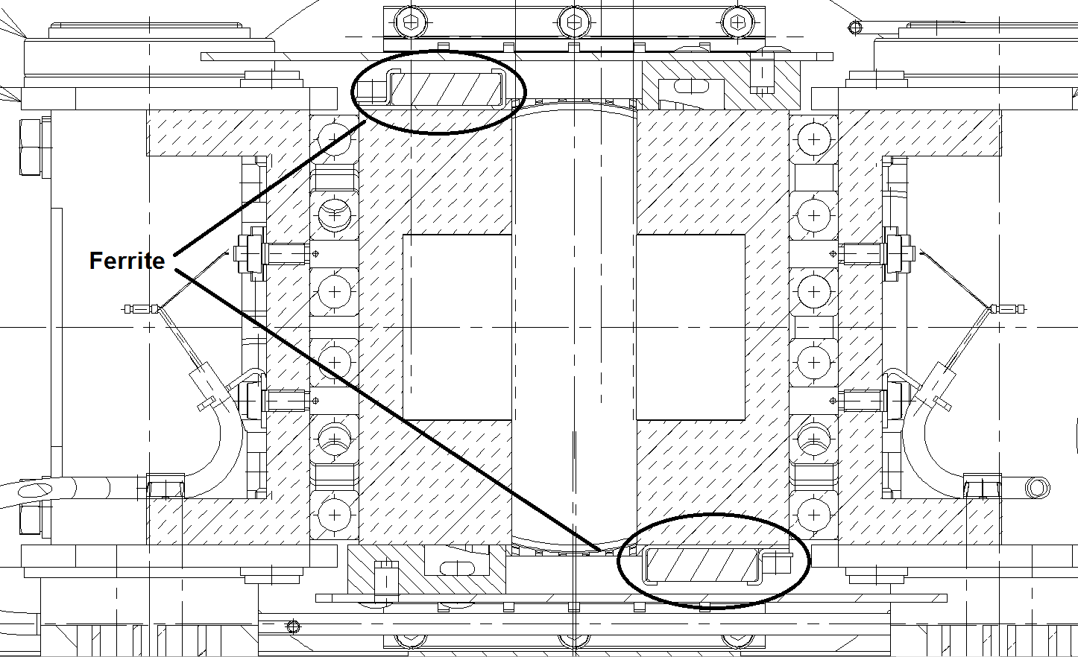
Noticeable TCTP features: New RF system
Cross cut of a TCTP collimator:
Total surface of ferrite per collimator = 1600 cm²
BEAM

Slide 6
Noticeable TCTP features: New tungsten
Tungsten is the constitutive material of the TCTP jaw.
Total surface per TCTP collimator = 2300 cm²
Chosen supplier: MG Sanders Ltd, type DENSAMET® WH9570C .
Outgassing rate results (EDMS 1238270) : 1∙10⁻¹² mbar.l/(s.cm²)
➔ Match with the LHC vacuum specification

Slide 7
Ferrite outgassing results

Slide 8
Outgassing results – closed up
250°C
200°C
150°C
100°C
50°C
R.T.
➔Factor 10 gain in outgassing rate for 100°C temperature increase

Slide 9
Scaled to TCTP collimator
Estimated outgassing flow for 1 TCTP collimator:
➔1600 cm² of ferrite ≈ 8∙10⁻⁸ mbar.l/s
➔2300 cm² of tungsten ≈ 2∙10⁻⁹ mbar.l/s
➔5000 cm² of stainless steel ≈ 1∙10⁻⁸ mbar.l/s
Total : 9∙10⁻⁸ mbar.l/s ➔ Close to LHC vacuum specification limit of 1∙10⁻⁷ mbar.l/s

Slide 10
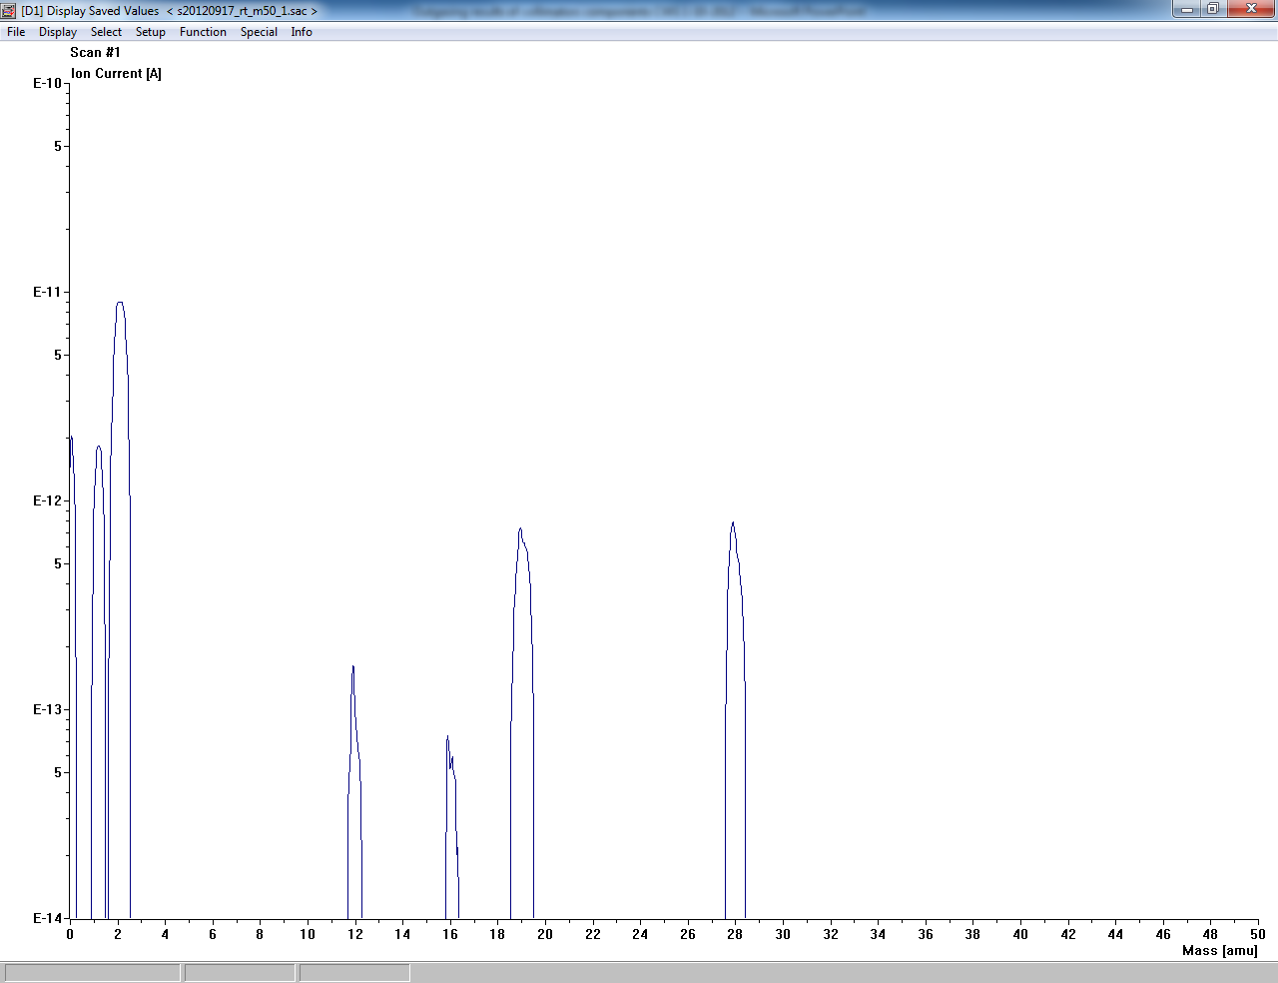
Outgassing results – Residual Gas Analysis
RGA scan of ferrite TT2-111R, 48h after bake out, SEM 1400V
No contamination visible up to mass 100

Slide 11
Conclusion
Estimated outgassing flow of one TCTP collimator (9∙10⁻⁸ mbar.l/s) is already very close to specified limit (1∙10⁻⁷ mbar.l/s)
Should temperature increases from RT to 50°C, outgassed flow is doubled.
Should temperature increases from 50°C to 100°C, outgassed flow increase by factor 10.
RGA analysis shows no contamination
➔The present solution does not present any safety margin in order to remain within the LHC vacuum specification should the ferrite temperature increase.
VSC proposal: Vacuum test of ferrite with increased thermal treatment temperature.

