Slide 1
RF Contacts in LHC Beam Instrumentation
Ray Veness
With help and input from
G.Burtin, S.Burger, M.Hamani, R.Jones, M.Sapinski, C.Vuitton,

Slide 2
Some Assumptions
Scope
Only considering the circulating rings of the LHC
Only equipment designed and/or provided by BI
Try, for completeness, to include both mobile and static contacts

Slide 3
Mobile (sliding) contacts

Slide 4
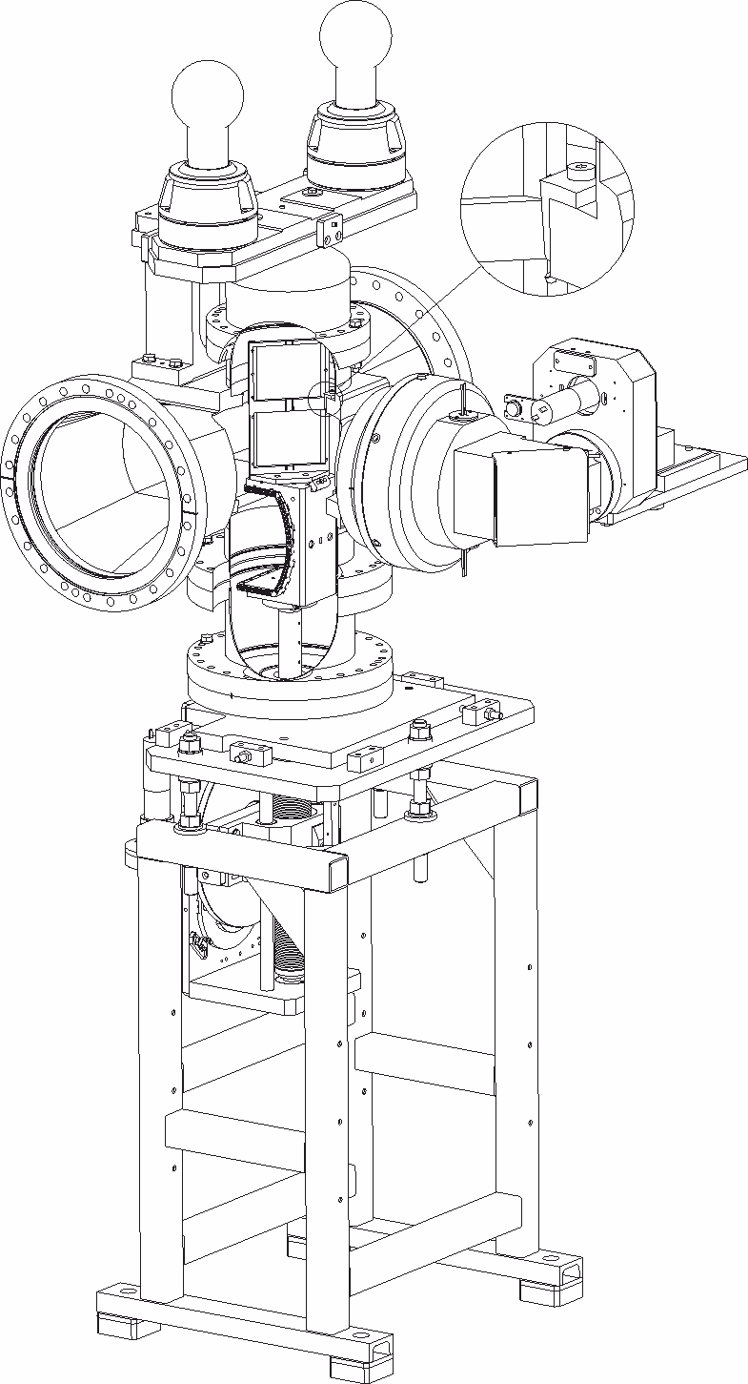
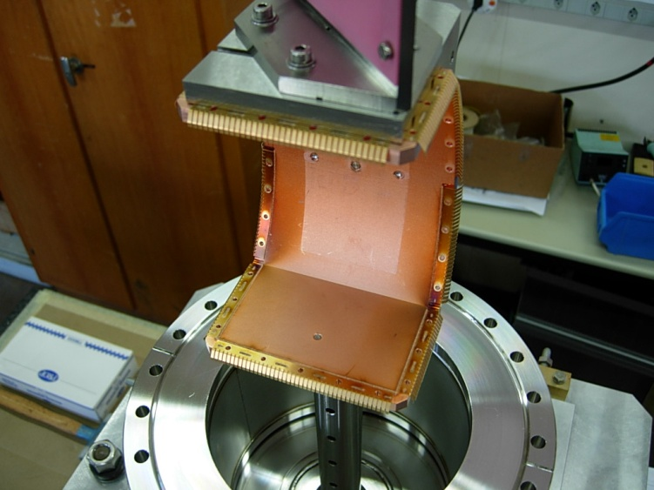
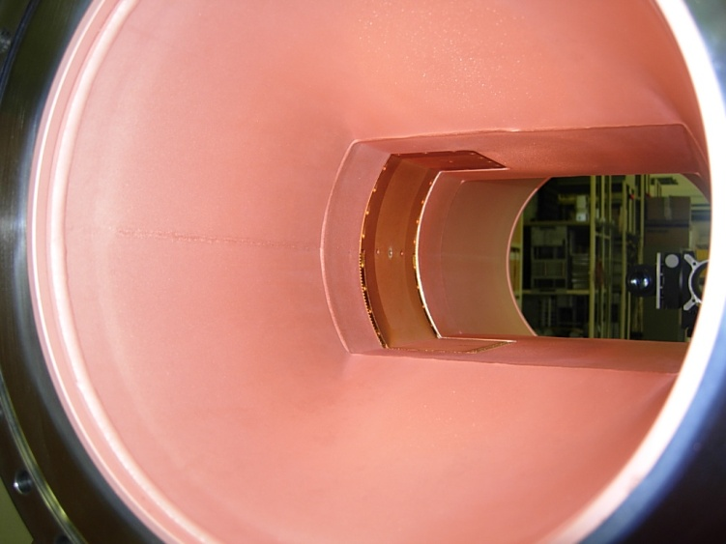
BTVST (BTVSS, BTVSE)
From drawing: LHC BTVST 0001

Slide 5
BTV (Double Beam)
DCUM Ring End (m) | Monitor Name | DC | Drawing Reference
3140.1560 | BTVSS B1E | C6L2 | LHCBTVSS0001
3247.2200 | BTVST B1E | AL2 | LHCBTVST0001
16617.4700 | BTVSE B1E | AL6 | LHCBTVSE0001
16706.6200 | BTVSE B2I | AR6 | LHCBTVSE0001
23401.0300 | BTVST B2E | AR8 | LHCBTVST0001
23507.8500 | BTVSS B2E | C6R8 | LHCBTVSS0001
23401.0300 | BTVST B2E | AR8 | LHCBTVST0001

Slide 7
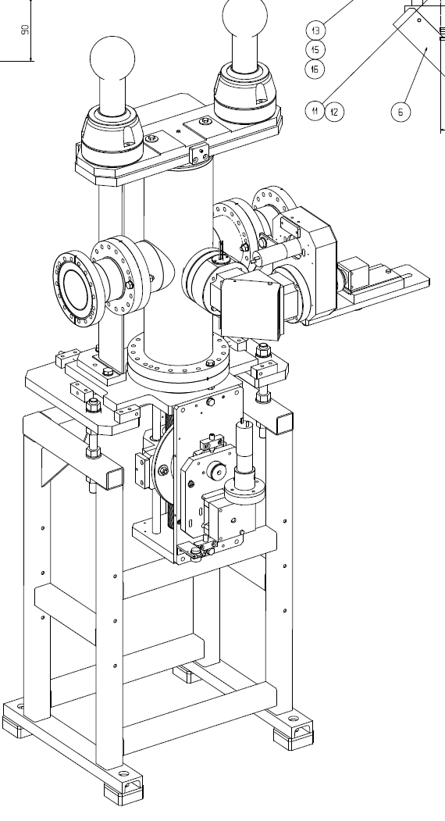
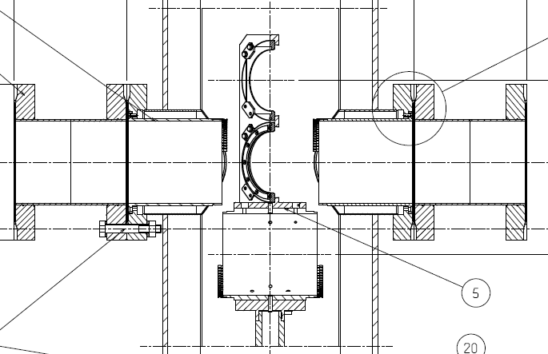
BTVSI (BTVM)

Slide 8
BTV (Single Beam)
DCUM Ring End (m) | Monitor Name | DC | Drawing Reference
3169.3400 | BTVSI B1E | C5L2 | LHCBTVSI0001
3186.6760 | BTVSI B1E | C5L2 | LHCBTVSI0001
6425.1100 | BTVM B2E | C7L3 | LHCBTVSI0001
6444.8500 | BTVM B1I | C7L3 | LHCBTVSI0001
9848.4600 | BTVM B1I | C6L4 | LHCBTVSI0001
9849.1600 | BTVM B2E | C6R4 | LHCBTVSI0001
20230.2500 | BTVSM B2I | AR7 | LHCBTVSI0001
23460.9800 | BTVSI B2E | C5R8 | LHCBTVSI0001
23478.8200 | BTVSI B2E | C5R8 | LHCBTVSI0001

Slide 9
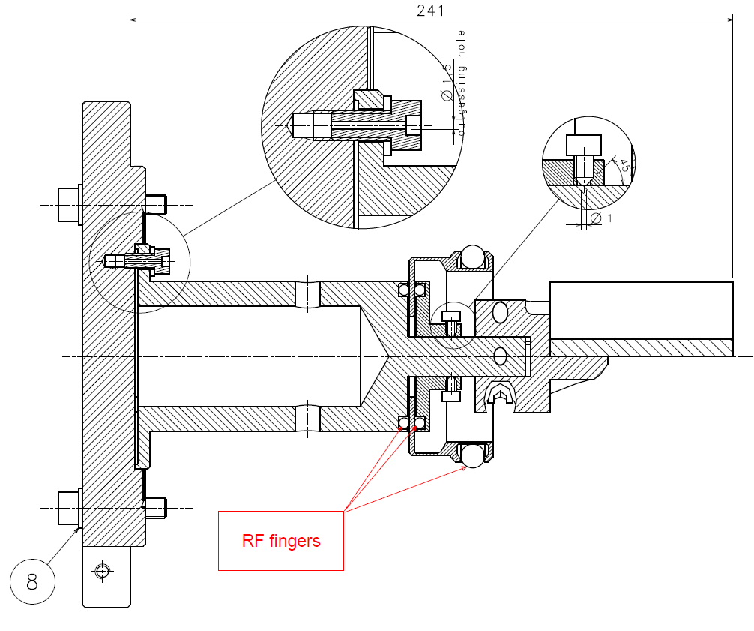
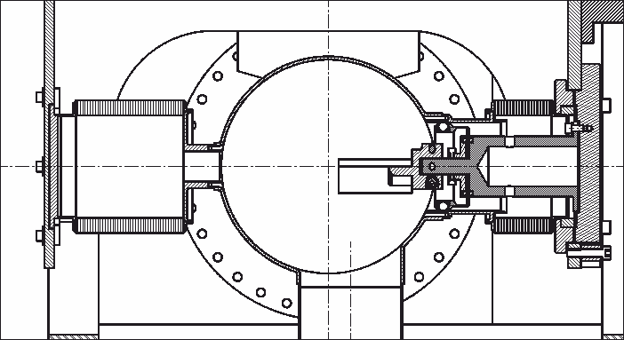
BSRTM
DCUM Ring End (m) | Monitor Name | DC | Drawing Reference
9924.3002 | BSRTM B2E | C5L4 | LHCBSRTM0054
10070.4622 | BSRTM B1I | C5R4 | LHCBSRTM0054
From LHC BSRTM 0059

Slide 10
Static Contacts

Slide 11
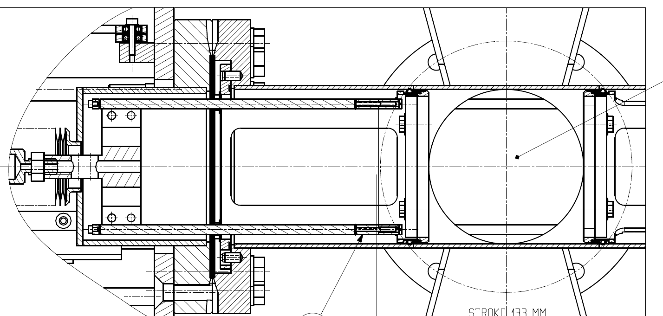
Wire Scanner (BWS)
DCUM Ring End (m) | Monitor Name | DC | Drawing Reference
9912.7052 | BWS | C5L4 | LHCBWS__0027
10082.4572 | BWS | C5R4 | LHCBWS__0027

Slide 12
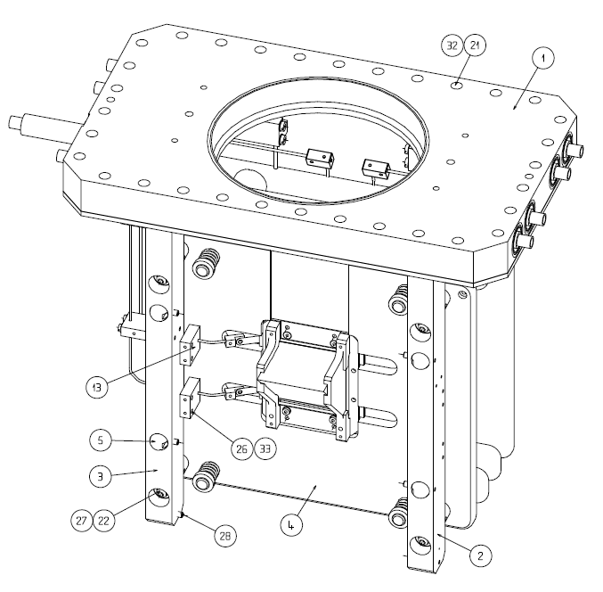
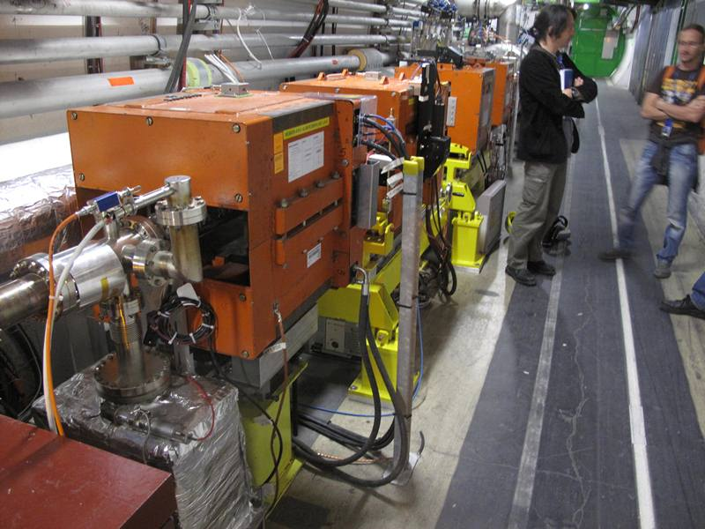
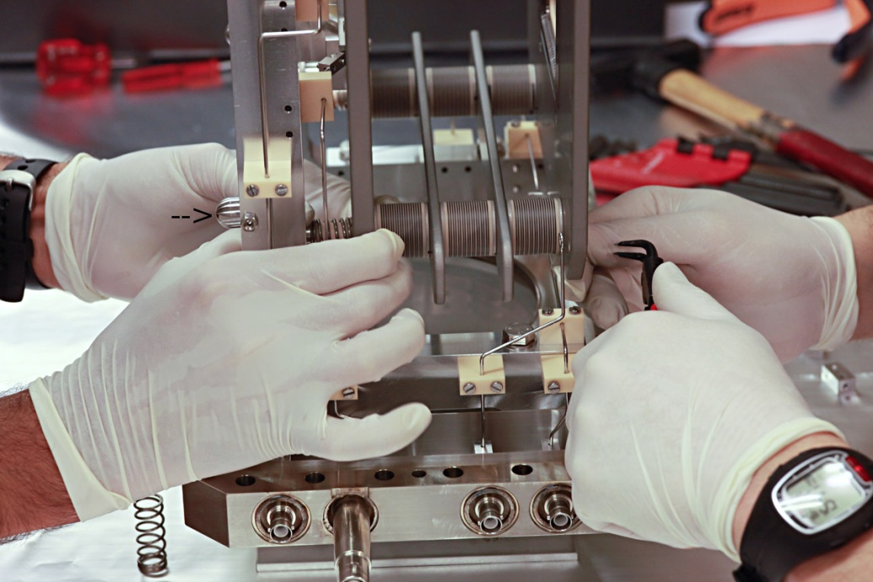
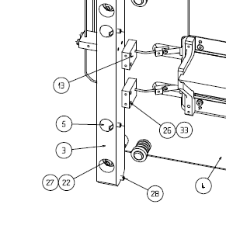
BGI Monitor

Slide 13
BGIH, BGIV
DCUM Ring End (m) | Monitor Name | DC | Drawing Reference
9933.8652 | BGIH | C5L4 | LHCBGIH_0001
10061.8972 | BGIH | C5R4 | LHCBGIH_0001
9935.6652 | BGIV | C5L4 | LHCBGIV_0001
10060.0972 | BGIV | C5R4 | LHCBGIV_0001

Slide 14
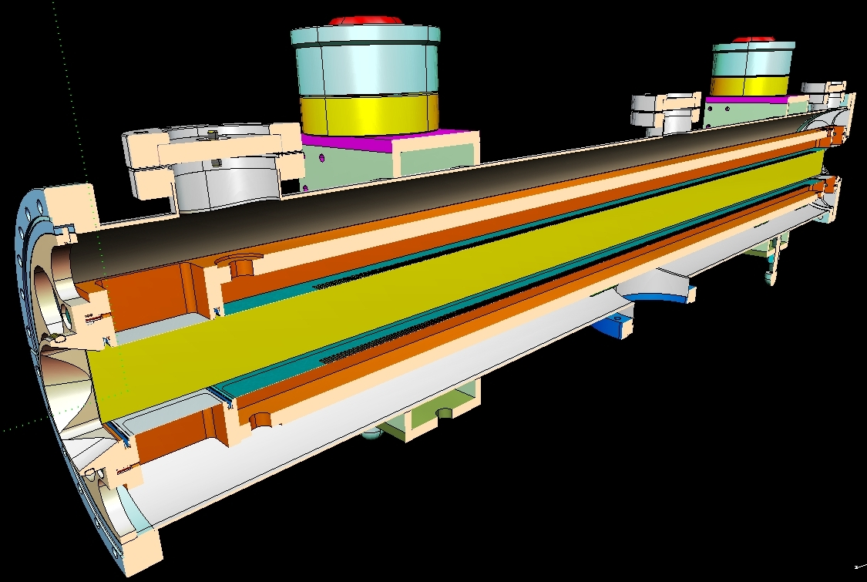
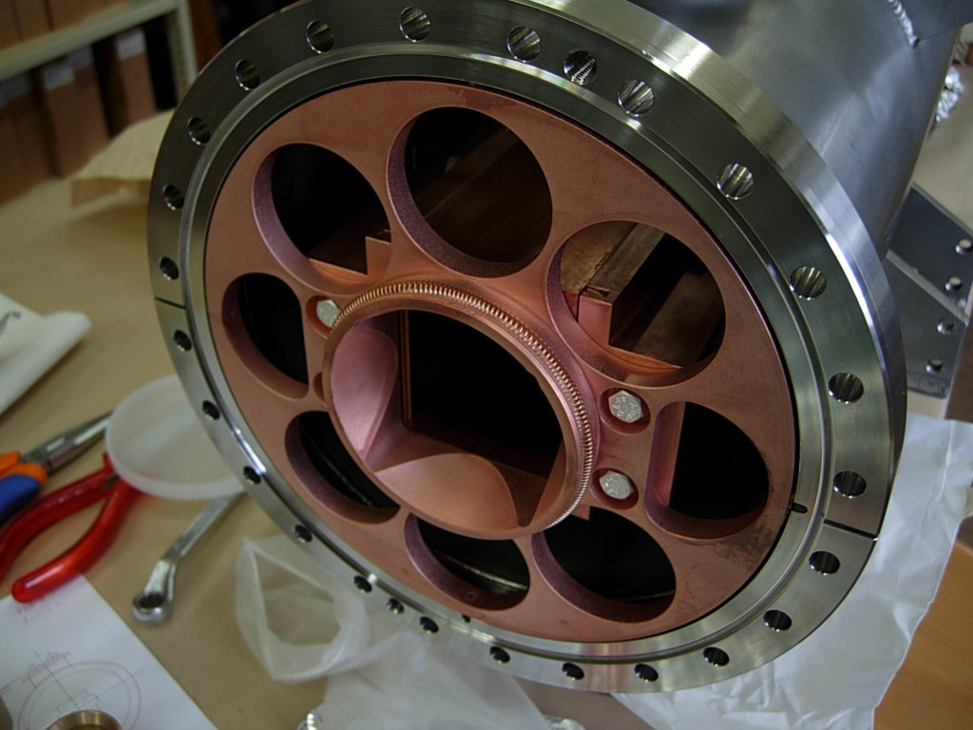
Schottky Monitor

Slide 15
Summary
Monitors with moving RF contacts
18 monitors
3 different design concepts
Monitors with Static RF contacts
~ 12 monitors
3 different design concepts
Currently observed issues
(Mechanical?) problems with BTVST-type design
(Heating) problem with BSRT mirror-type design

Slide 16
Extra Material

