Slide 1
Beam-beam deflection during Van der Meer scans
T. Pieloni for the BB team with W. Kozanecki
Acknowledgments: X. Buffat, D. Banfi, W. Herr, G. Iadarola, K. Lee, R. Tomas

Slide 2
Luminosity Basics
μ_{vis} = ε∗μ = Mean number of interactions per Bunch crossing seen by detector
Mean number of inelastic
interactions per Bunch crossing
Inelastic cross section
(unknown)
Cross section seen by detector
σ_{vis} is determined in dedicated fills based on beam parameters
W. Kozanecki
Ref. S. Van der Meer, “Calibration of the Effective Beam Height in the ISR”
CERN-ISR-PO-68-31, 1968.

Slide 3
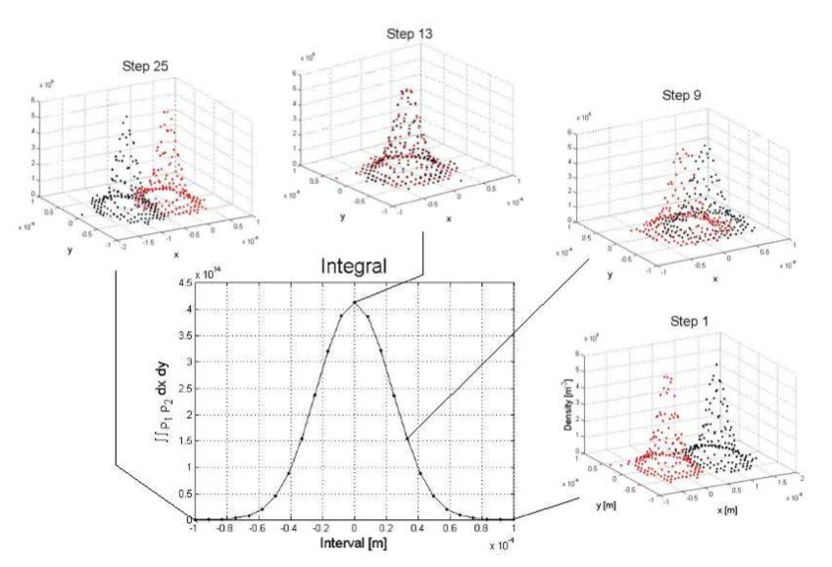
Van der Meer Scans
Luminosity in terms of beam densities ρ₁ and ρ₂ in machine:
Luminosity in general
Gaussian beams and uncorrelated x & y components no crossing angle:

Slide 4
Calibrating σ_{vis} during van der Meer Scans
Gaussian fit of Lumi scans to extrapolate
μ_{vis}^{Max} and Σ_{x}
μ_{vis}^{Max}
Measured in VdM scan
Detector
independent
Σ_{x}
Measured by beam instrumentation
Detector
dependent
W. Kozanecki

Slide 5
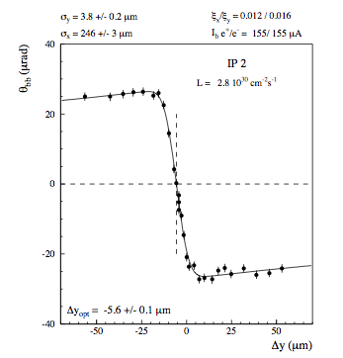
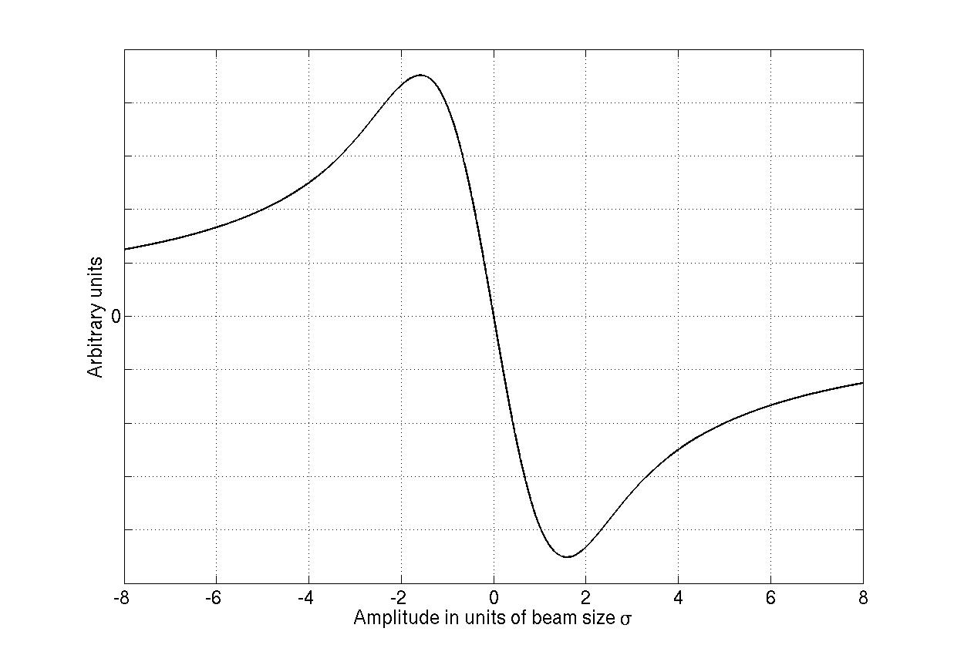
Van der Meer scans and Beam-beam
Beam-Beam force
Beam-beam angular kick:
Ref. M. Venturini and W. Kozanecki, SLAC-PUB-8700
J. Wenninger, SL Note 96-01 (OP)

Slide 6
Beam-Beam deflection angles and orbit in the LHC: model for round and non-round beams
Deflections:
Bassetti-Erskine formula:
Closed Orbit effect:

Slide 7
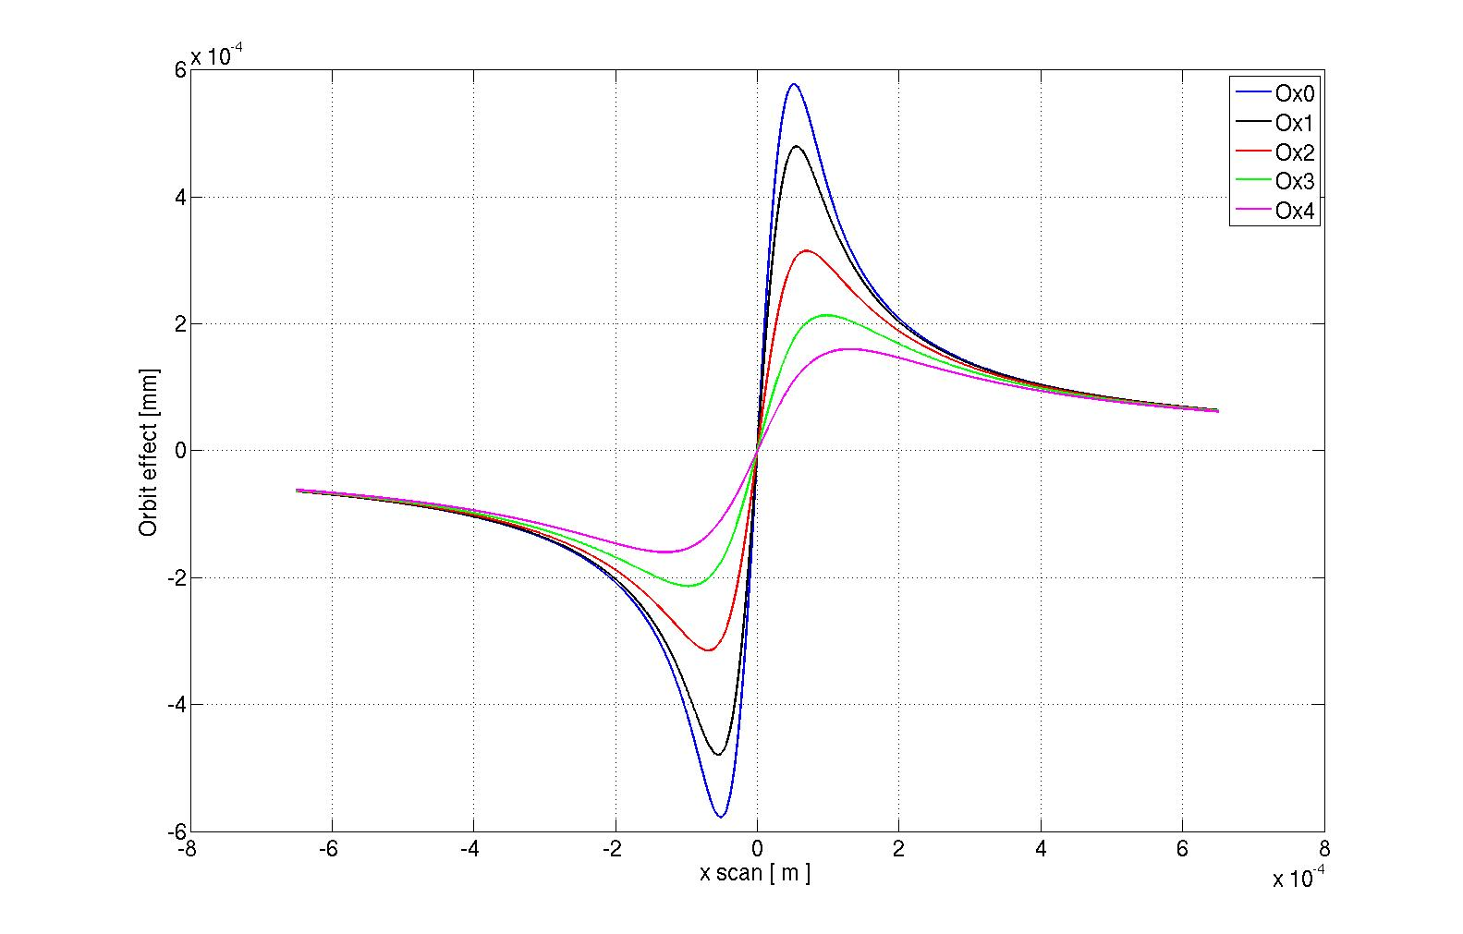
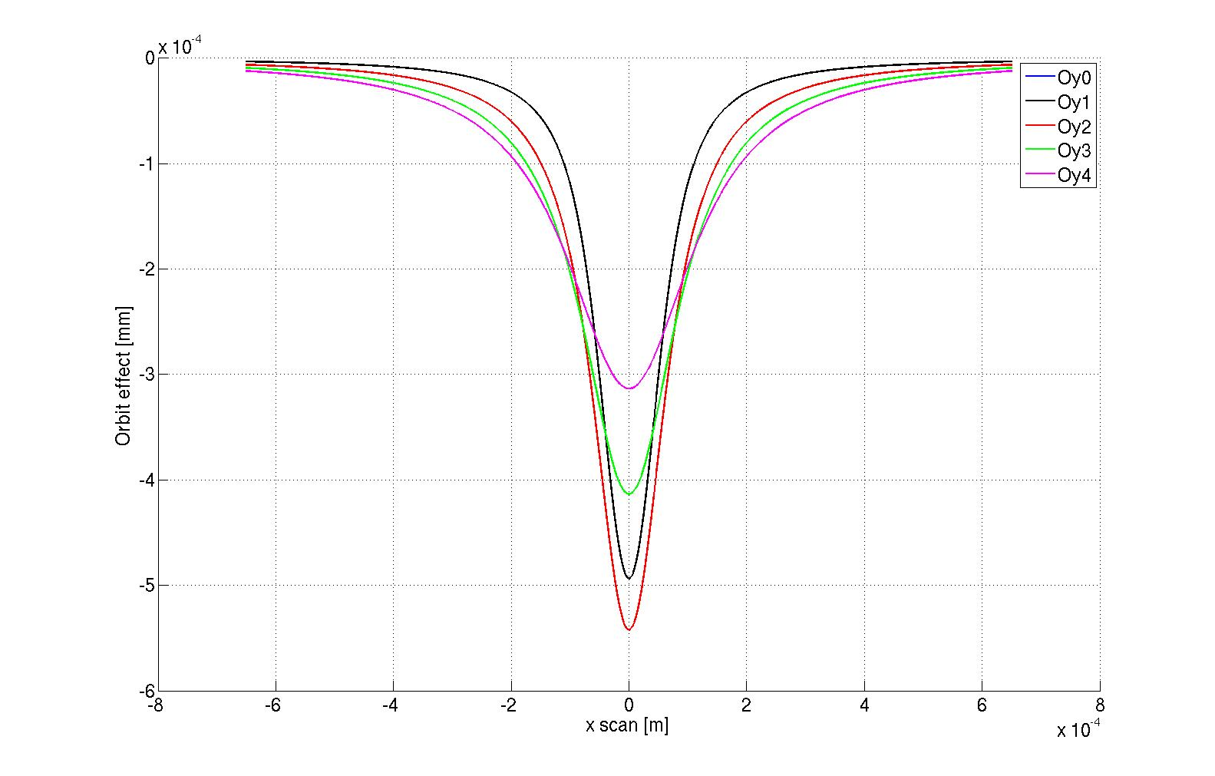
Beam-beam deflection during VdM Scans:
Analytical calculations using round Gaussian beams
X-plane
Y-plane
Analytical estimates
Angular kicks less than μrad depends on separation and offset in non scan plane
Orbit effects less than μm
In both planes if offsets scan

Slide 8
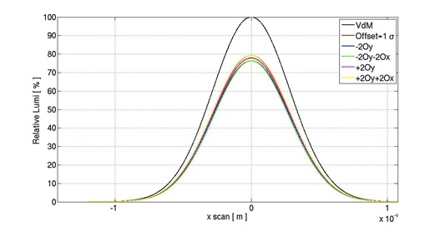
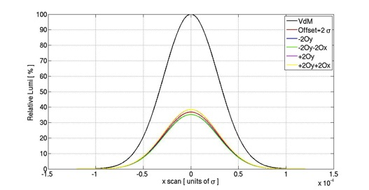
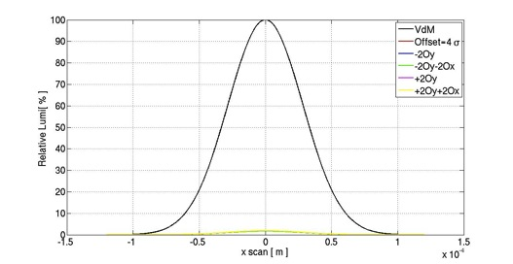
Impact on Luminosity measurements:
Analytical calculations using round Gaussian beams 1 IP
1 σ offset
2 σ offset
4 σ offset
Orbit effect small but impact on luminosity high precision measurements not negligible

Slide 9
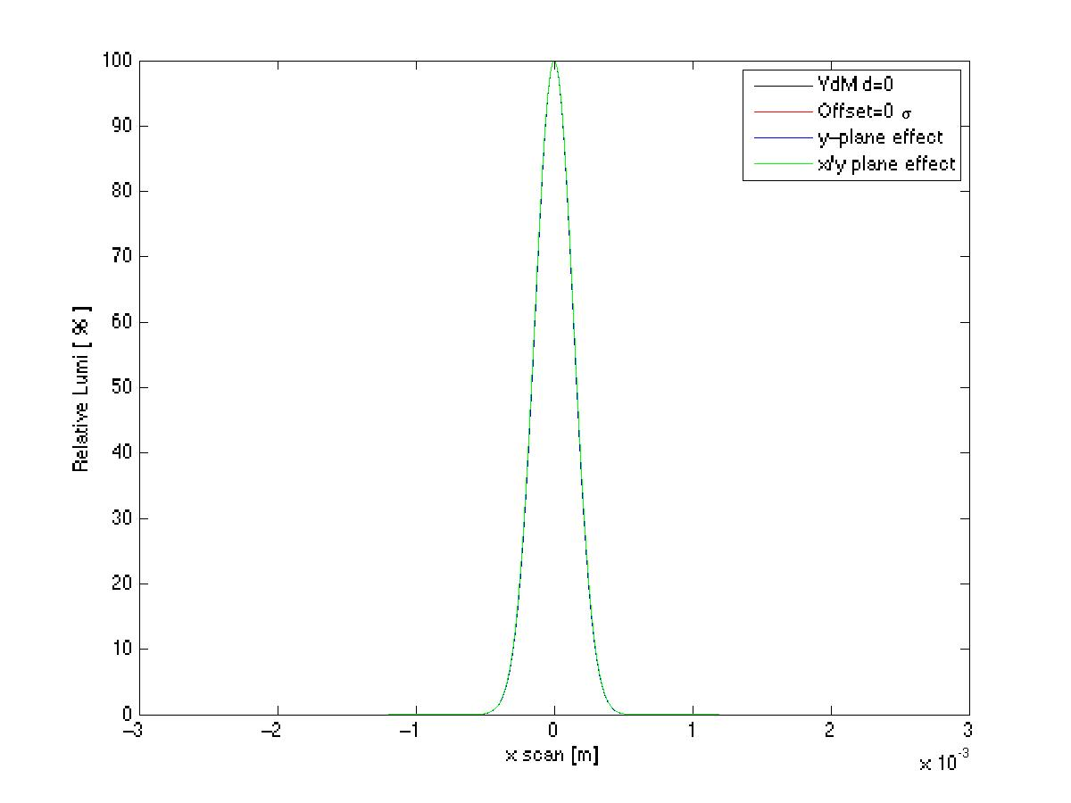
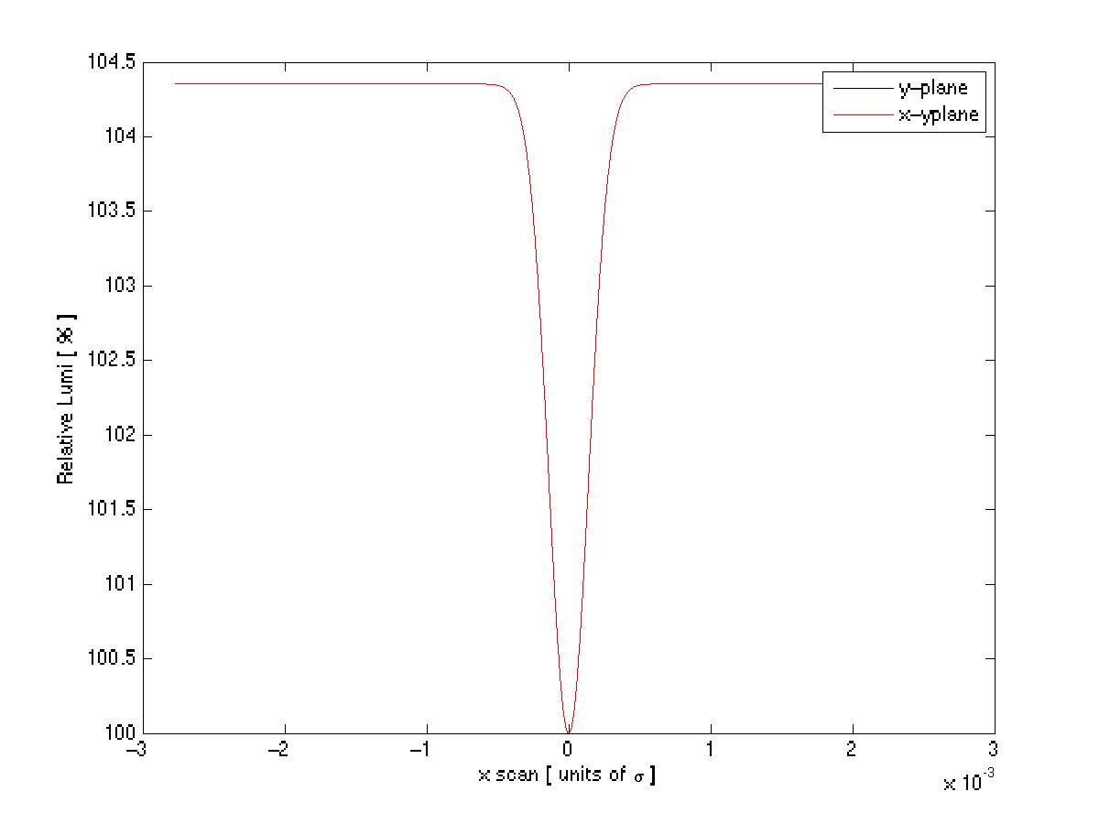
Impact on Luminosity measurements:
Δy = 0
b-b orbit kick
neglected
b-b orbit kick
included
W. Kozaneski
L / L_{peak} (%)
μ_{vis}^{Max}
Horiz. beam separation Δ_{x} (m)
Σ_{x}
μ_{vis}^{Max}
L_{with bb kick} /L_{no kick} (%)
~ 3 %
Σ_{x}
Direct impact on μ_{vis}^{Max} and
Horiz. beam separation Δ_{x} (m)

Slide 10
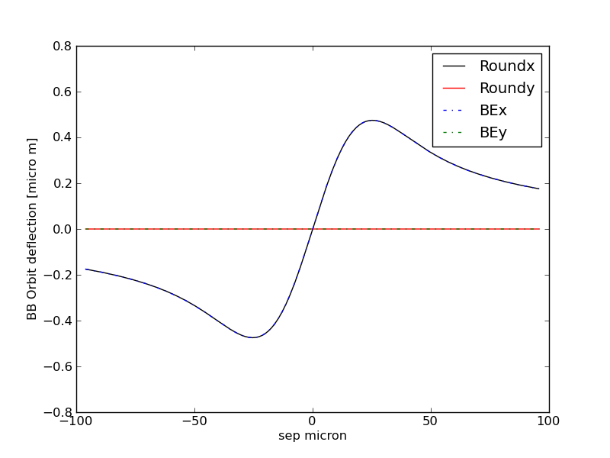
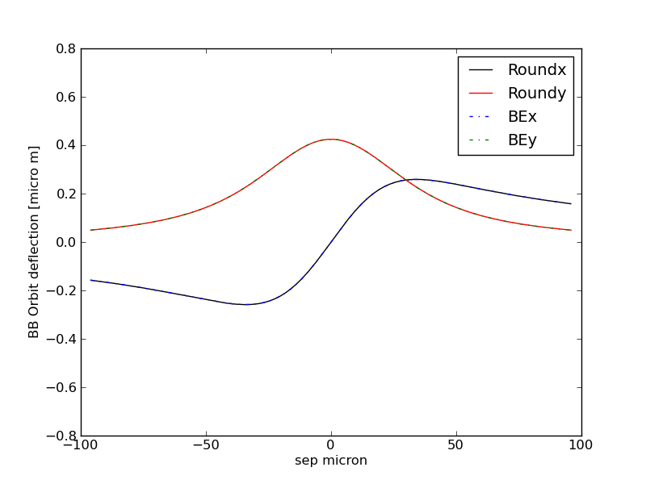
Not negligible effect:
Like for dynamic beta effect, it has to be taken into account!
How will this affect 2011 and 2012 results? Under study.
H in-plane scan
H out-plane scan 2σ
We provided them a Python routine to be implemented in their luminosity calculations to calculate the bb orbit effect for given beam parameters
BBScan.py: to test the BB routine, available for estimates
BB.py: calculation routine uses Bassetti-Erskine general formula and computes kicks and orbit effects
BassErsk: to calculate the electric fields Ref. CERN-ISR-TH/80-06.

Slide 11
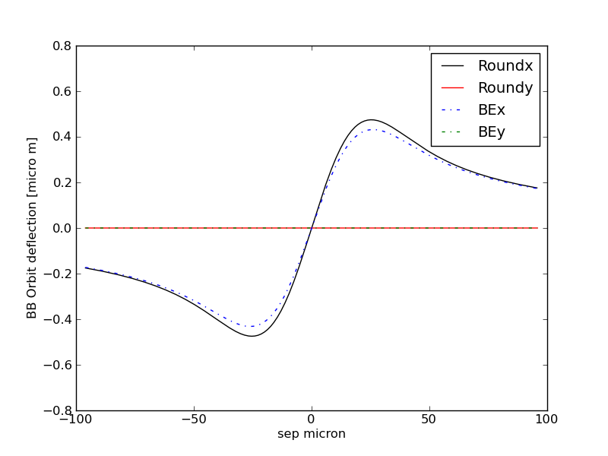
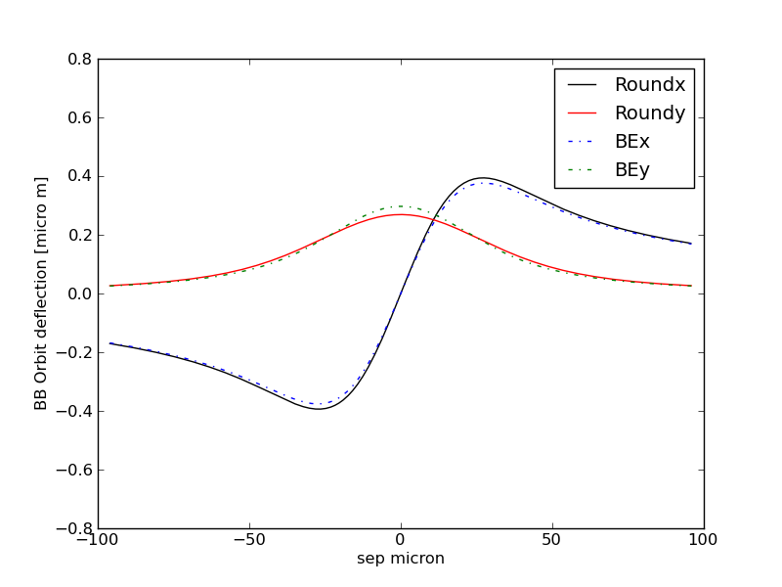
Example: non-round beams
1 IP
H in-plane scan
H out-plane scan 1σ

Slide 12

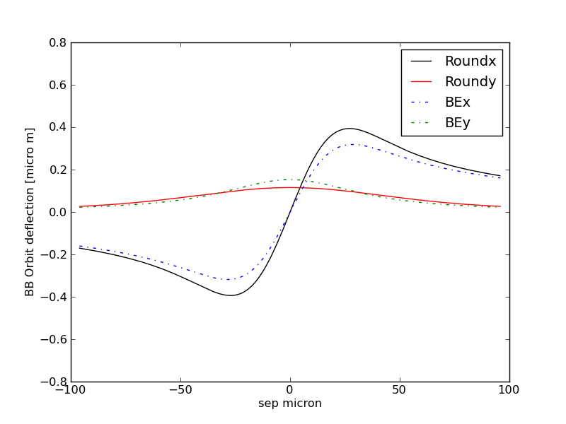
Example 2
non-round beams
H in-plane scan
H out-plane scan 1σ

Slide 13
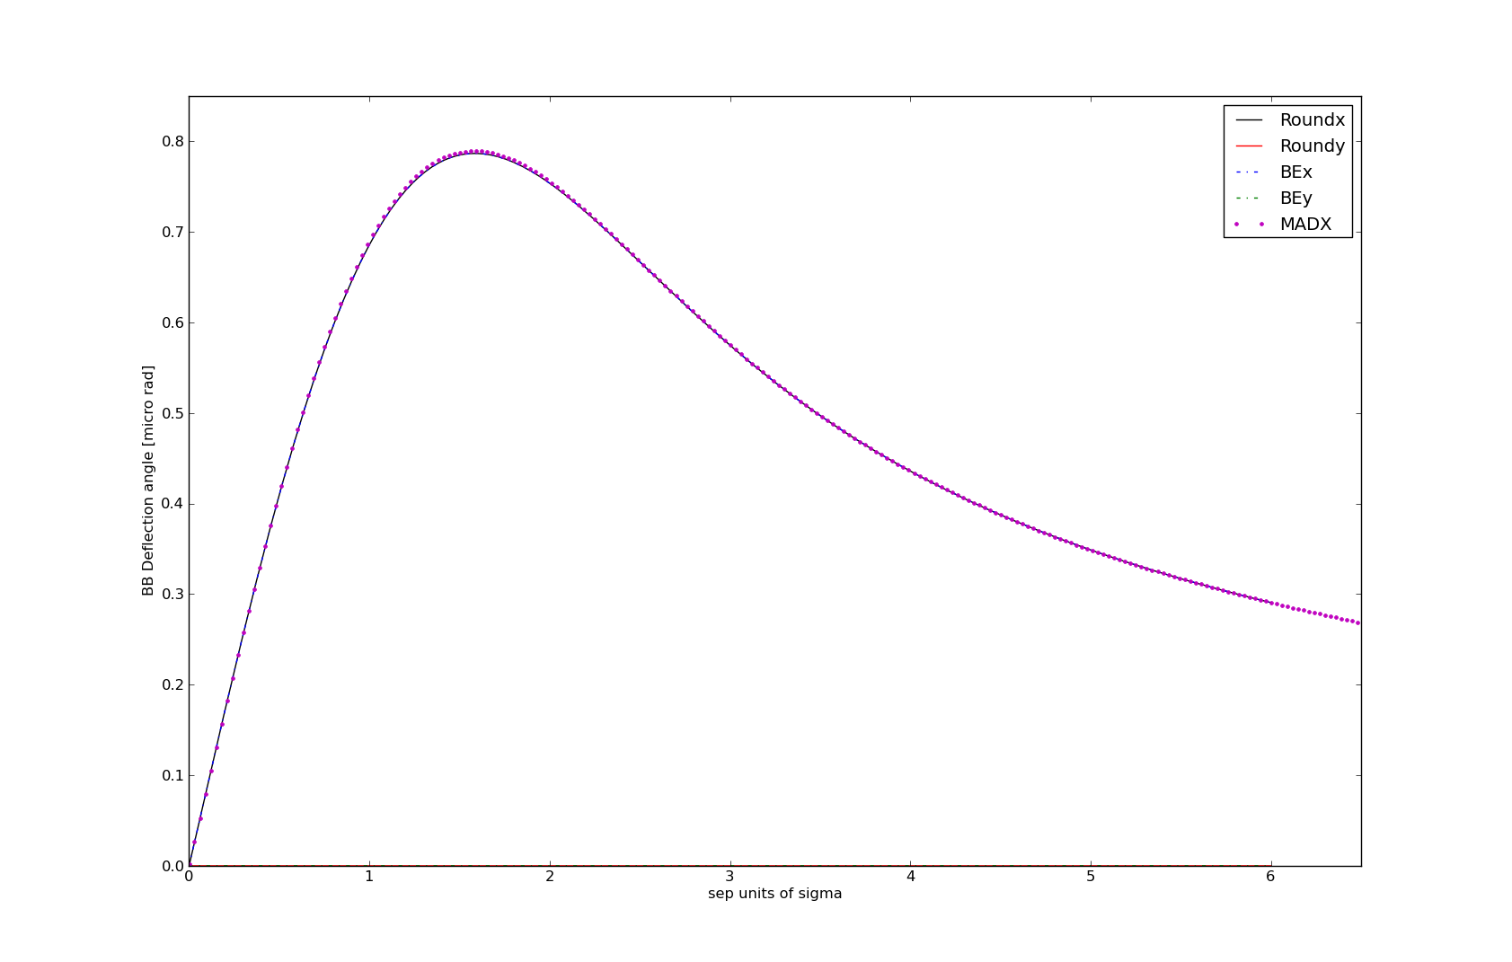
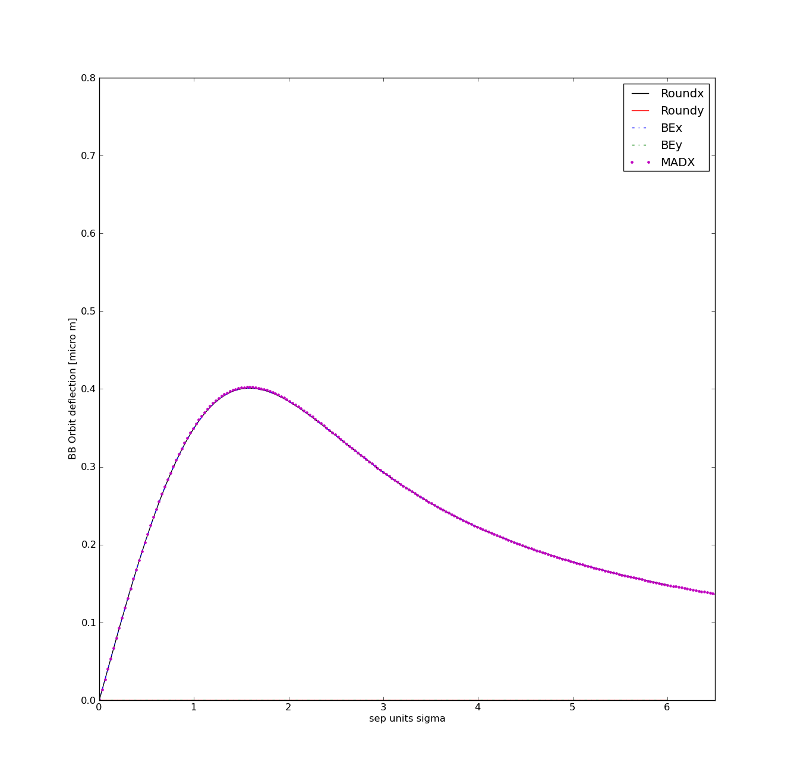
MADX vs analytical model IP1 scan H
VdM scans May 2011 beam parameters and optics
MADX to evaluate the effects for various configurations with multiple IPs
Study is on-going for VdM scan of 2011 and 2012

Slide 14
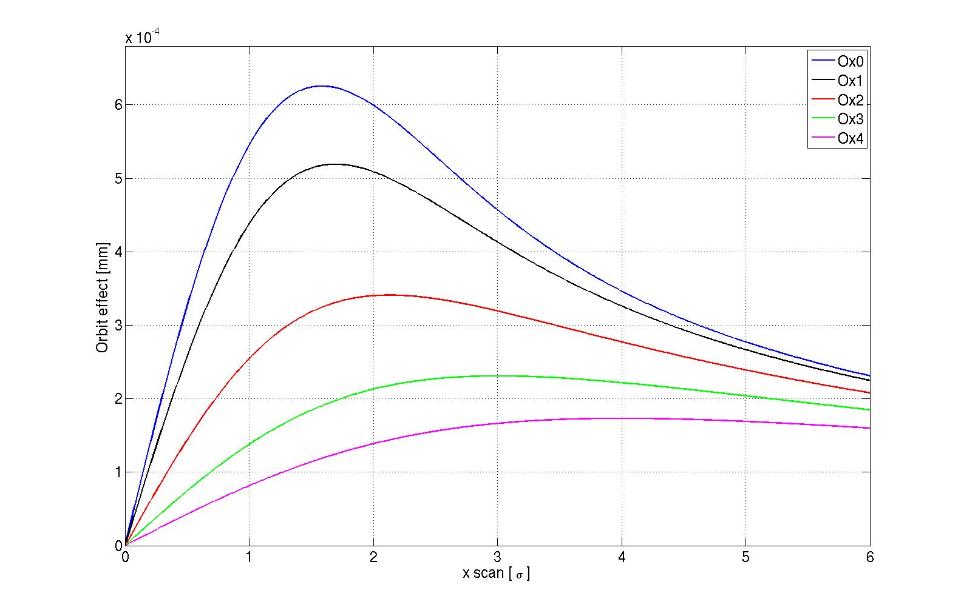
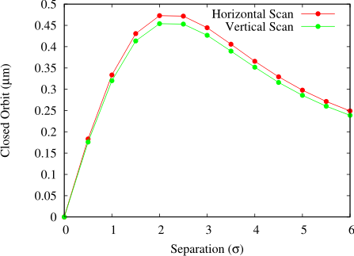
Analytical versus self-consistent?
In the past estimates for some case with self consistent calculations
Comparison with non-self consistent confirms order of magnitude but real effect has to take into account both beams
S. White from Lumi days 2011
Closed orbit effects for ξ = 0.003.
Simulated with TRAIN.
Orbit effects for ξ = 0.003, analytical model
TRAIN code estimates needed and work is on-going

Slide 15
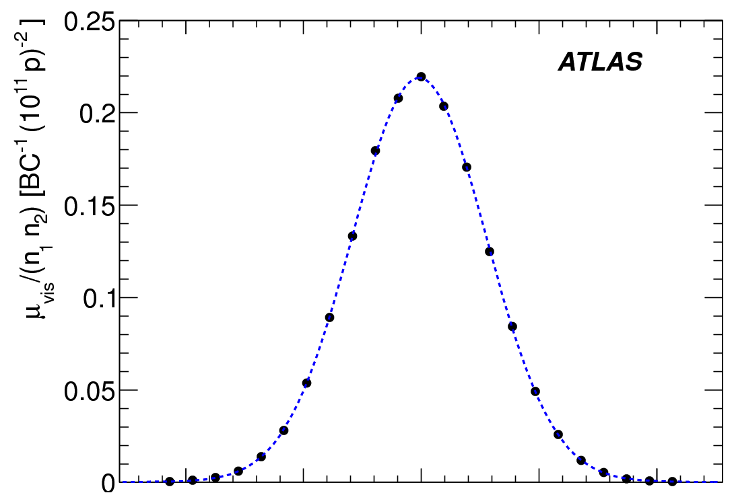
Impact of long-range encounters on L scans: data
IP 1+ 5 + 8
IP 1+ 5
μ-Scan I
μ-Scan II
μ-Scan I
μ-Scan II
Orbit drift
May 2011
vdM scan
W. Kozanecki
Total # Long-Range Encounters

Slide 16
Summary
Beam-beam orbit effects during Van der Meer scans for high presicion Lumi measurements are important and have to be taken into account
Studies of impact on 2011 and 2012 VdM scan measurements are on-going
Analytical calculations were done and Python routine provided to the experiments for evaluations for single IP scans impact
Experiments in the process to evaluate impact on their estimates of Lumi for 2011
MADX study on-going to provide estimates for more complex configurations with multiple IPs, preliminary results available for VdM May 2011
In the future estimate the change due to self consistent orbit effects from BB with the TRAIN code, correct treatment.
Analyze measurements data and compare with estimates
Evaluate cases for after LS1 (different optics options and beam parameters)

Slide 17
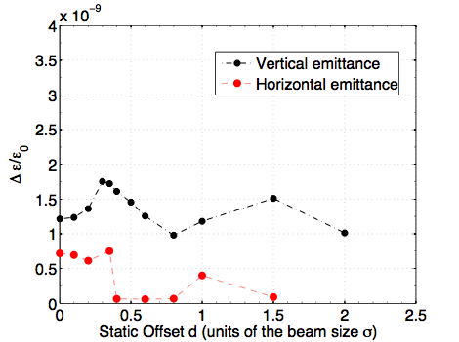
In addition:
Is there something more during VdM scans?
Are distributions modified?
How different initial distribution will change the results? Bunches with tails from injectors
Emittance growth?
T. Pieloni, W.Herr and J.Qiang, PAC09
Δσ / σ ₀ (per turn)
Multi-particle simulations
(work started M. Schubiger EPFL student):
Any particle distribution allowed
Leaves particle distribution evolve in time
Time consuming simulations…will need time to conclude if needed!

