Slide 1
CERN Space Charge Studies
Review of 2012
General Plan
Highlights
  PSB
  PS
  SPS
Collaboration
  GSI
  FERMILAB
Plan for 2013
Simulation, Simulation…
Code Benchmarking
  Giuliano’s Test
  Orbit
  SYNERGIA
  Frozen Space Charge
SC-13 Workshop in April
Benchmarking with Experiments
1

Slide 2
2012 General Plan
Main goal to take data from all three machines
  To allow benchmarking with space charge codes
  Understand relevant resonances + SC
  Measure resonances in absence of SC
PTC-ORBIT in collaboration with Molodozhentsev and Nishikawa
  Provide all required features and updates
  “Document” code and provide examples for all 3 machines
  Convergence of long-term behavior of emittance growth
  First attempts to validate code results with experiments
International collaborations (see below)
2/27/2013 FS/ICE
Overview Space Charge 2012/13
2
2

Slide 3
PSB
Elena Benedetto, Vincenzo Forte
Program of Experiments
Benchmarking with Experiment
3

Slide 4
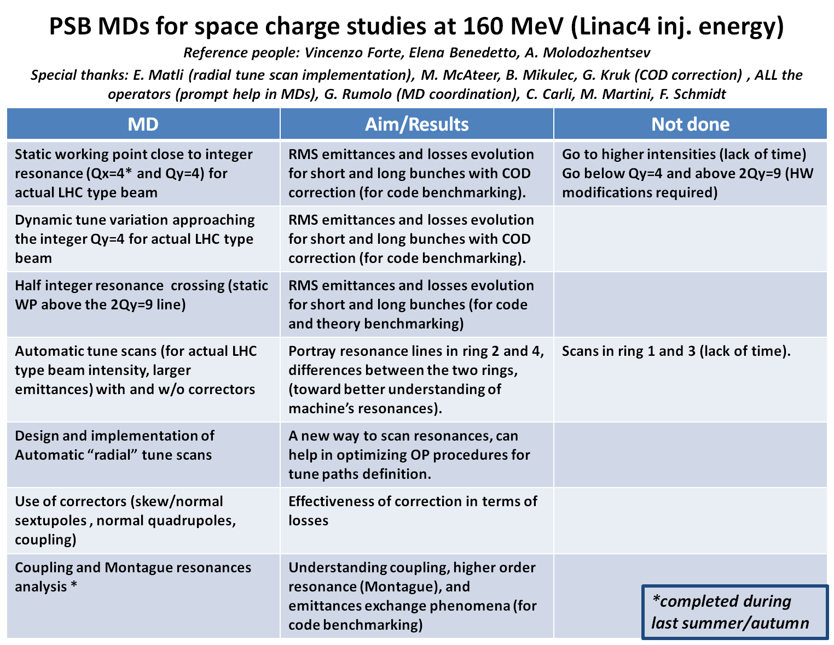
PSB Highlights
2/27/2013 FS/ICE
Overview Space Charge 2012/13
4
4

Slide 5
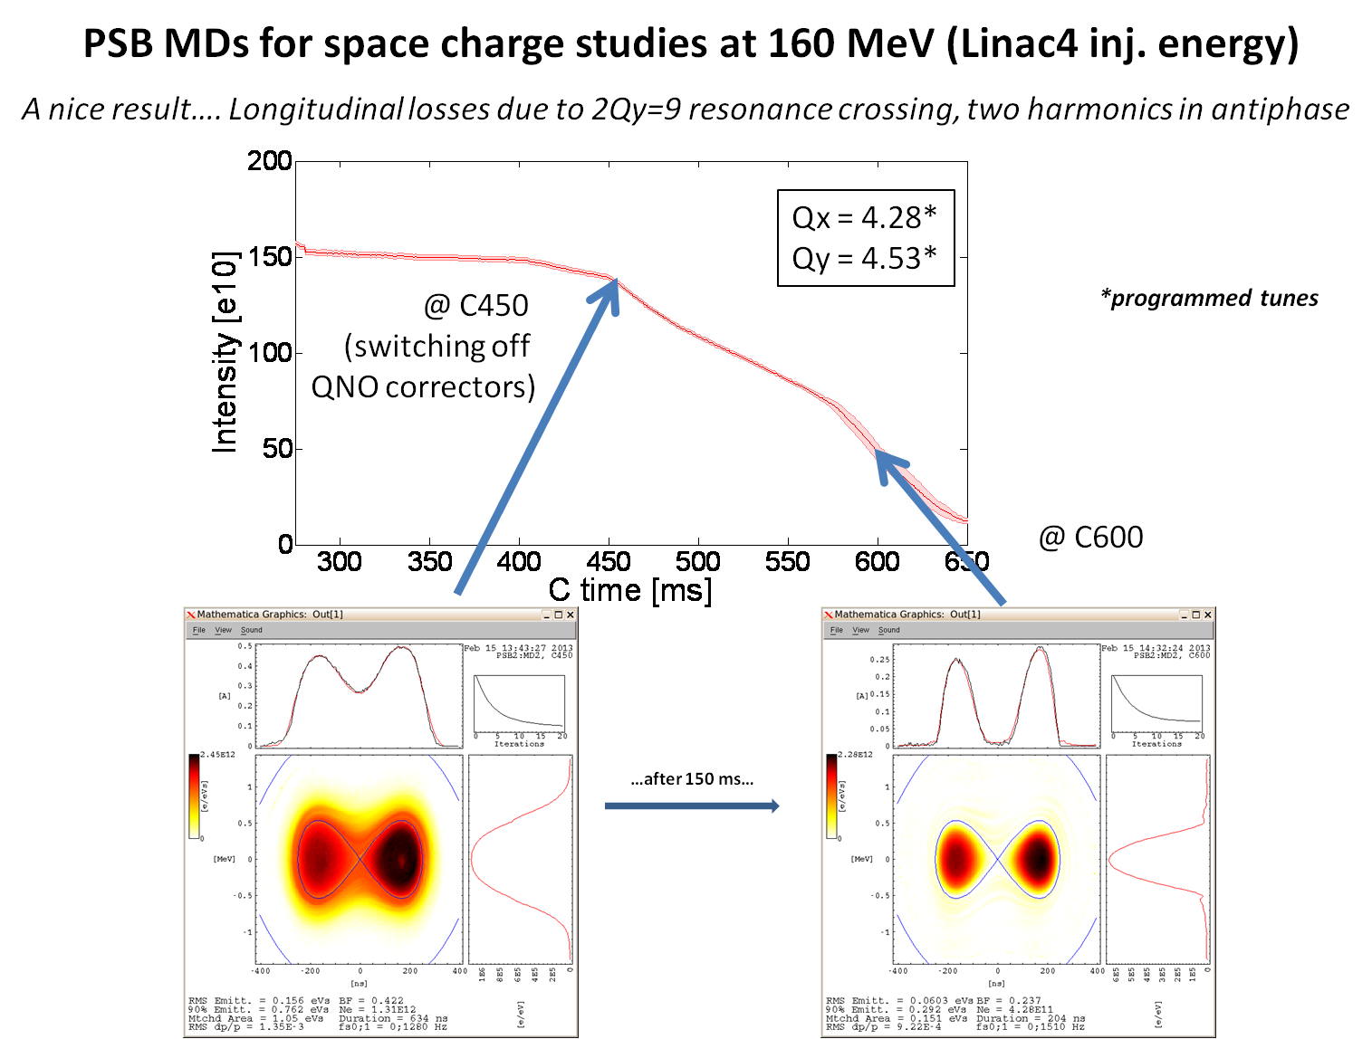

Slide 6
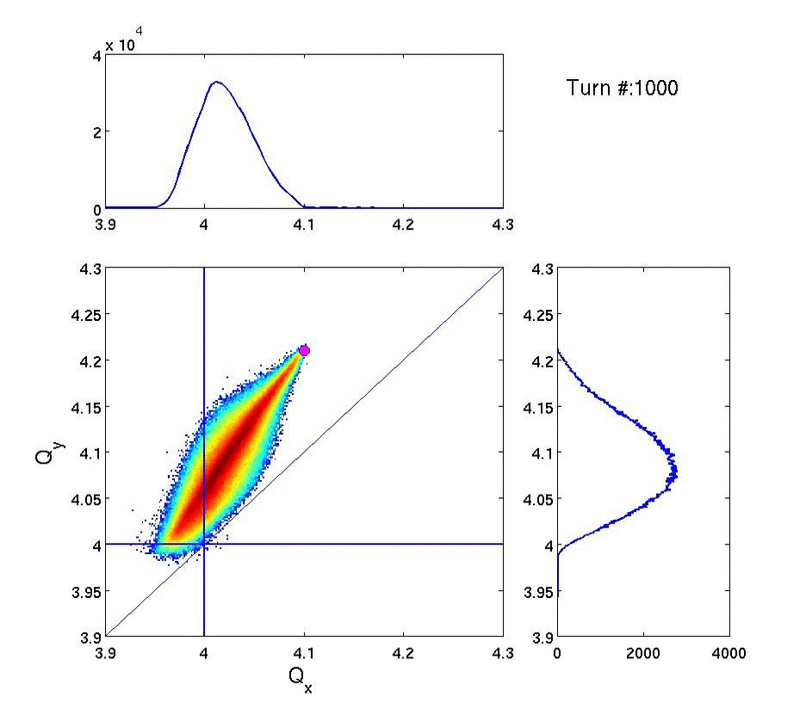
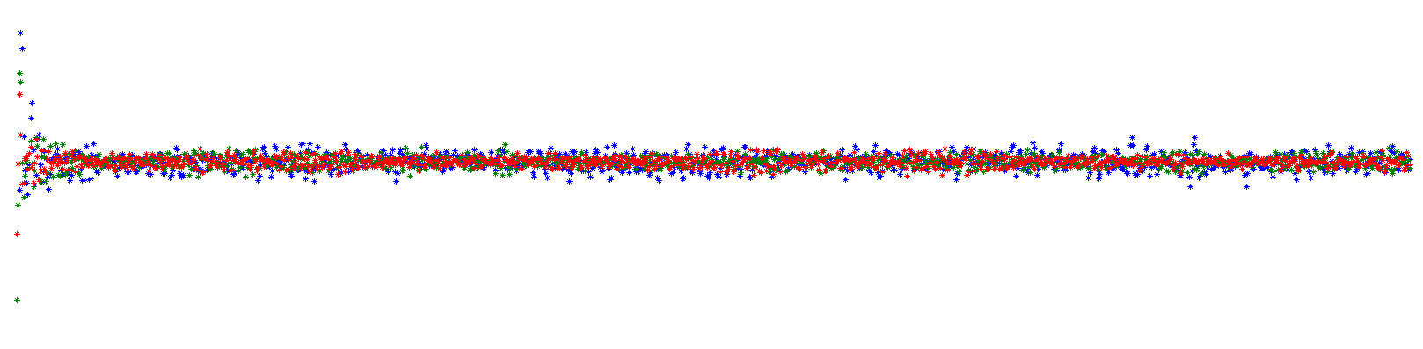


Tunes footprint evolution…
Status of space charge studies and simulations in the PS Booster – Vincenzo Forte

Slide 7
Integer resonance (Qx=4) effect
PS The random quad. field errors are used while waiting for a detailed estimation in the PSB.
Status of space charge studies and simulations in the PS Booster – Vincenzo Forte

Slide 8
PS
Raymond Wasef
Experimental Results
PTC-ORBIT convergence test done but no conclusive simulations yet
8

Slide 9
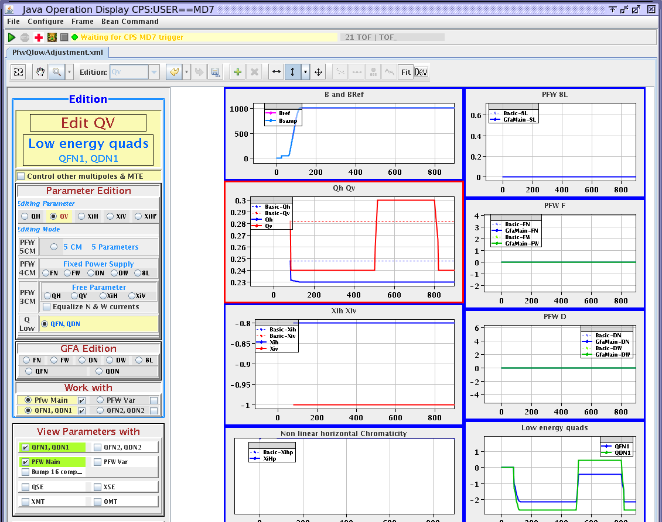
4th order resonance
Testing if the 4qy=1 is excited by Space Charge:
-Tune step between C500 and C800
4 different settings:
  I=115 e10 ppb Laslett for Q21Q23 optics [.22 ; .4]
  I=80 e10 ppb Laslett for Q21Q23 optics [.18 ; .37]
  I=35 e10 ppb Laslett for Q21Q23 optics [.08 ; .24]
  I=115 e10 ppb Debunched

Slide 10
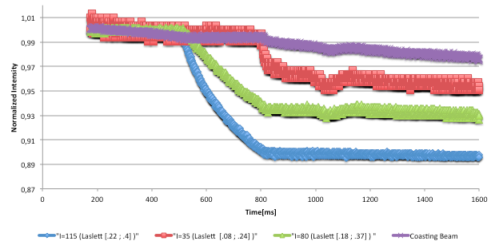
4th order resonance

Slide 11
LHC50-clone

Slide 14
SPS
Hannes Bartosik
Experimental Results
PTC-ORBIT convergence test
14

Slide 15
SPS – Overview measurements
Single bunch studies (Q20)
  Static tune scan (in selected regions of tune-diagram)
  Emittance blow-up close to integer resonances (also as function of time)
  Issues
    Large shot to shot variation of beam parameters for high brightness bunches -> multibunch beams (h=9, BCMS) in the end of 2012
    Wire scanner resolution for small beam size
    Hard to get statistics
Multi bunch studies (Q20), 50ns
  Emittances as function of working point for h=9 (BCMS) beam for estimating space charge tune spread from blow-up (tune spread of up to ΔQ_{y}=0.18 without blow-up or losses)
  Data set not yet analyzed in detail, but brightness achieved in SPS similar to LIU requirements! Beam also injected into the LHC for MDs!

Slide 16
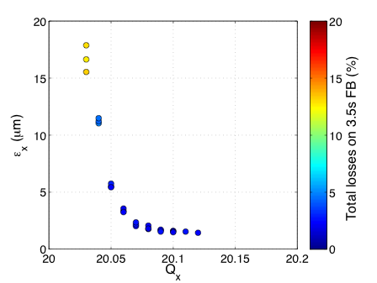
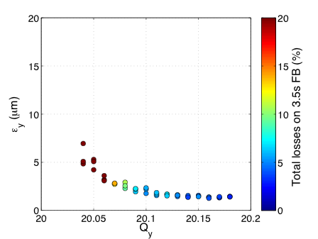
Blow-up close to integer resonance
Standard LHCindiv bunch -> 1.2e11p/b with (ε_{x}+ε_{y})/2~1.2μm
  Expect ΔQ_{x}~0.07/ΔQ_{y}~0.11
Large aperture in horizontal plane allows for huge emittance blow-up without losses
Aperture limitations in vertical plane lead to increasing losses with vertical beam size

Slide 17
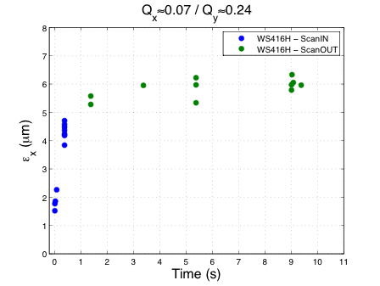
Blow-up close to integer resonance
Emittance growth as function of time
  Fast blow-up close to integer resonance
  Only the very first part can be accessed in simulations (CPU time)
  Similar scan was performed for vertical integer resonance in 10ms time steps with sudden change of tune to be used for benchmarking PTC-Orbit (using time varying fields)

Slide 18
Simulation studies
Status
  Convergence studies for simulation parameters done
  Basic version of lattice (no higher order multipoles apart from chrom. Sextupoles)
Further steps
  Include double harmonic cavity in the simulations
  Include measured closed orbit
  Include measured quadrupole alignment errors
  Benchmark PTC-Orbit on integer resonance (using measured orbit)
  Generic studies of resonances by introducing artificial resonance excitation
  Resolve issue with horizontal instability (no impedance in the model!)

Slide 19
Collaboration (GSI)
Start in December 2011 as a visit to GSI to kick-start the collaboration
GSI retreat in Mossautal May 2012 ➔ Planning of PS MDs with a visit of Giuliano to CERN and myself to GSI
1st PS MD in June
Followed by a visit to GSI to install PTC-ORBIT on GSI computers including examples ➔ most relevant has been the starting of Giuliano’s Benchmarking suite using PTC-ORBIT
2nd PS MD in December
19

Slide 20
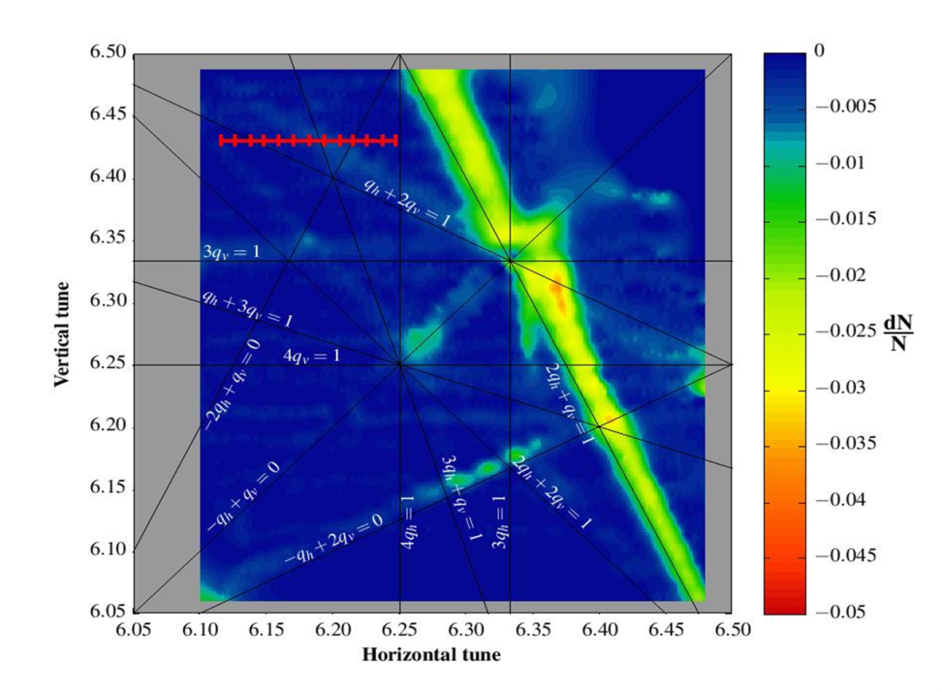
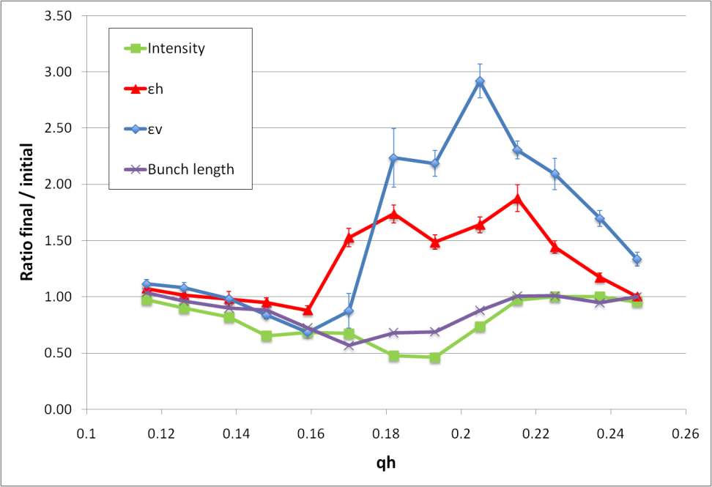
1st MD PS Tune Scan Crossing Normal Sextupole Resonance Qx+2*Qv=19
(2nd MD in Preparation)
Calculated space charge tune spread Qx = 0.052, Qy = 0.067

Slide 21
Collaboration (FERMILAB)
4 month visit to FERMILAB from August to end of November
  Frozen space charge model in MAD-X already benchmarked with Giuliano’s suite ➔ collaboration with Valery Kapin
  In-depth attempt to benchmark the ORBIT code. Discovery of micro-scale instability confirmed by ORBIT experts Jeff Holmes and Leonid Vorobiev. Giuliano involved in the studies
  Implementation at CERN of the SYNERGIA code as an alternative PIC code ➔ collaboration with James Amundson, Eric Stern and Leo Michelotti
2/27/2013 FS/ICE
Overview Space Charge 2012/13
21
21

Slide 22


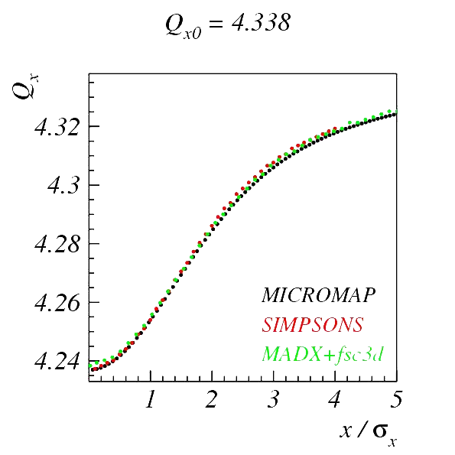
H-DETUNING GSI SIS18
Giuliano’s Benchmark WEB page:
http://web-docs.gsi.de/~giuliano/
Giuliano Franchetti
Shinji Machida
Valery Kapin (2008)

Slide 23
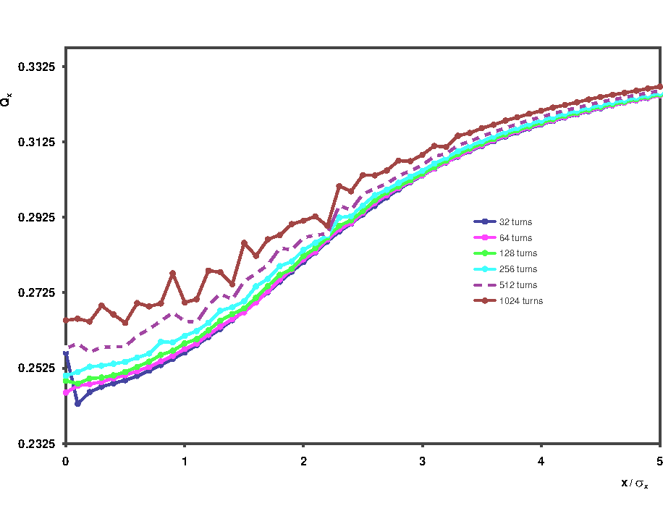
H-DETUNING PTC-ORBIT

Slide 24
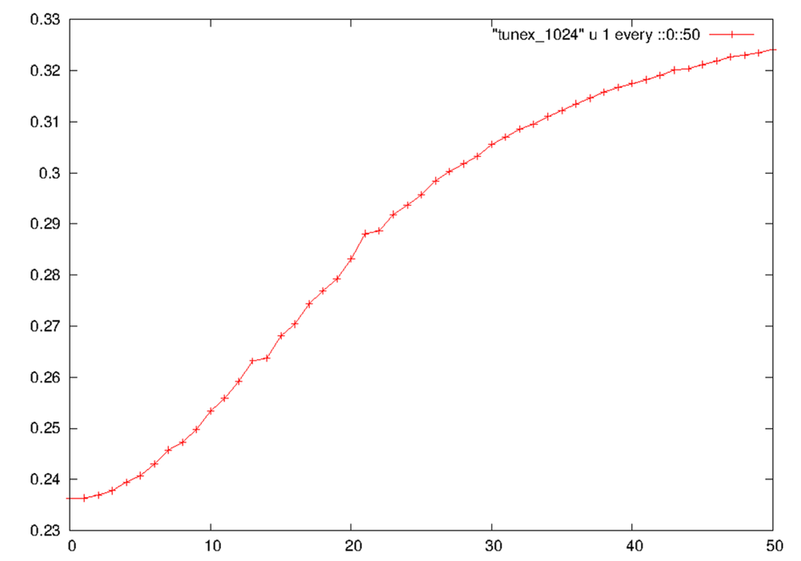
H-DETUNING SYNERGIA 1024 Turns
Qx
0.1 σ

Slide 25
Plan for 2013 Part I
The main goal of 2013 is to understand the experimental results with simulation mostly with PTC-ORBIT our main work horse
To this end we have provided ample computer resources with our space charge queue
However, the micro-instability of the ORBIT code will have to be checked with our examples
We also hope that we will be able to mitigate this ORBIT issue in the near future with the help of Leonid and Jeff
On the other hand we have alternatives:
  Fully functional SYNERGIA Code
  Frozen space charge in MAD-X
-> A full code benchmarking is planned in the coming months
-> Helped by the SC-13 workshop in April and the following week with Jeff, Leonid and Eric to discuss all simulation issues and possible mitigations
25

Slide 26
Plan for 2013 Part II
After the workshop we should be in a position to decide how we should proceed with our simulations
The benchmarking of the codes with the experiments should be fully pursued
The various collaborations should be continued with SNS, GSI and Fermilab
We should also contemplate if we would need a long-term visitor to help us with specific space charge issues. To this end Leonid might be the right candidate given his decade long experience with ORBIT
It remains to be seen to which extent we will look into the alternative codes and in particular how we could tackle long-term issues of space charge in circular nonlinear machines
26

Slide 27
Reserve

Slide 28
-- simple lattice
-- -- simple lattice with misalignments random errors
(1σ = 2.17e-5 and 4.28e-5 rad)
Measured and simulated effect of the 4th order coupling resonance [2,-2,0] for the lattice working point Qx = 4.18, Qy = 4.23
Status of space charge studies and simulations in the PS Booster – Vincenzo Forte

Slide 29
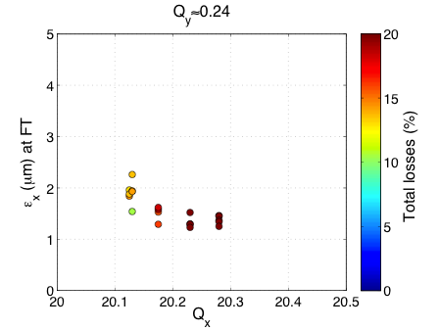
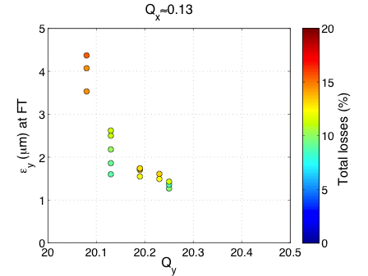
Estimation of space charge tune spread
23.04.2012
Approaching the integer resonances leads to
  Emittance blow up in the respective plane
  A reduction of losses in the horizontal plane (no 3rd order resonance around)
  Increasing losses in vertical plane -> aperture restriction
For 2.7e11p/b and about (ε_{x}+ε_{y})/2~1.0-1.2μm injected -> ΔQ_{x}≈0.15 / ΔQ_{y}≈0.25

Slide 30

Emittance growth for Qx close to integer
26.04.2012
Same beam parameters as last plot -> initial tune spread is about ΔQ_{x}≈0.15 / ΔQ_{y}≈0.25
(lossless) blow up of the core
  εx>2μm after 40ms
  εx~4-5μm after 400ms

Slide 31
Emittance with BCMS beam (50ns)
Measurements during the preparation of BCMS beam for LHC
  Emittance at injection and end of flat bottom
  Emittance at end of flat bottom for different tunes around the usual Q20 tunes
  Measurements with 1 and 3 batches for direct comparison (if 1st batch is blown-up)
  Cross check of emittance measurements with data at LHC injection
Advantage of multi-bunch beam: beam parameters are more stable
  Easier to measure emittance (multi-scan on flat bottom)
  Detailed data analysis to be performed in LS1

Slide 32
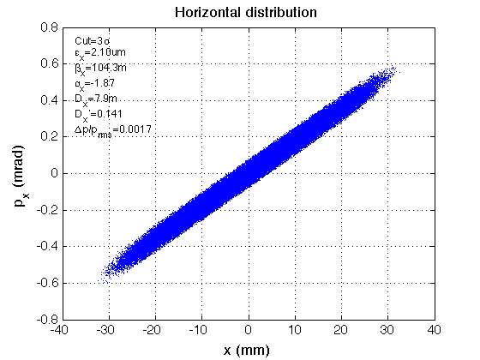
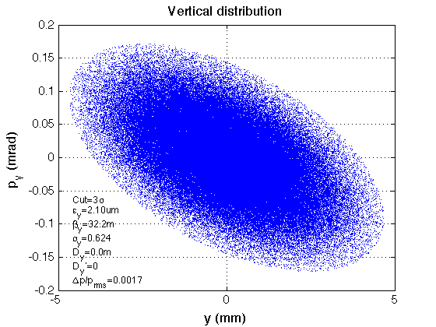
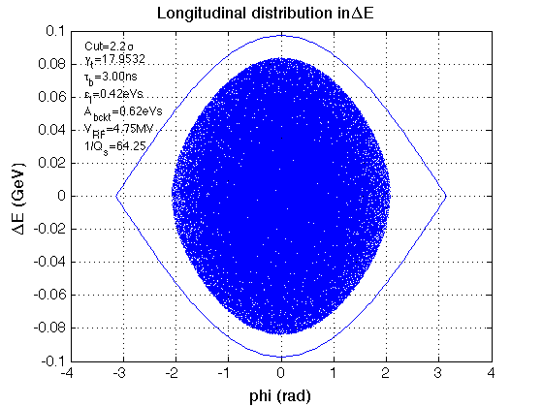
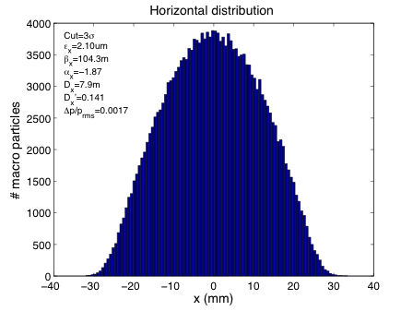
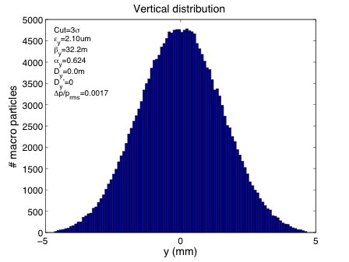
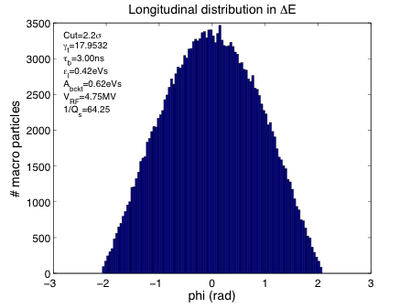
Multi particle simulations
17.05.2012

Slide 33
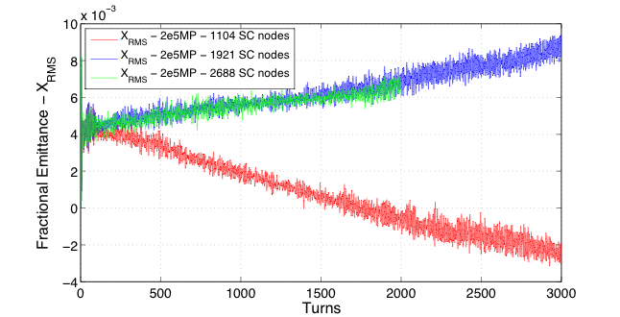
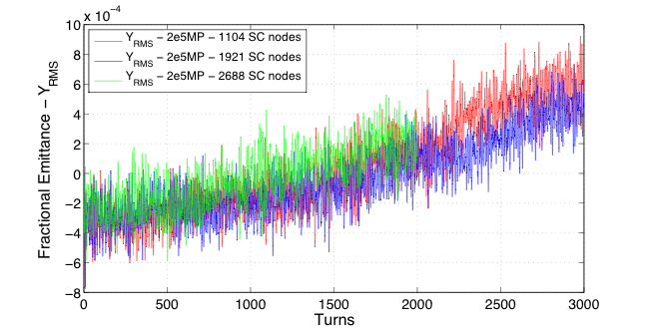
Scanning number of space charge nodes
15.06.2012
???

Slide 34
Blow-up close to integer resonance
Standard LHCindiv bunch -> 1.2e11p/b with (ε_{x}+ε_{y})/2~1.2μm
  Expect ΔQ_{x}~0.07/ΔQ_{y}~0.11
Large aperture in horizontal plane allows for huge emittance blow-up without losses
Aperture limitations in vertical plane lead to increasing losses with vertical beam size

Slide 35
Blow-up close to integer resonance
Emittance growth as function of time
  Fast blow-up close to integer resonance
  Only the very first part can be accessed in simulations (CPU time)
  Similar scan was performed for vertical integer resonance in 10ms time steps with sudden change of tune to be used for benchmarking PTC-Orbit (using time varying fields)

Slide 36
Conclusions and further steps
Space charge effects can be clearly observed when tune spread reaches integers
  Behavior as expected -> blow-up of the beam core without immediate losses (apart from aperture restrictions)
  Good case for benchmarking with (PTC-ORBIT) simulations
The highest brightness delivered from the pre-injectors yields a tune spread of about ΔQ_{x}≈0.15 / ΔQ_{y}≈0.25 in the SPS
  Even larger than required by LIU?
  Operational beams sent to the LHC have about ΔQ_{x}≈0.08 / ΔQ_{y}≈0.13 in the SPS
Study the losses on flat bottom
  In the context of high brightness (and in comparison with Q26: high brightness but low intensity)
  Measure resonance driving terms and try to compensate resonances if needed -> tried but not yet conclusive
  Better correction of orbit on flat bottom needed?

Slide 37
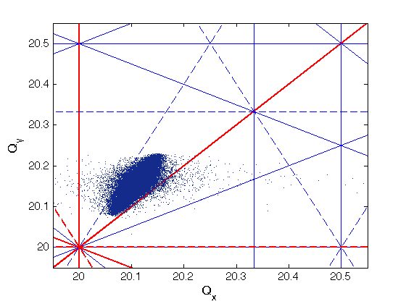
SPS with space charge
24.05.2012
(MP=100k, no boundary, 64x64x128)
WP: 20.15/20.23
N_{b}=2.7e11
ε_{x}=ε_{y}=2.1μm -> ΔQ_{x}≈0.1, ΔQ_{y}≈0.16 is estimated
τ=3ns
0.1
0.15

Slide 38
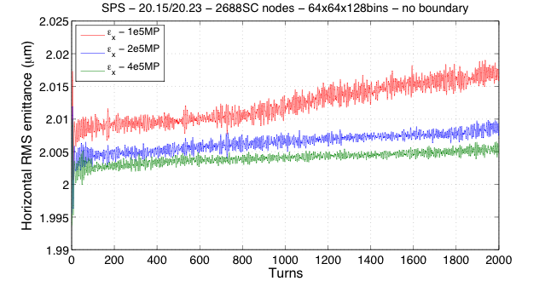
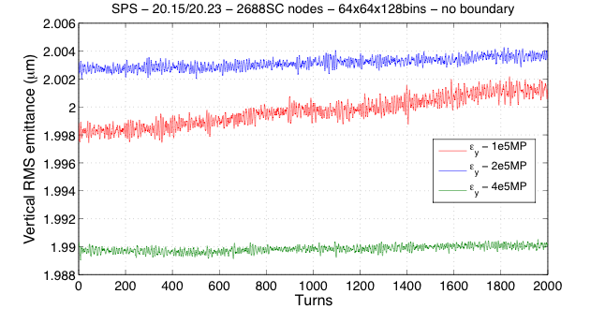
Varying number of macro particles …

Slide 39
Result of convergence study
FOR SPS (optimized with up to 2.7e11 p/b and 2.1um emittances):
  4e5 MP
  64x64 transverse bins
  128 longitudinal bins
  1921 SC nodes
Approaching parameters typically used in MD studies (2.7e11 p/b, 1.2um)
  Observe fast increase of horizontal emittance in simulation:

Slide 40
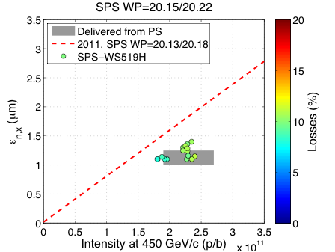
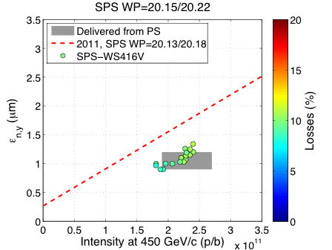
Single bunch brightness
Maximal brightness at flat top with WP moved up (20.15, 20.22)
  Higher brightness compared to 2011 data (20.13, 20.18)
    Total losses in 2011 below 9% for similar intensity
    Higher losses in 2012 (space charge?, closed orbit?, …)
  Single bunch wire scanner measurements for small beam size at flat top is difficult!

Slide 41
Emittance with BCMS beam (50ns)
Measurements during the preparation of BCMS beam for LHC
  Emittance at injection and end of flat bottom
  Emittance at end of flat bottom for different tunes around the usual Q20 tunes
  Measurements with 1 and 3 batches for direct comparison (if 1st batch is blown-up)
  Cross check of emittance measurements with data at LHC injection
Advantage of multi-bunch beam: beam parameters are more stable
  Easier to measure emittance (multi-scan on flat bottom)
  Detailed data analysis to be performed in LS1

