Slide 1
Summary of collimator impedance MD (Sunday 24 June 2012 10pm to 6am)
Collimation: Belen, Stefano, Valentina
Impedance: Alexey, Benoit, Nicolas
Operation: Alick, Mirko, Stephane (LHC), James, Johan (SPS)
RF: Juan

Slide 2
Beam availability for impedance measurements
from 03:42 am to 05:42 am (~ 2h):
Killing 2 out of 3 bunches per beam (done by Stefano)
secondary collimator movements for both beams
primary collimator movements for both beams
Chromaticity measurements
from 06:19 am to 06:30 am (11 min):
Reducing the octupole current for both beams

Slide 3
Problems/ constraints
Difficulty to measure horizontal chromaticity due to 2 close dominant peaks in the spectrum
Needed to stay below 3e11 protons per beam → difficult fine tuning of injectors to obtain ~1e11 p/b but not more (manual “post-it” BQM technique).
Lost all control over all knob linked to LSA database from 5:42 to 6:19 (a node in the database cluster partially crashed).

Slide 4
Fill 2772: beam conditions
2 beams injected, ramped to 4TeV and squeezed
3 bunches per beam (~1e11 p/b)
2 bunches used for loss maps and selectively killed before the impedance measurements

Slide 5
Preliminary results: moving IR7 secondary collimators (11 TCS)
Nothing obvious was seen on the synchronous phase shift from logging, but need to analyze the data taken by Juan.

Slide 6
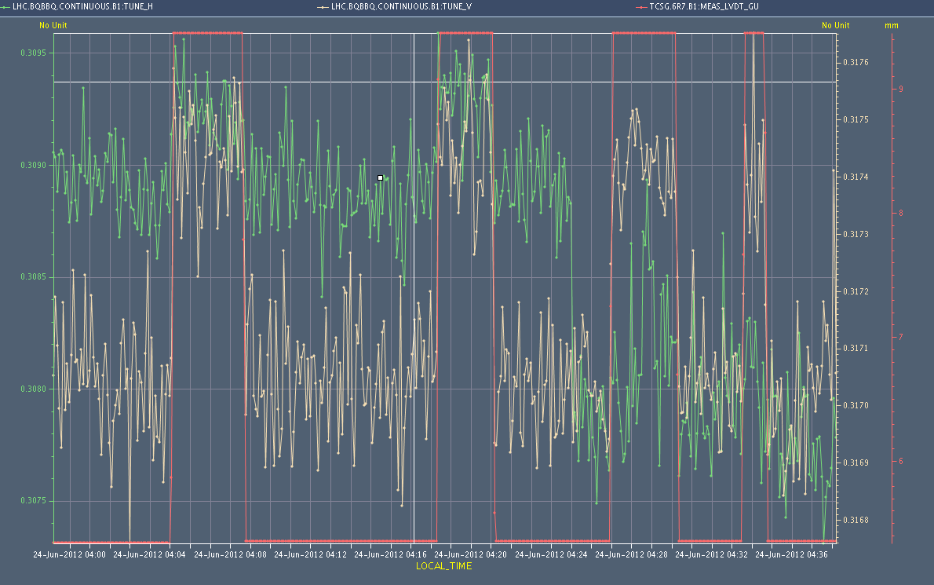
Preliminary results: moving IR7 secondary collimators for B1
Qh scale = 5e-4
Qv scale = 5e-4
Collimator gap
ADT off
All IR7 TCS were moved back and forth from 5.1 sigma to 9 sigma.
Need to postprocess the data to gain a better resolution on the tunes (in particular the horizontal tune)
clear correlation between tune and gap (~5e-4)
ADT off did not seem to help much this time

Slide 7
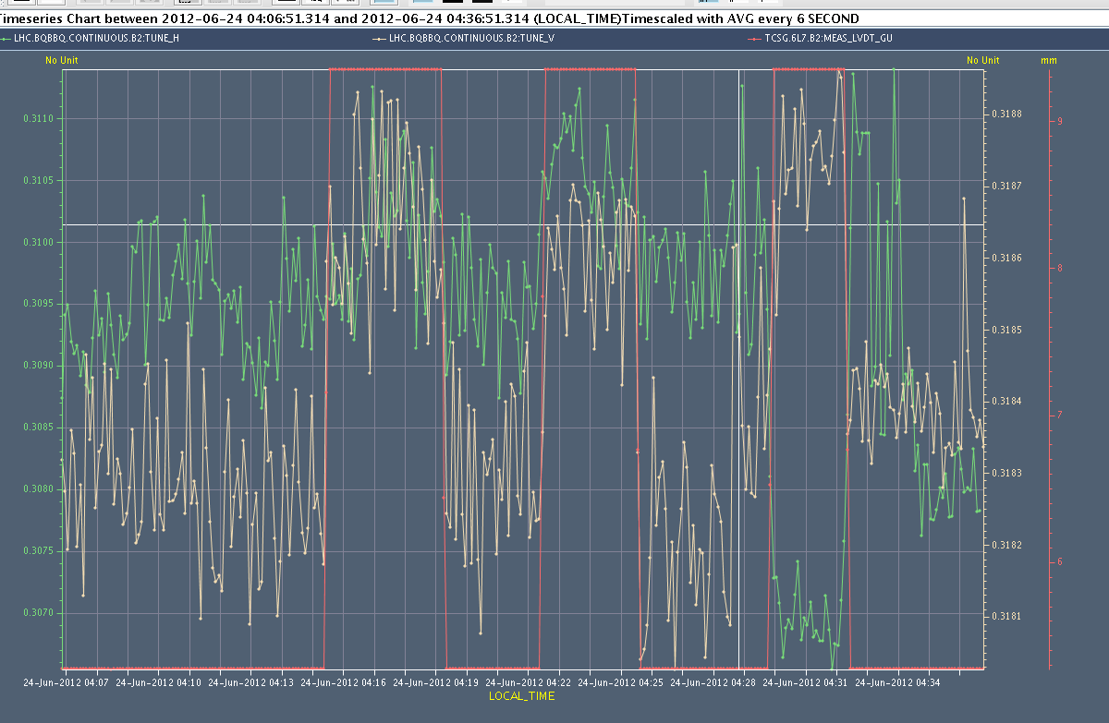
Preliminary results: moving IR7 secondary collimators for B2
Hor scale = 5e-4
Ver scale = 5e-4
Collimator gap
ADT off
All IR7 TCS were moved back and forth from 5.1 sigma to 9 sigma.
Need to postprocess the data to gain a better resolution on the tunes (in particular the horizontal tune)
clear correlation between tune and gap (~5e-4)
ADT off did not seem to help much this time

Slide 8
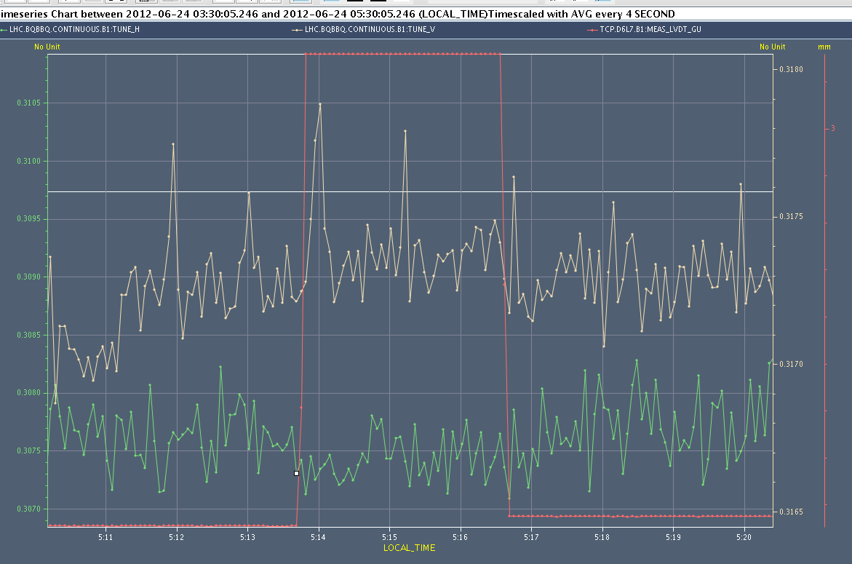
Preliminary results: moving IR7 primary collimators (3 TCPs from )
No tune correlation with collimator gap was seen online
Need to postprocess the BBQ data to increase the resolution
Nothing obvious was seen on the synchronous phase shift from logging, but need to analyze the data taken by Juan.

Slide 9
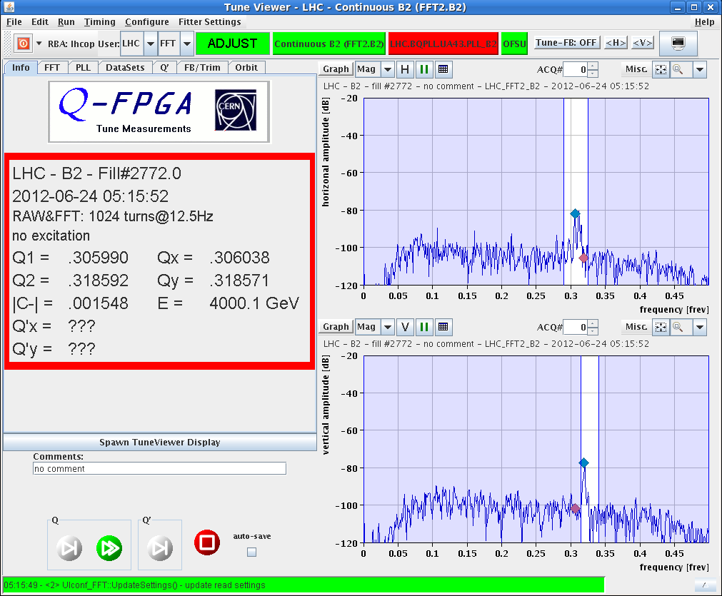
Tune and chromaticity measurements: difficult
2 peaks in H plane

Slide 10
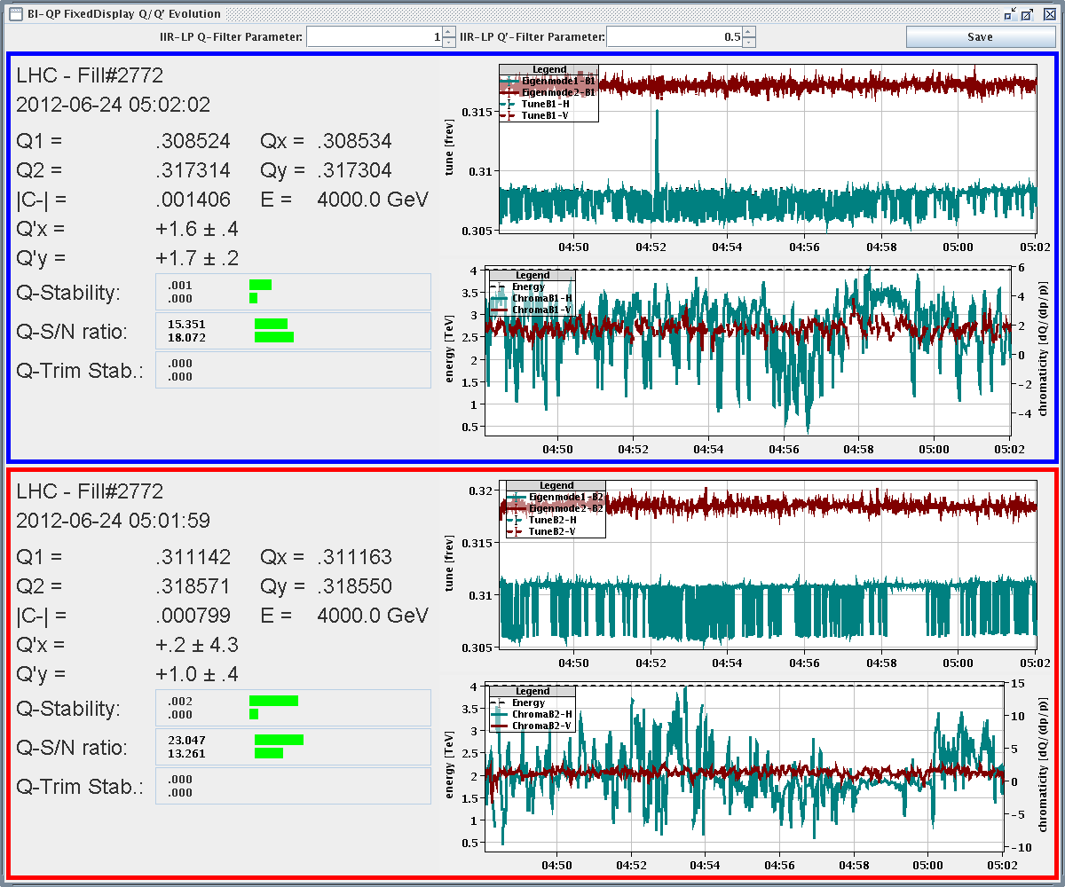
Measured chromaticity was set to ~2 in both beams both planes (trim of -2 in H for both beams)

Slide 11
Decrease of octupole current with ADT off (in a rush)
Collimators back to the same position as for the octupole MD of the afternoon to compare

Slide 12
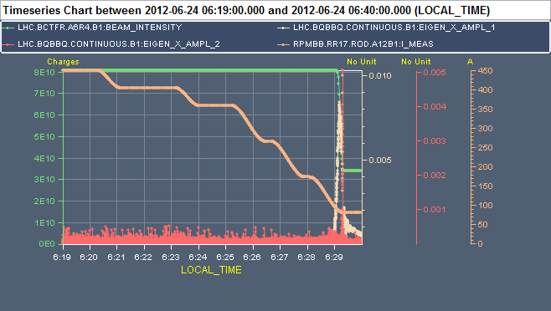
Decrease of octupole current for B1 with ADT off (in a rush)
Octupole current
Max horizontal FFT amplitude
Max vertical FFT amplitude
Horizontal amplitude increase → severe losses during the last step to 80 A

Slide 13
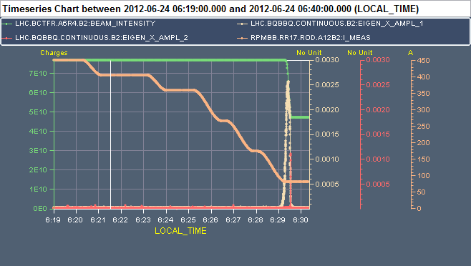
Decrease of octupole current for B2 with ADT off (in a rush)
Octupole current
Max horizontal FFT amplitude
Max vertical FFT amplitude
Horizontal amplitude increase → severe losses during the last step to 80 A

Slide 14
Preliminary conclusions
Still a lot of postprocessing needed
Both beams seem to have the same behaviour
Tune shift for all IR7 TCSs: ~5e-4/1e11 p/b
Tune shift for all IR7 TCPs: not measurable
If the chromaticity is the same (we should check the trims) the stability threshold for octupole current seems similar for the single bunch and the full beam

