Slide 1
TCTVB-VMTSA-TCDD area
Xrays at 4L2
V. Baglin (8/11/11)
CERN TE-VSC, Geneva
X-Rays made by A. Vidal (TE/VSC) and A-M Piguiet (EN/MME)

Slide 2
Layout LSS2 : A4L2
LSS2L :
TCTVB
TCDD
VAB
BPMSX
D1L2
TCDD
VAMTF.A4L2.X
DCUM = 3259.3524
VGPB.120.4L2.X
D1L2
VPIA.A151.4L2.X

Slide 3
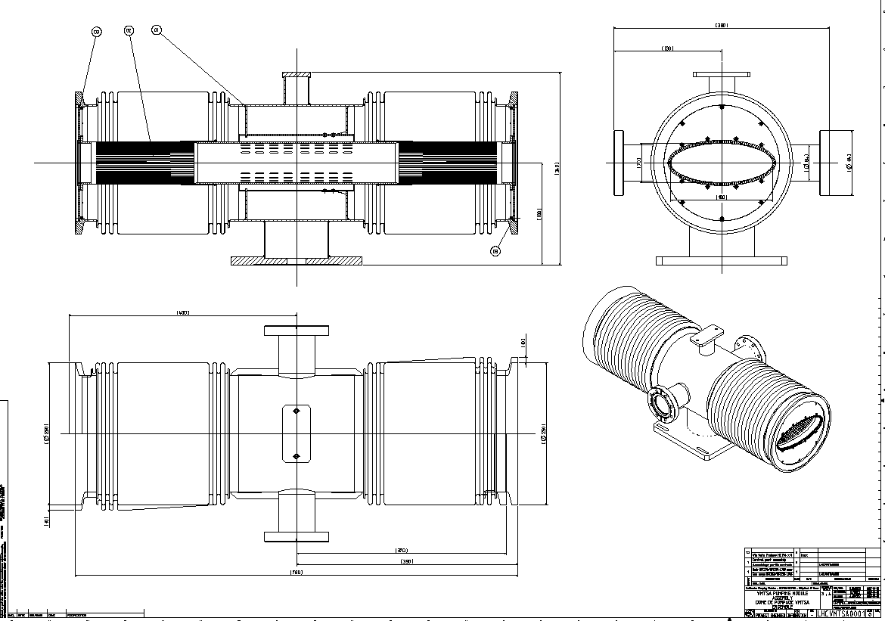
VMTSA son of VAMTF.A4L2.X
Horizontal ellipse 180/70
Left side
Right side
LHCVMTSA0001

Slide 4
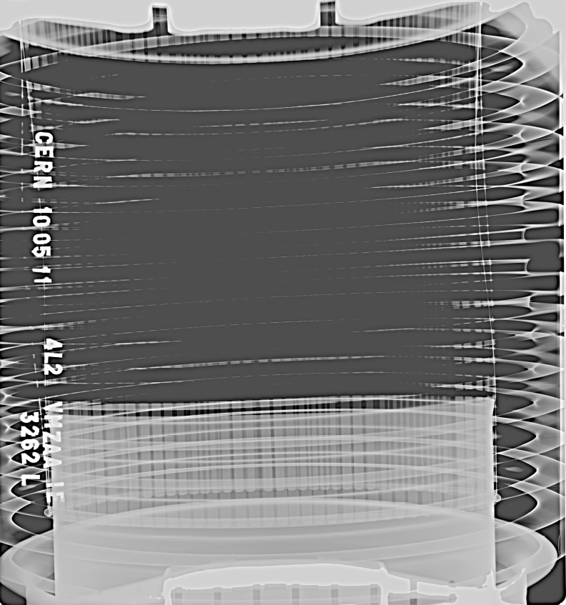
X-rays the 10-5-2011, DCUM 3259
a
b
Left side
Top view (xray from top to bottom)
a)Slight deformation of
RF finger.
b)No metallic noise due to loose spring
Use as IS

Slide 5
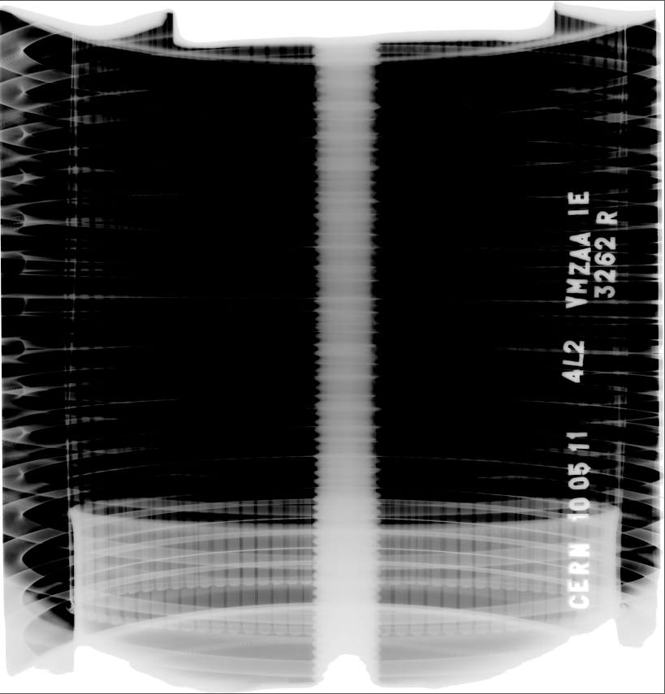
X-rays the 10-5-2011, DCUM 3259
b
Right side
Top view (xray from top to bottom)
b) No metallic noise due to loose spring
Conform

Slide 6
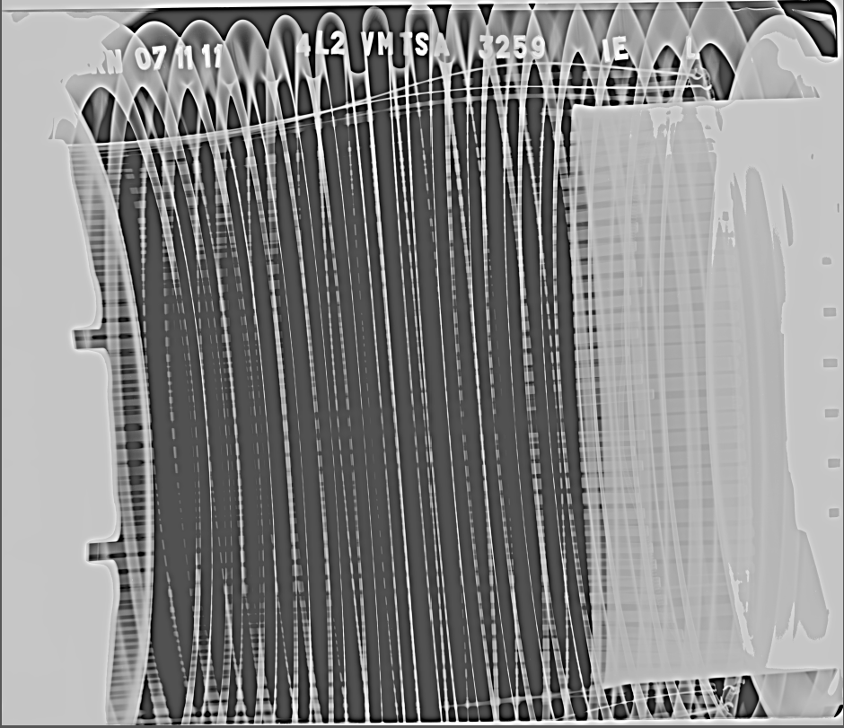
X-rays the 7-11-2011, DCUM 3259
b
a
Left side
Top view (xray from top to bottom)
a)Strong deformation of
RF finger.
b) Metallic noise due to loose spring when hitting vacuum chamber
Non Conform

Slide 7
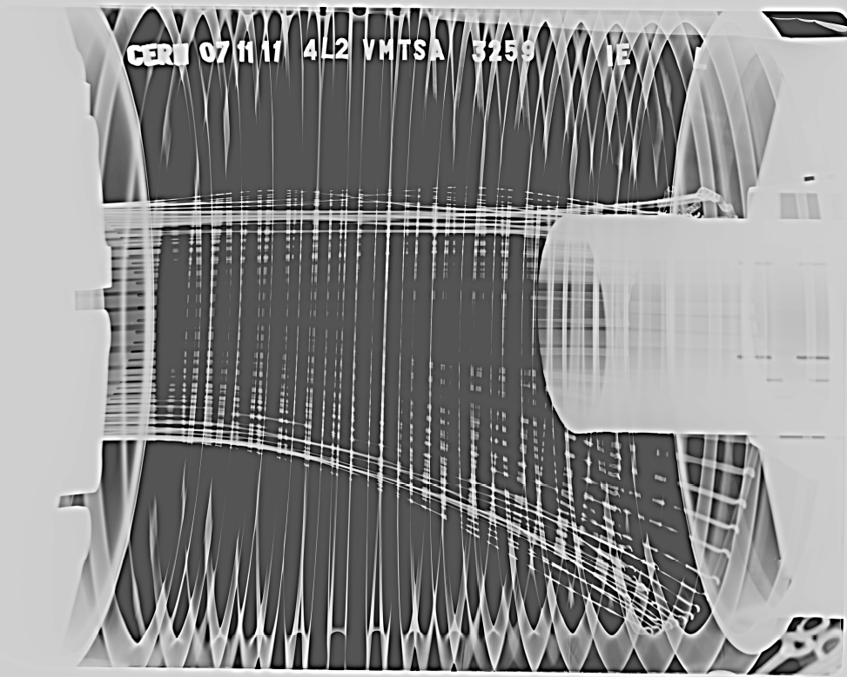
X-rays the 7-11-2011, DCUM 3259
Left side
Side view (xray from corridor to QRL)
b) Metallic noise due to loose spring when hitting vacuum chamber
c) RF fingers falling due to broken spring
Non Conform
b
Spring was broken between May and November 2011
Probably as a consequence of irradiation
c

Slide 8
X-rays the 7-11-2011, DCUM 3259
Right side
X-ray done also
RF fingers and spring are
Conform
Photo to come

Slide 9
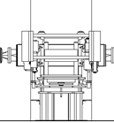
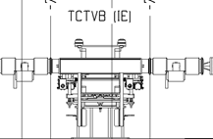
Other similar regions in LHC: Layout LSS2-LSS8
https://lhc-div-miwg.web.cern.ch/lhc-div-miwg/Main_Pages/new_frame%20miwg_icl.htm
TCDD
VGPB.120.4L2.X
LSS2L :
TCTVB
TCDD
VAB
BPMSX
D1L2
D1L2
VPIA.A151.4L2.X
LSS2R :
D1R2
BPMSX
VAB
VCTCQ
TCTVB
TCLIA
VGPB.120.4R2.X
TCLIA
D1R2
VPIA.A170.4R2.X
TCLIA
VGPB.120.4L8.X
LSS8L :
TCLIA
TCTVB
VCTCF
VAB
BPMSX
D1L8
D1L8
VPIA.A173.4L8.X
LSS8R :
D1R8
BPMSX
VAB
TCDDM
TCTVB
VGPB.120.4R8.X
D1R8
VPIA.A147.4R8.X

