Slide 1
Transverse emittance measurements from FWS
C. Zannini

Slide 2
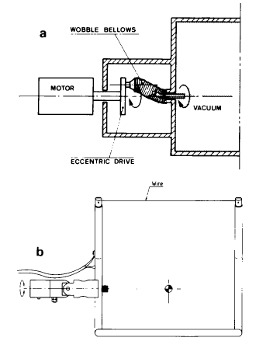
How the equipment works
The wire scanners allow measurement of the emittance
of each individual bunch of protons with negligible perturbation to the circulating beams.
These devices are used to follow the emittance evolution during storage.
The beam energy is limited by the heating of the wire by the beam, which increases with energy

Slide 3
Application

Slide 4
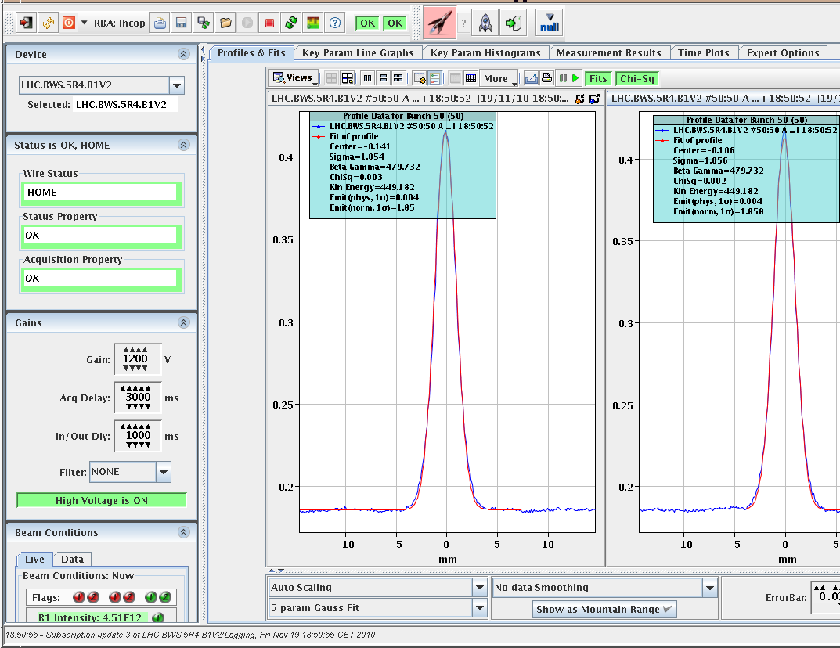
Starts wire scanner acquisition
Define device
Setting mode of operation and lattice.
Send data after setting!
Output values
> 700
Limitations at high beam intensity
Modes of acquisitions:
-Turn acquisition
-bunch by bunch acquisition
(due to memory limits the number of bunch is limited)
The fit of visualized data is different from the fit of exported data.

Slide 5
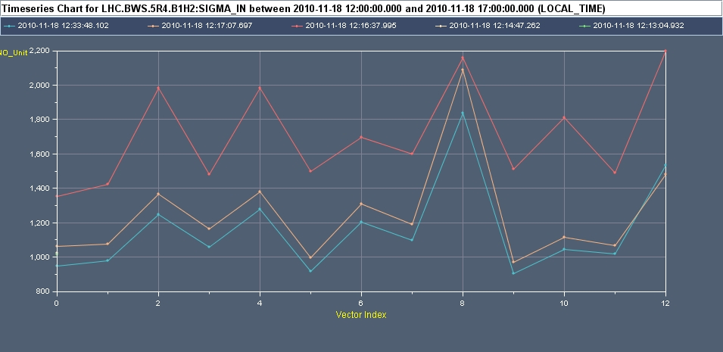
Data Reading: Examples

Slide 6
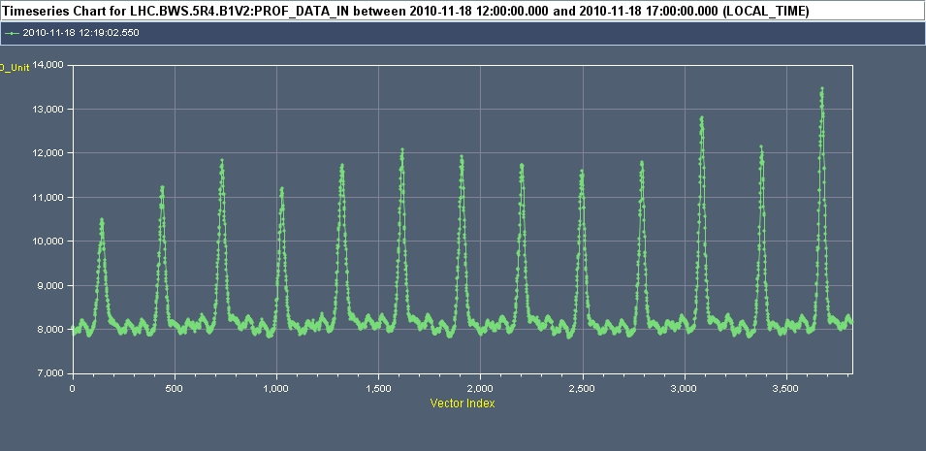
Data Reading: Examples

